Slide 1
CCAWA
Major Sponsor Update
Emma Goldie
National Sales & Customer Engagement Manager
Friday 4th April 2025

Slide 2
Supporting The Industry
Arrow Bronze has been associated and a sponsor of CCAWA for over 15 years
Create partnerships with our customers and industry members.

Slide 3
What's New
Customer training with consultants
Plaque enhancements
Strengthening our commitment to Sustainability and the Environment.

Slide 4
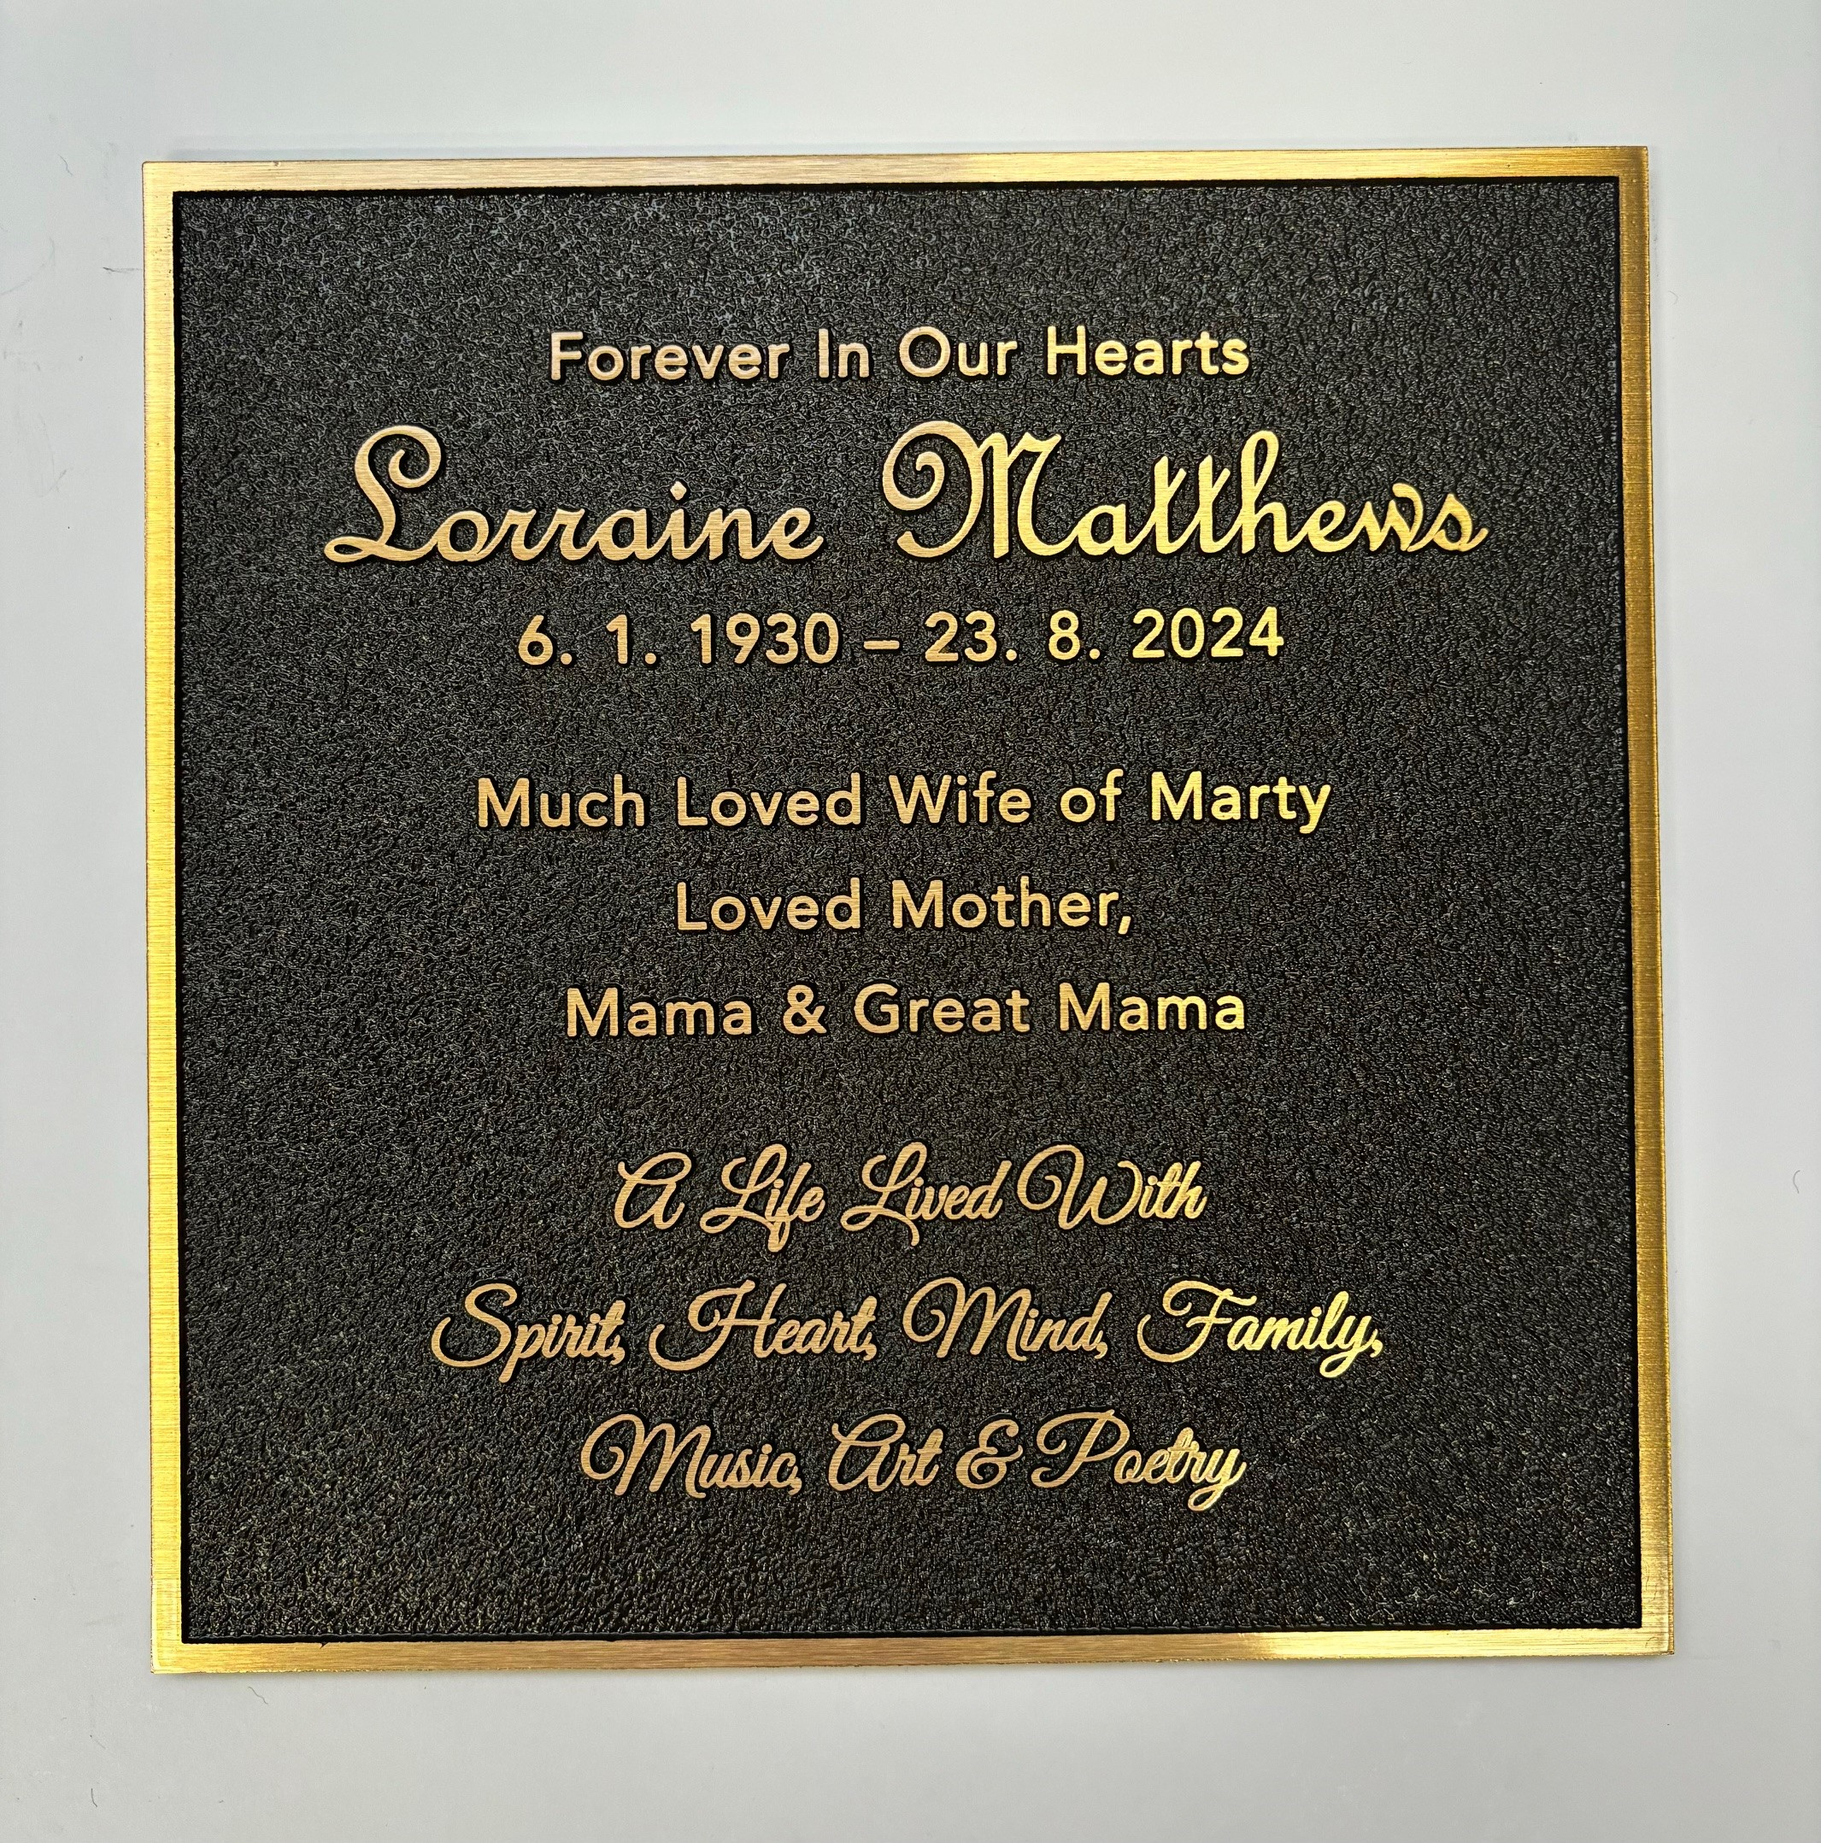
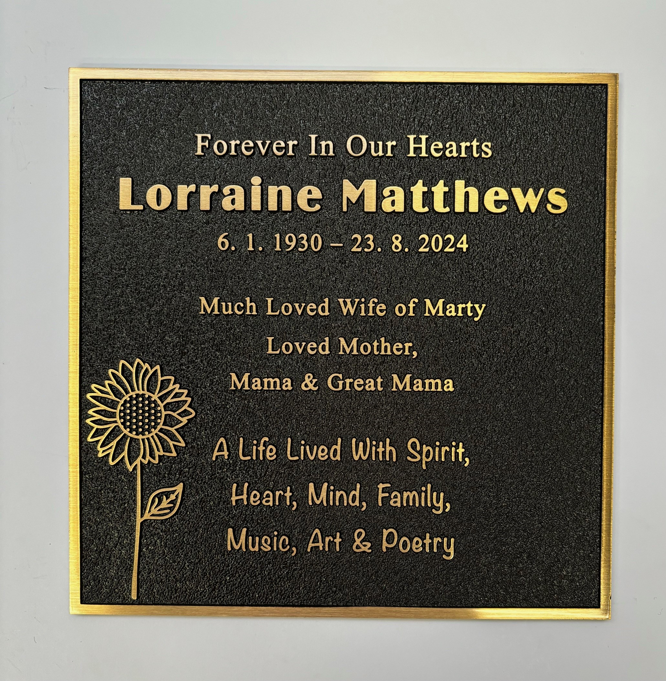
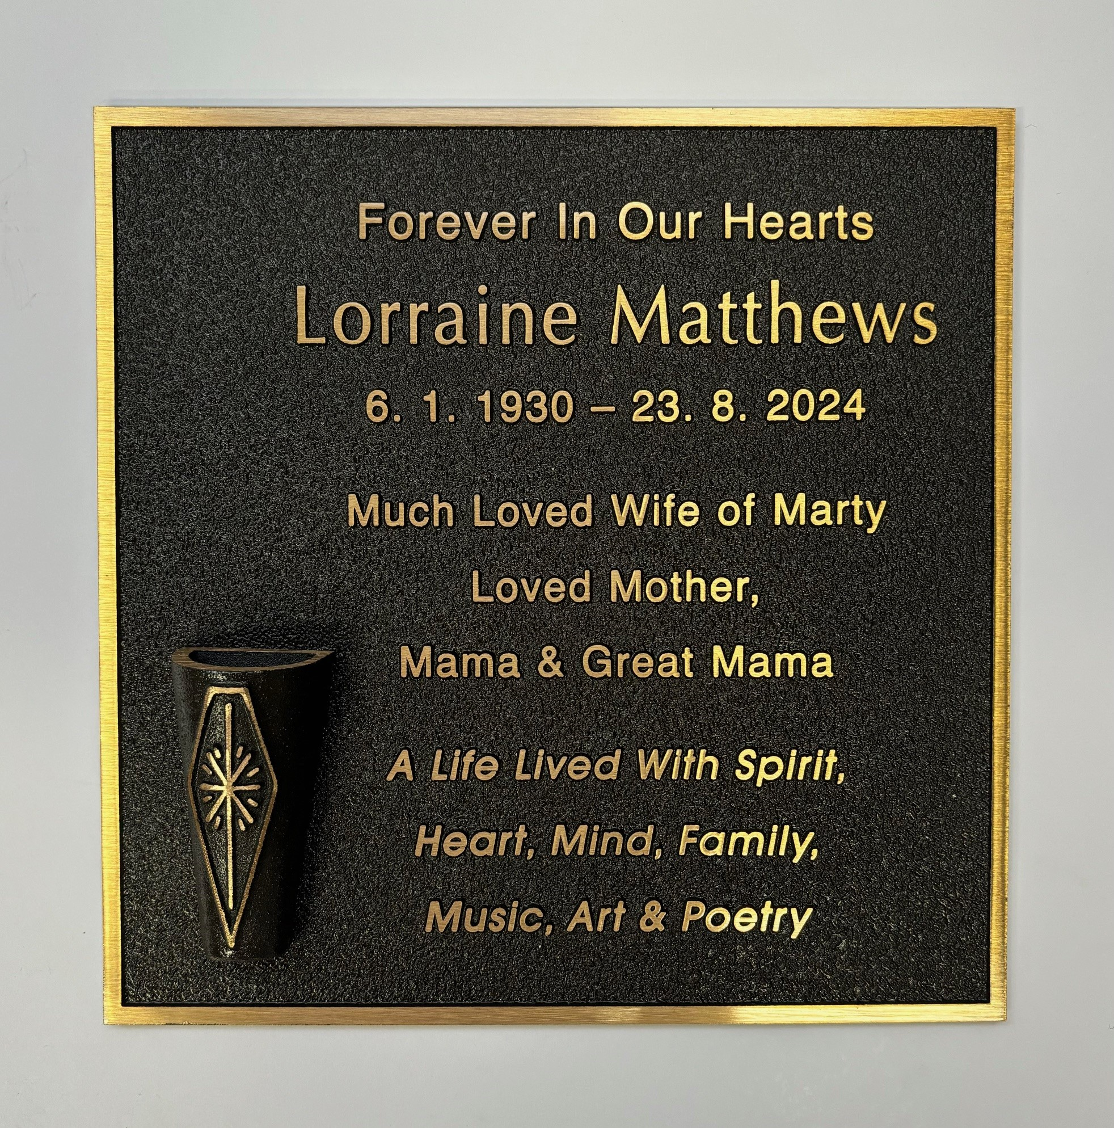
Enhancing a Bronze Plaque

Slide 5
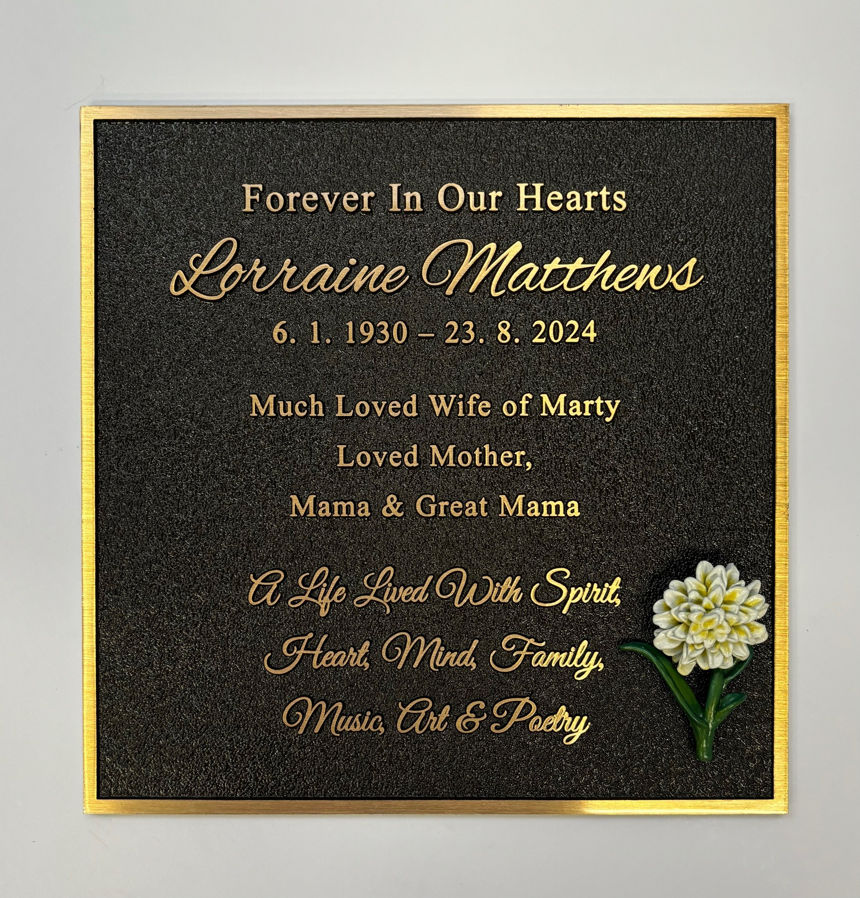
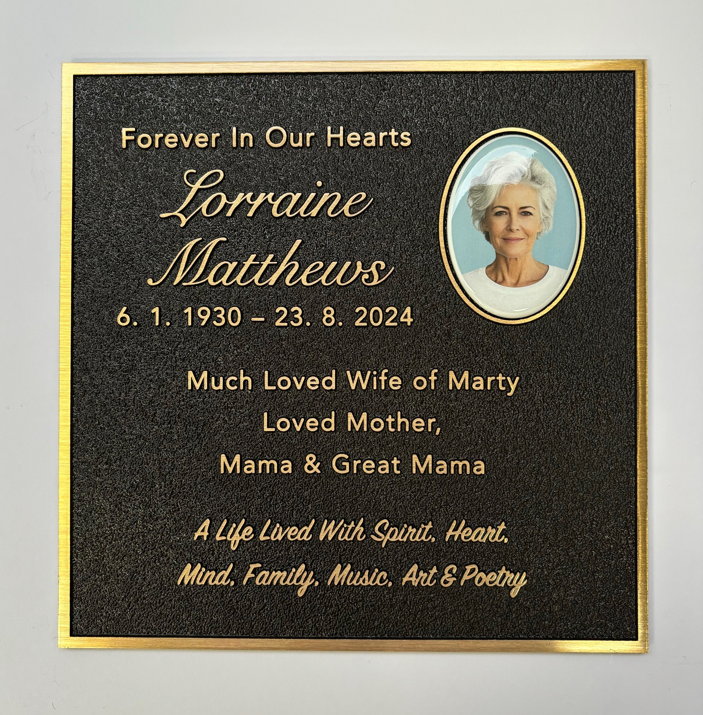
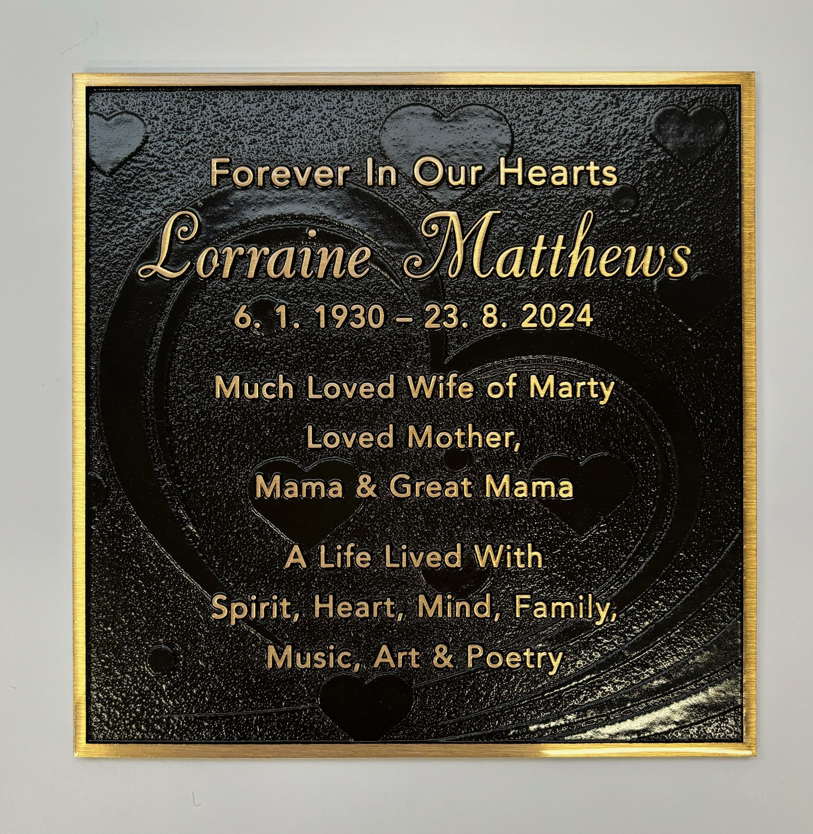
Enhancing a Bronze Plaque

Slide 6
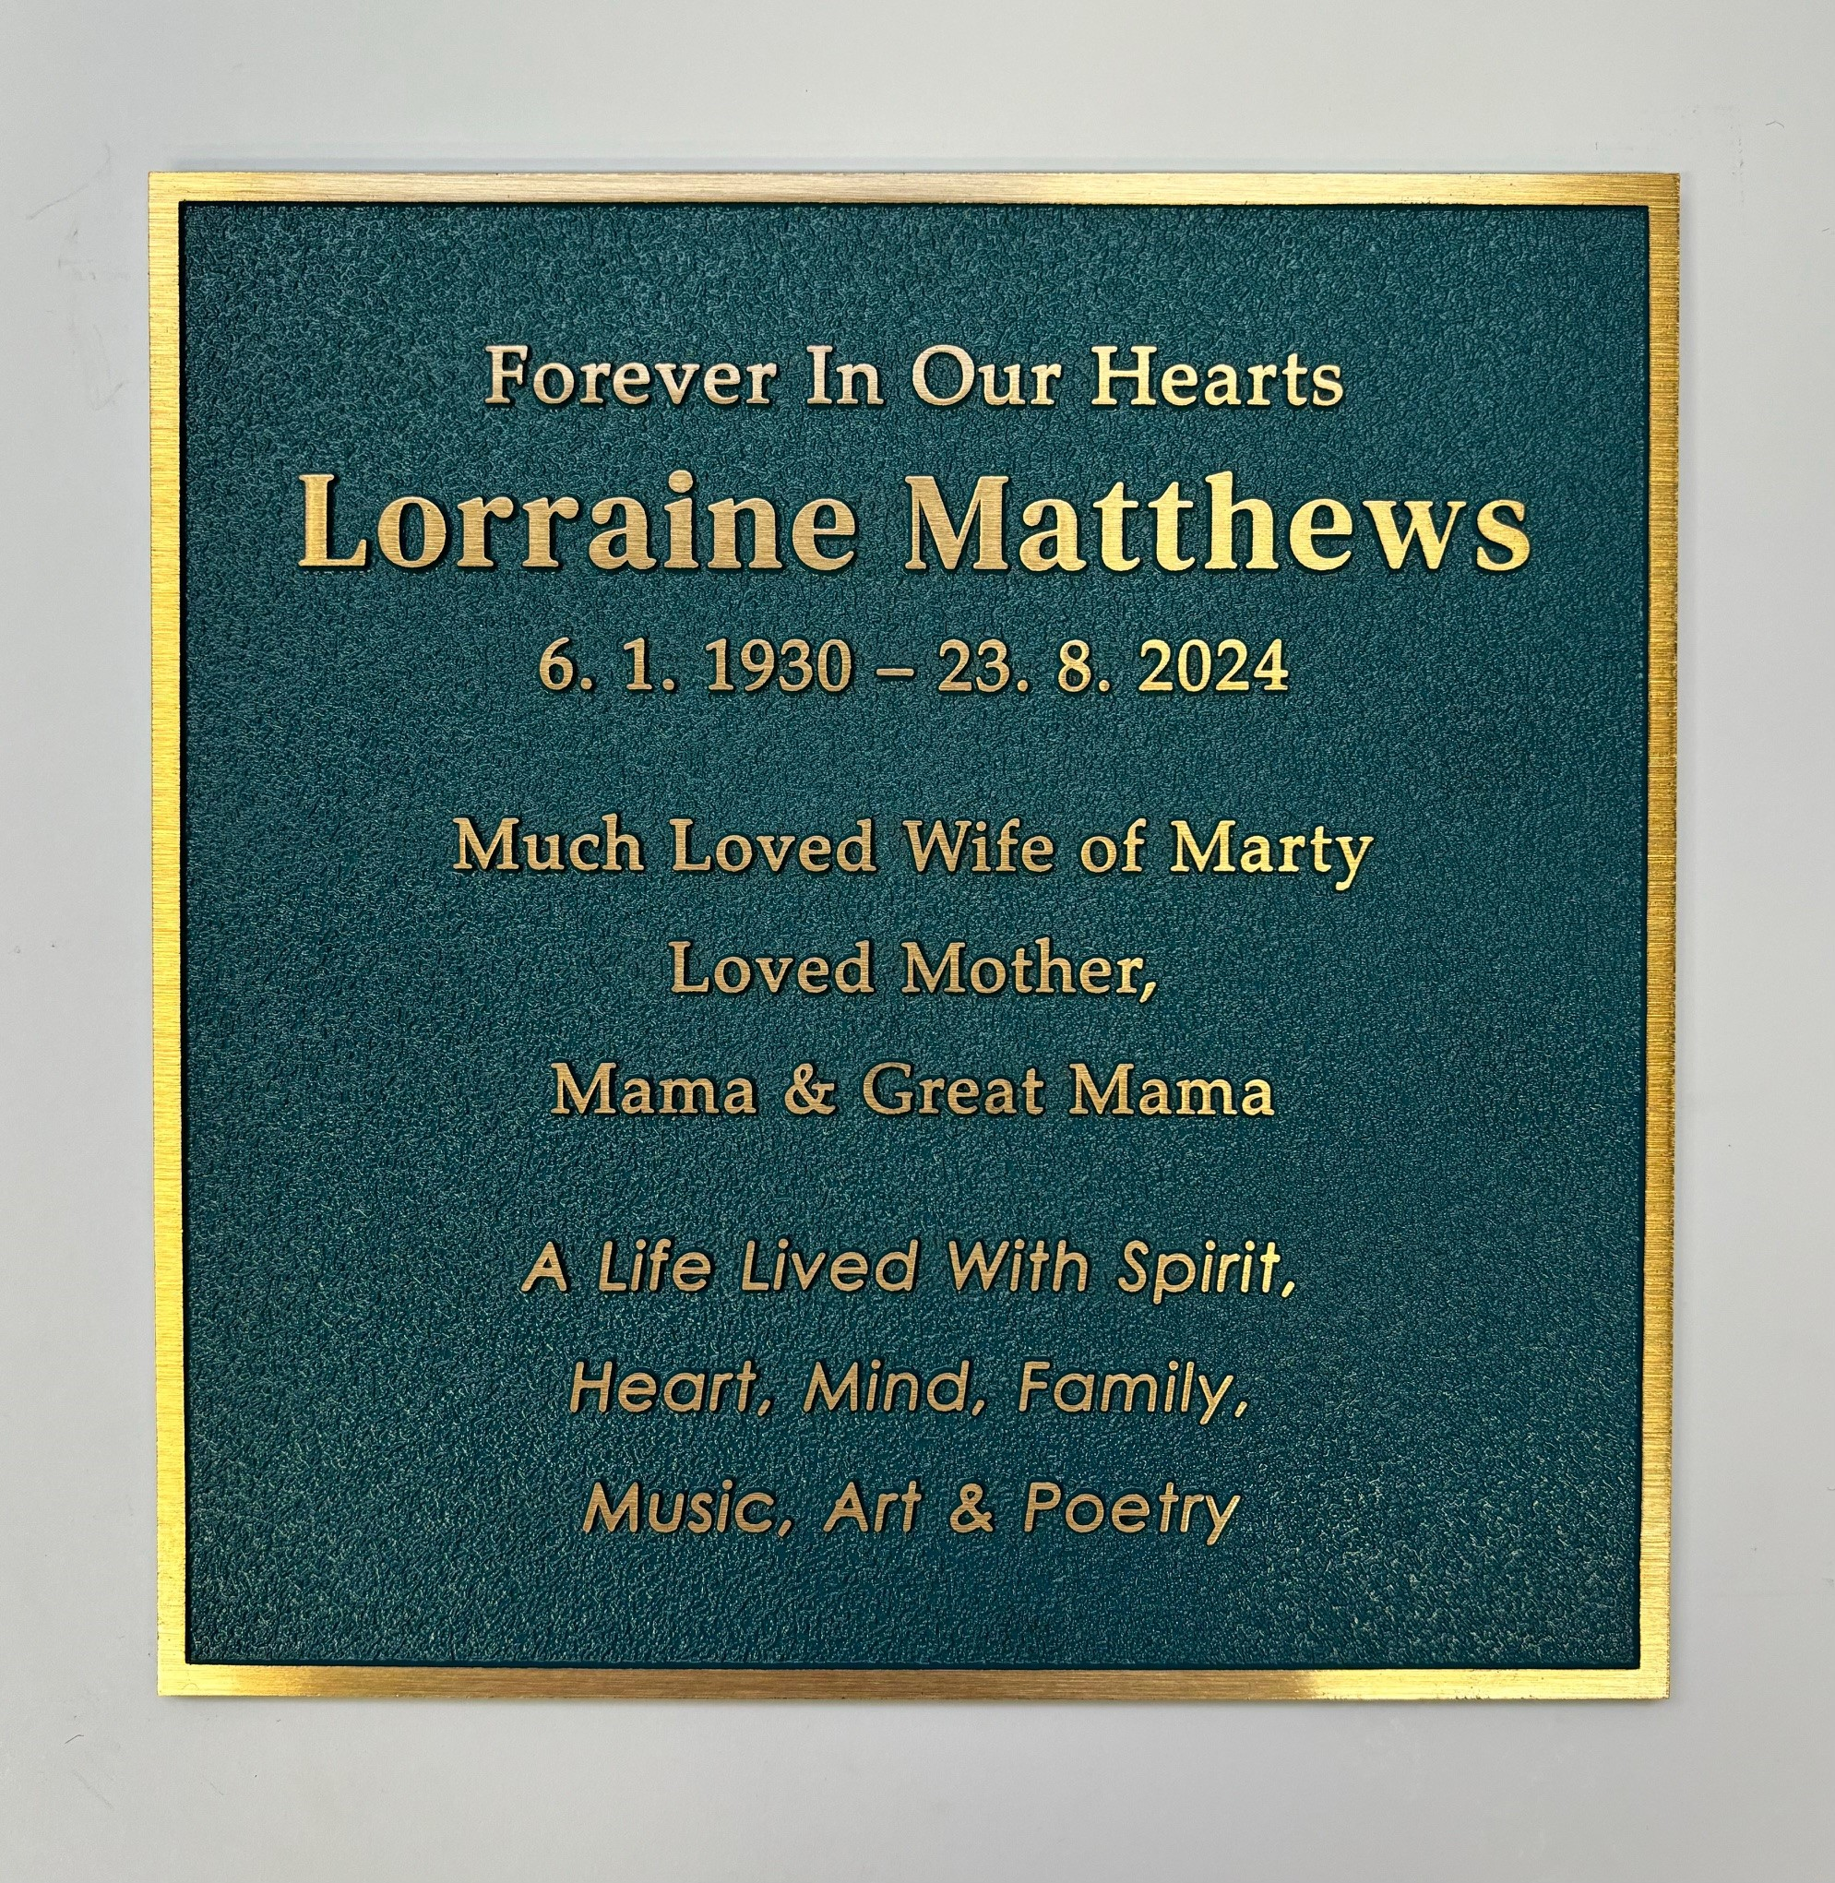
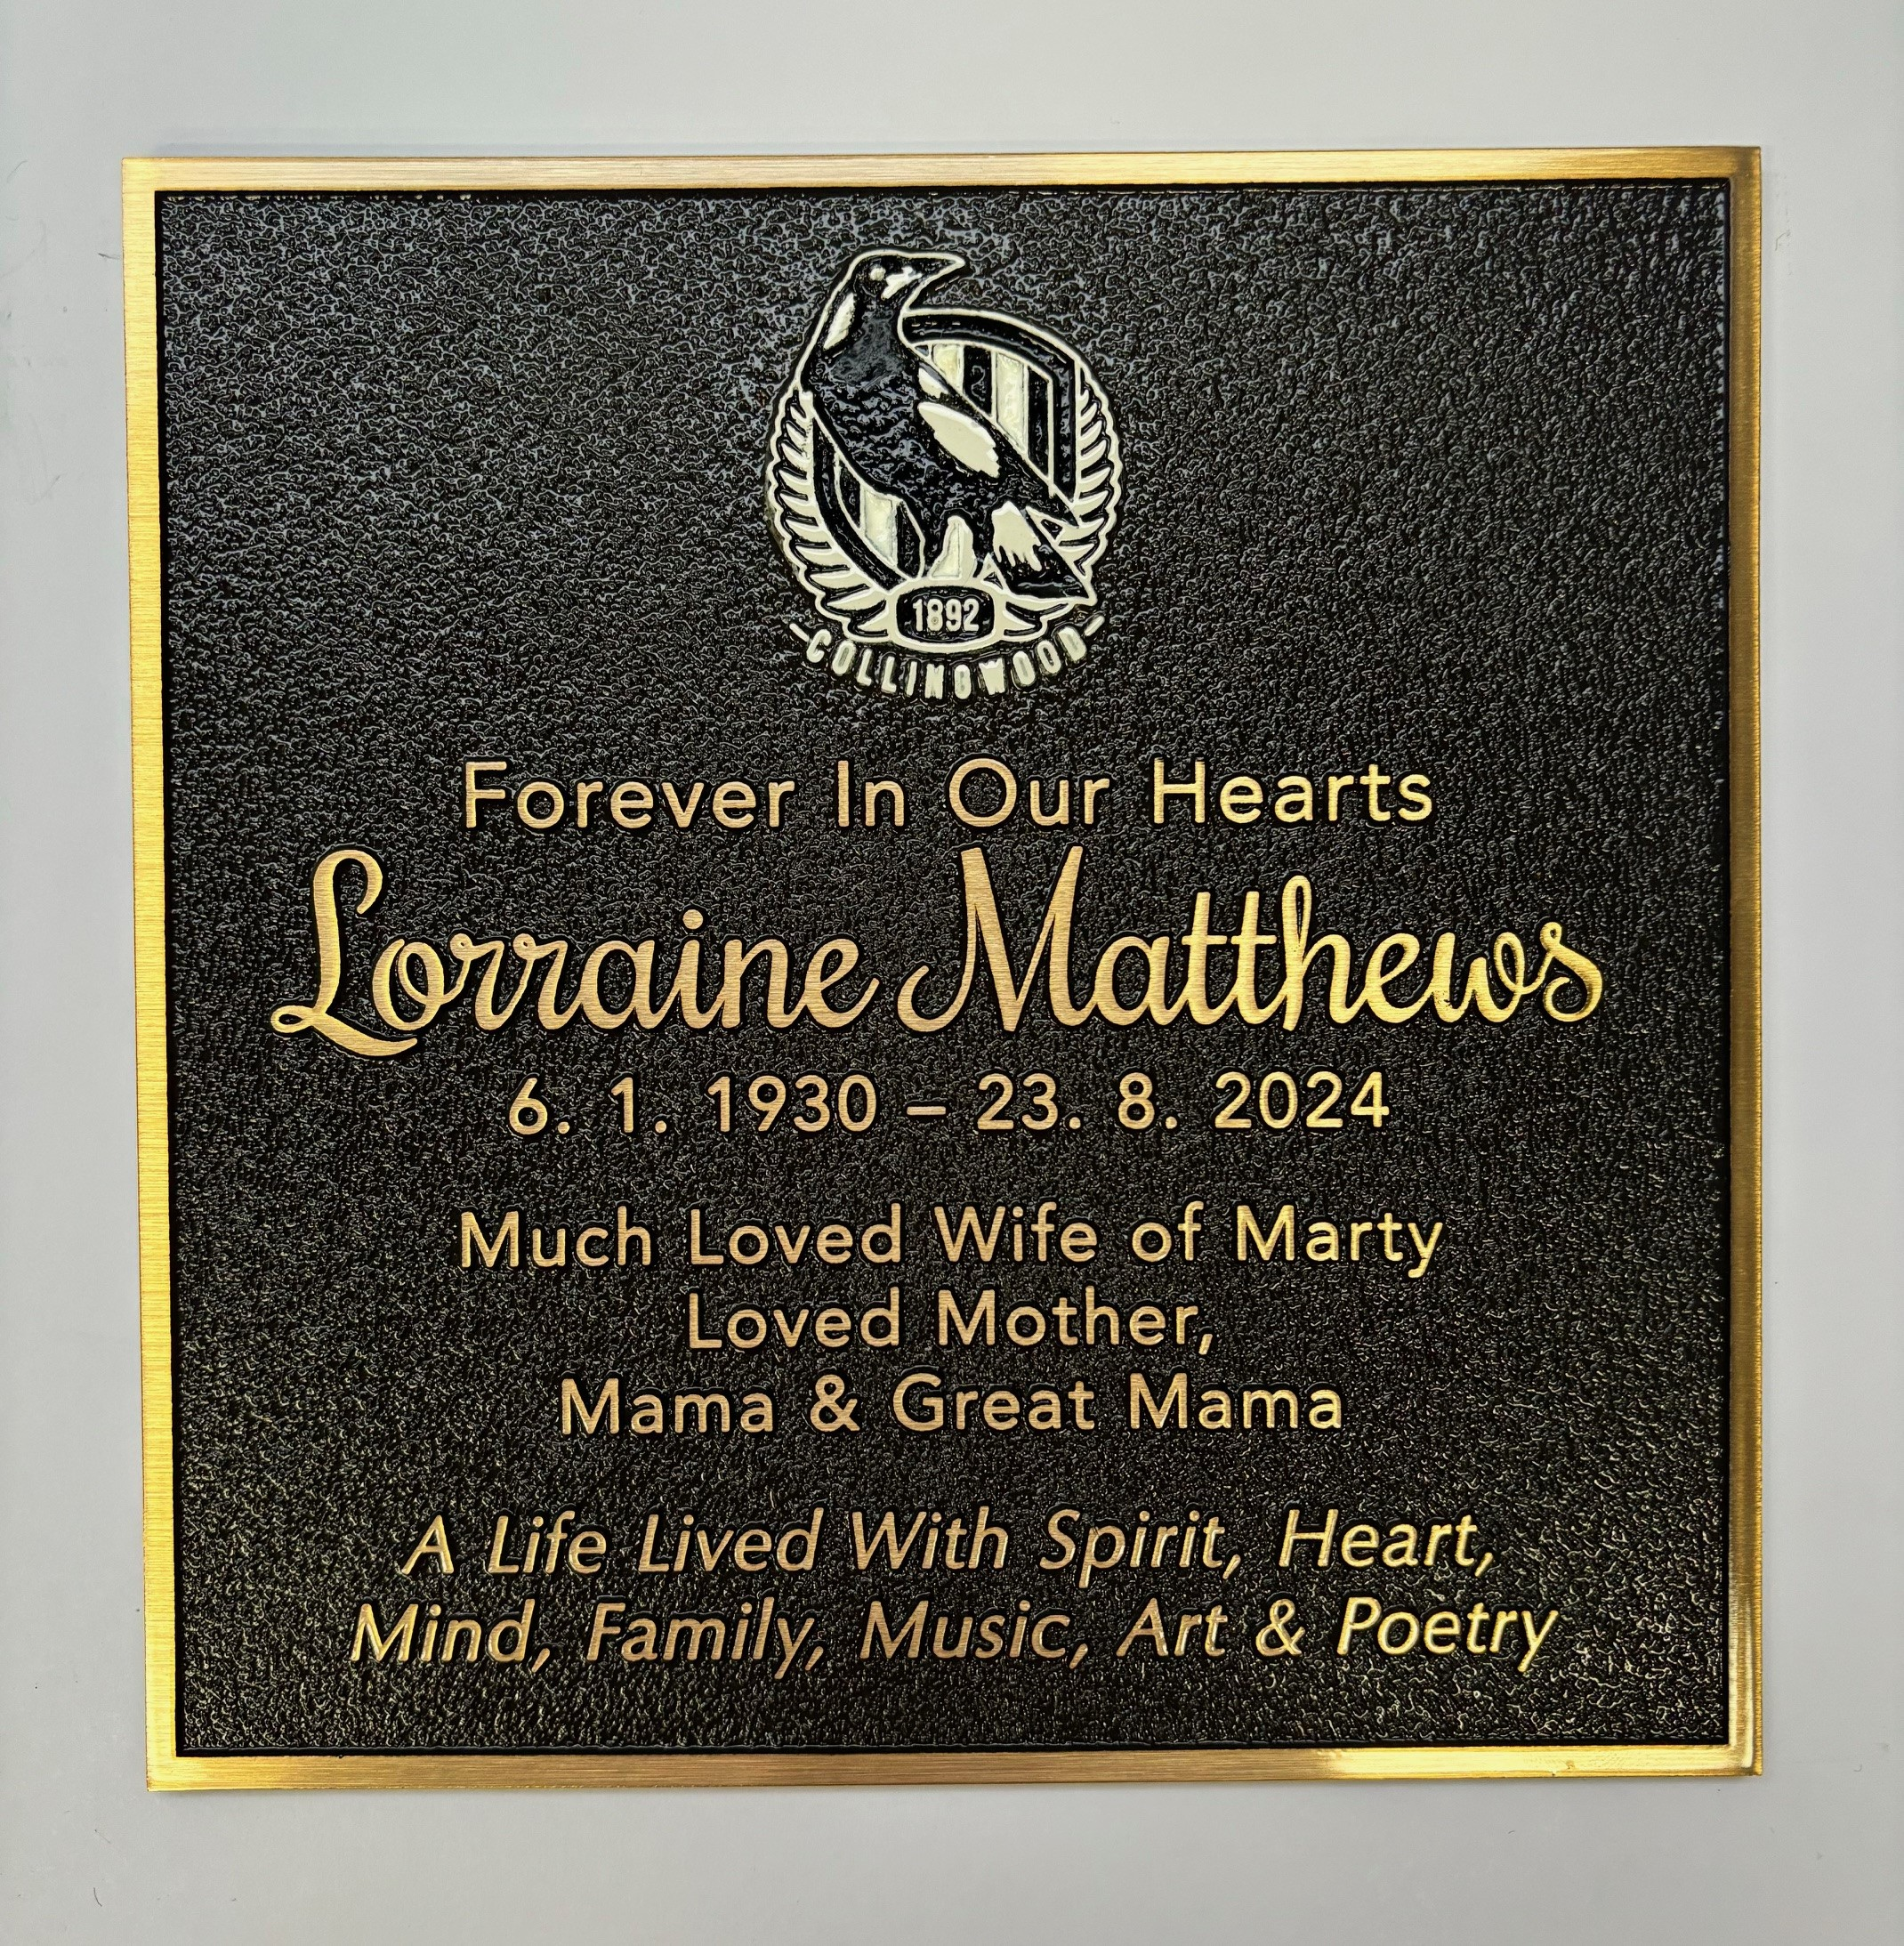
Enhancing a Bronze Plaque

Slide 7
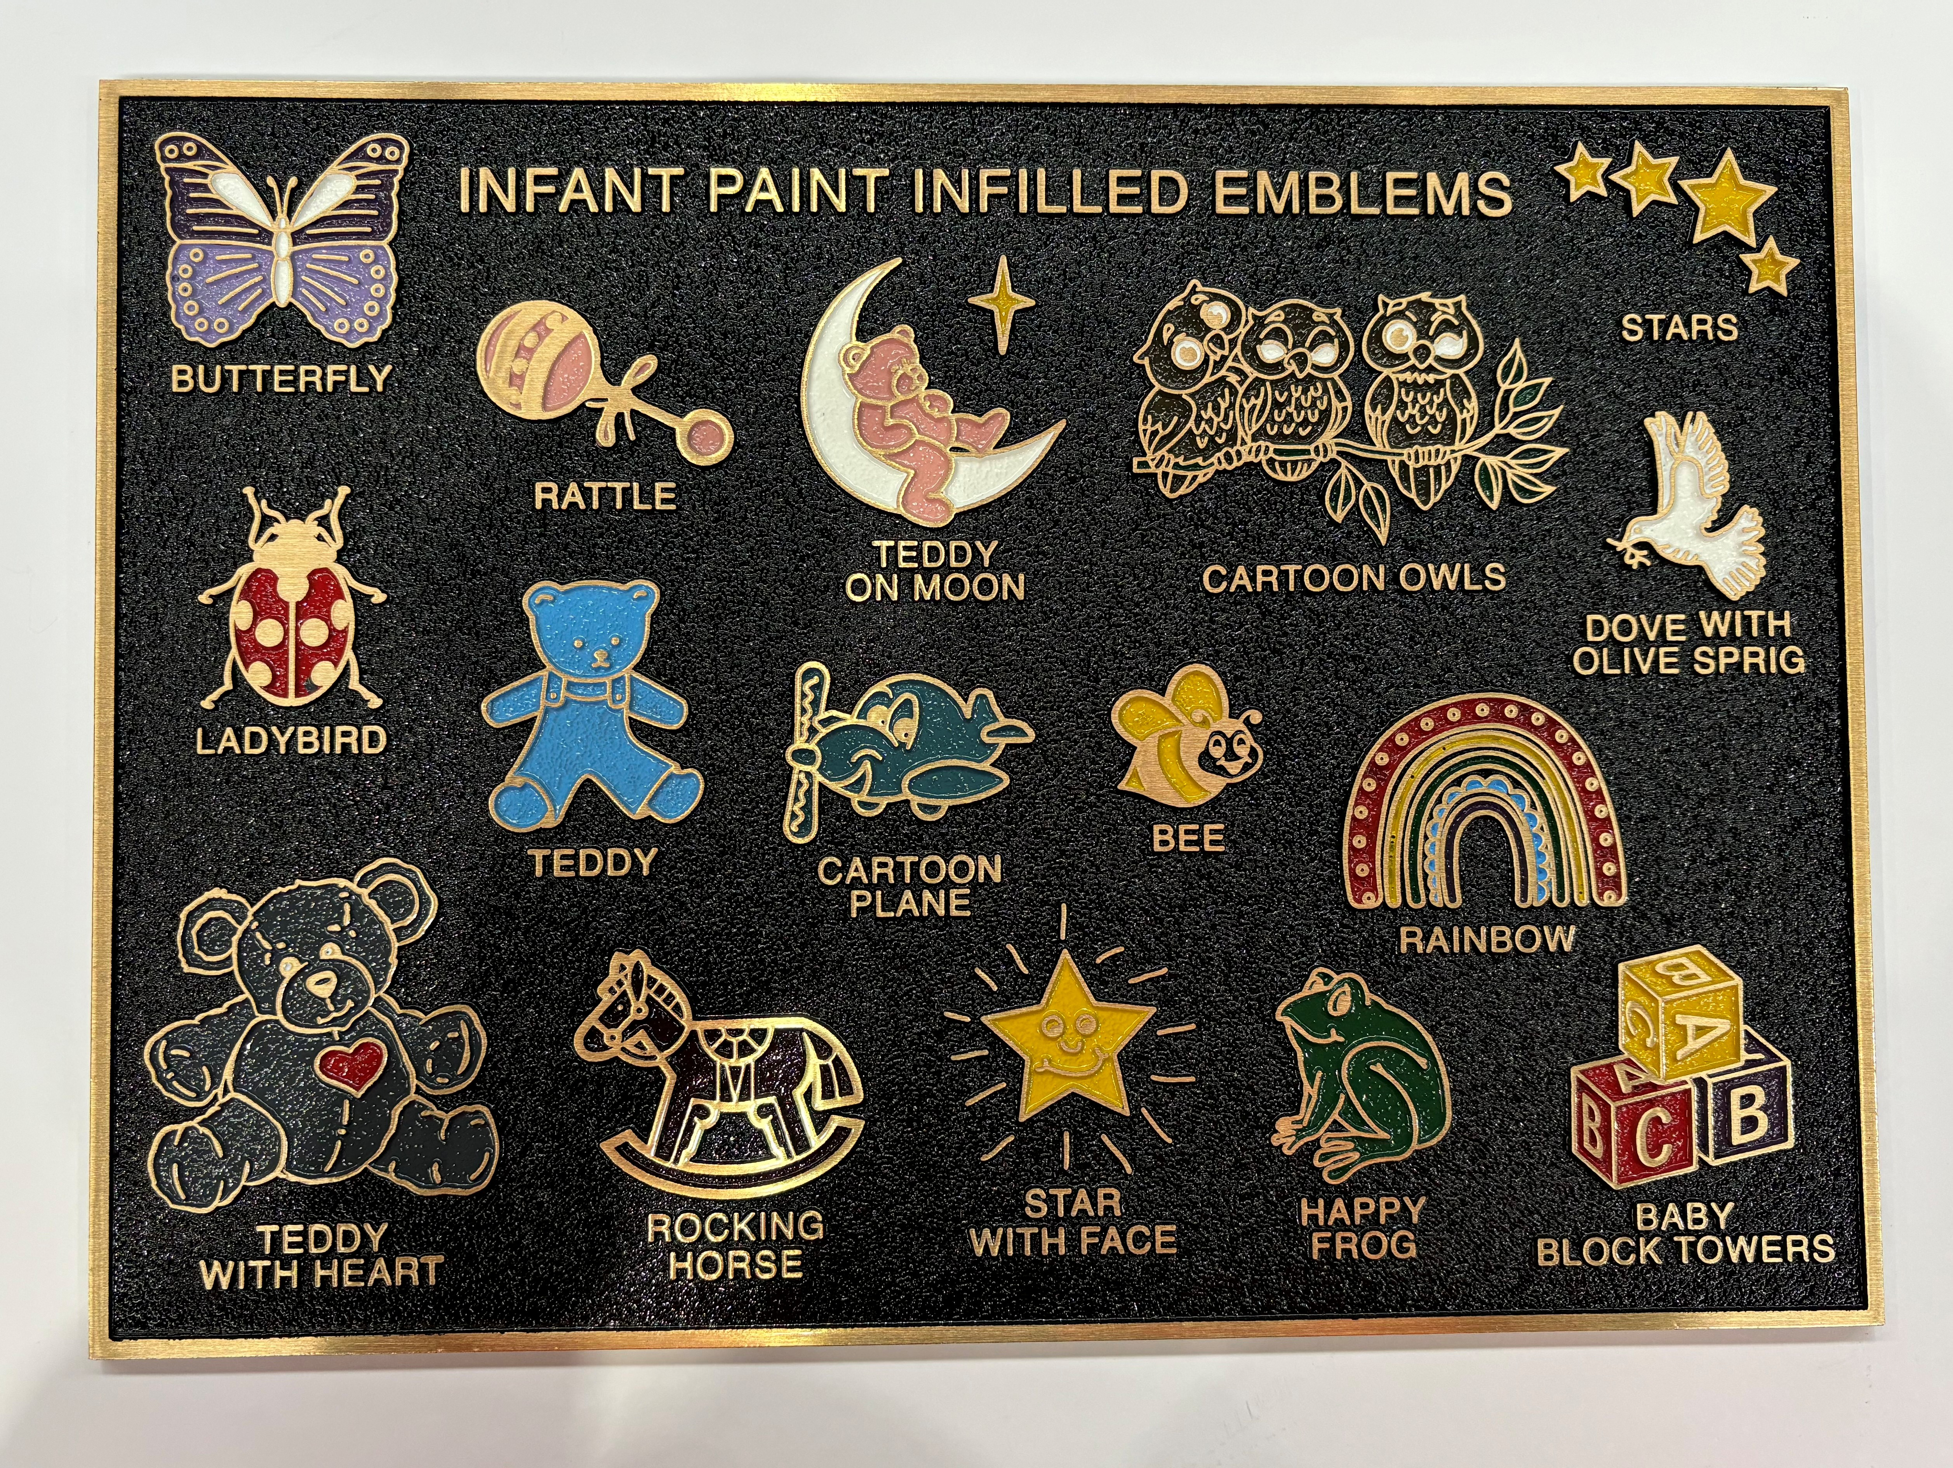
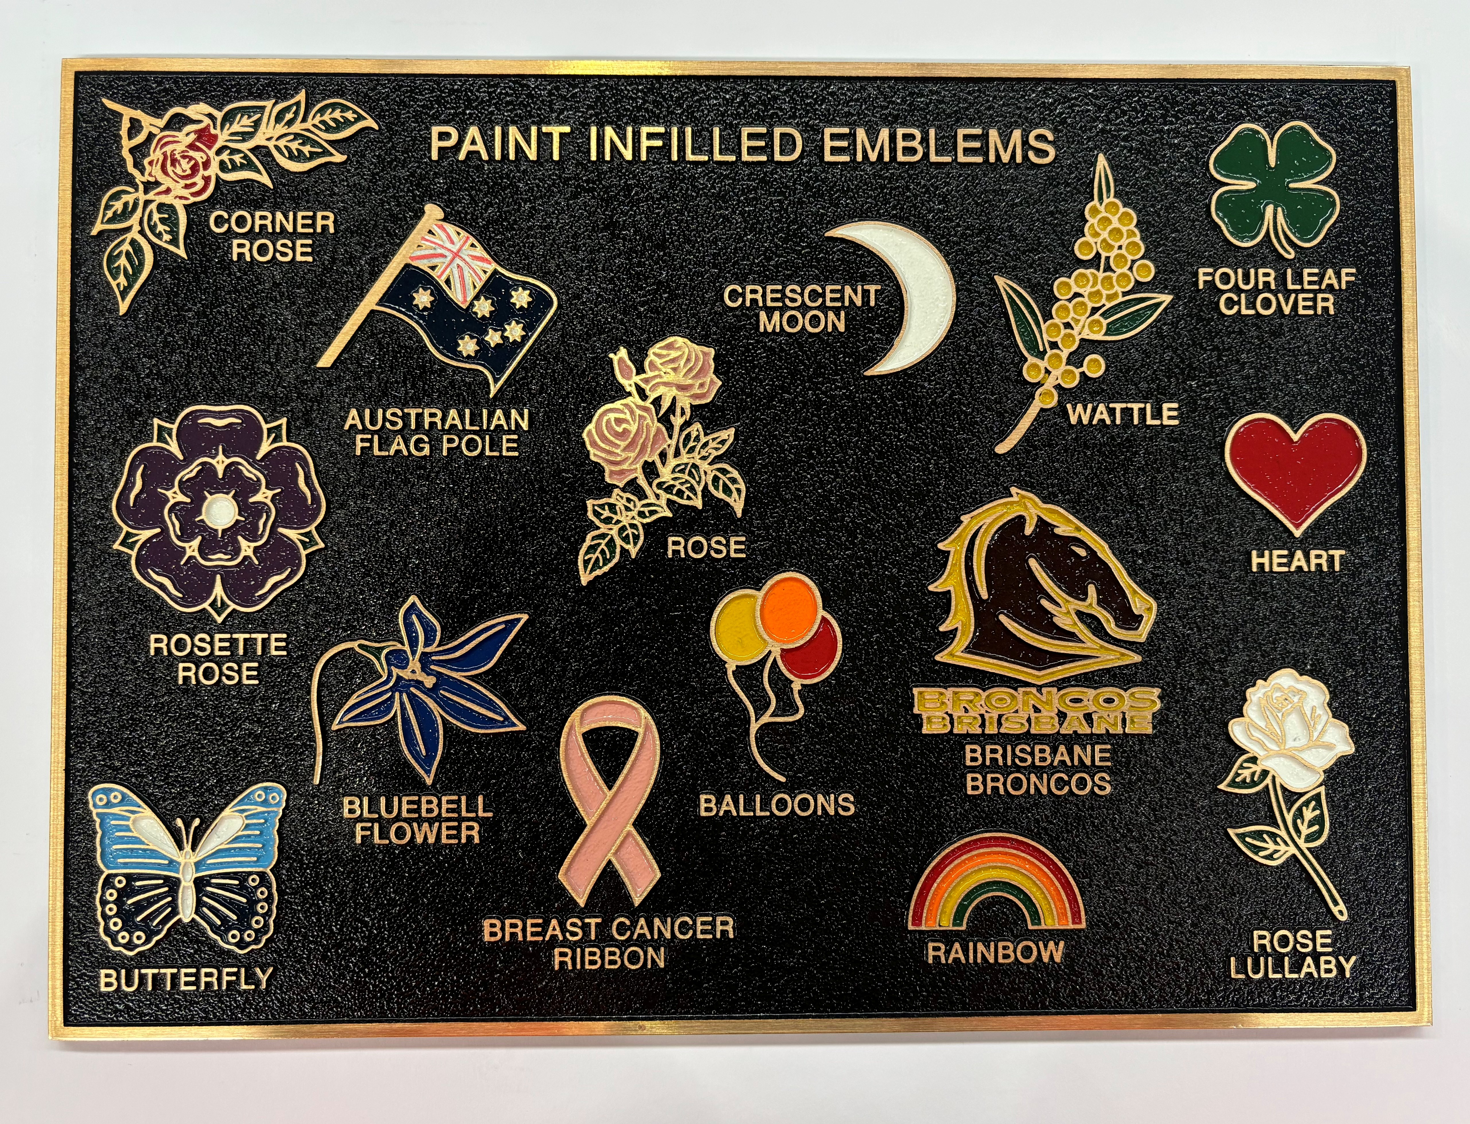
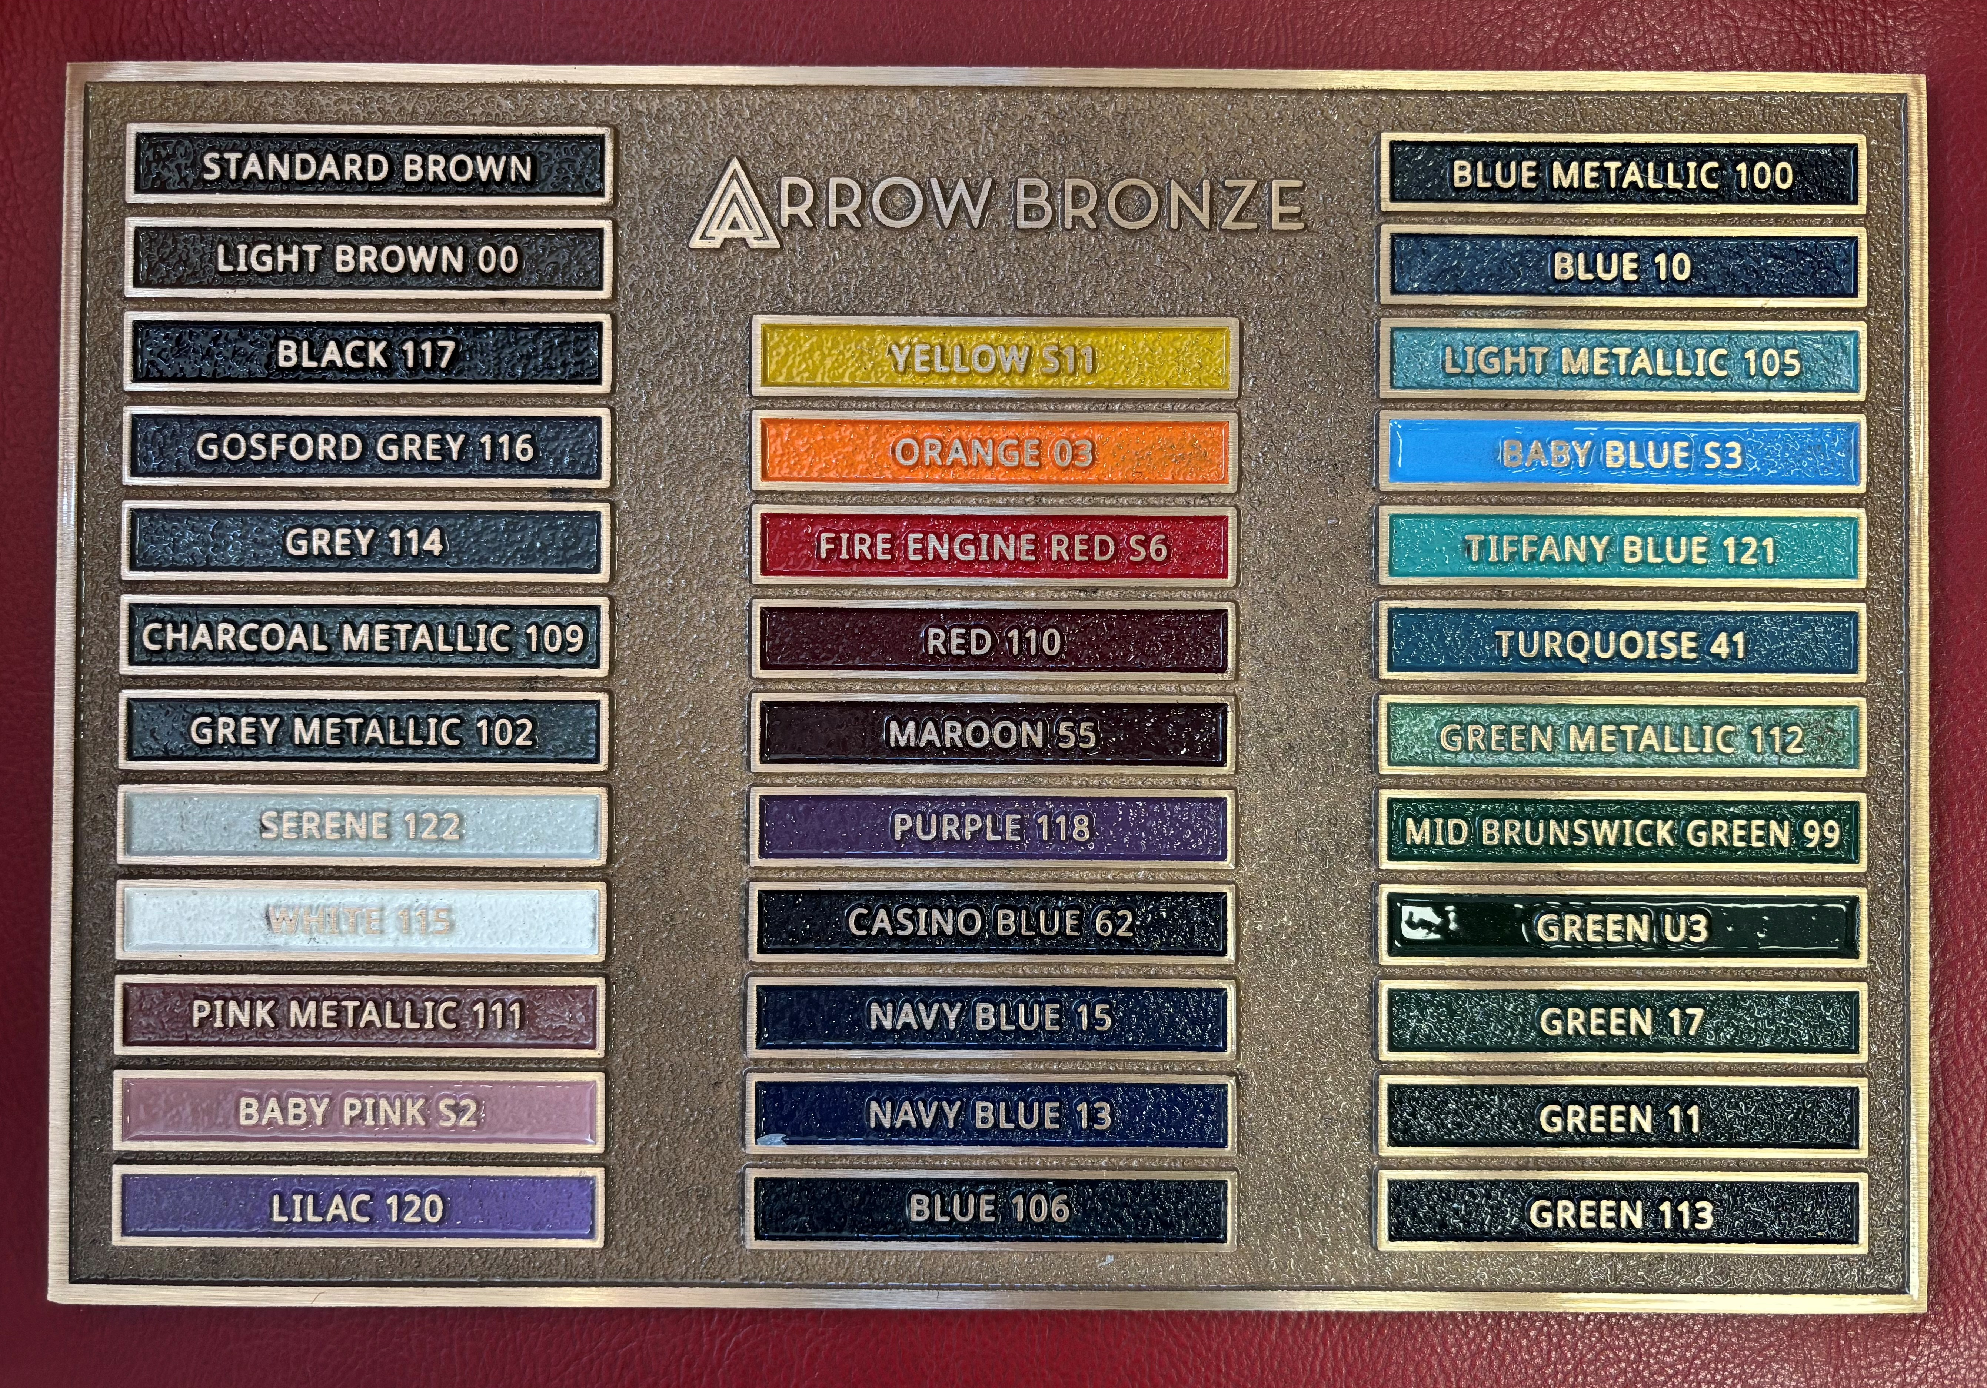
Add a Splash of Colour

Slide 8
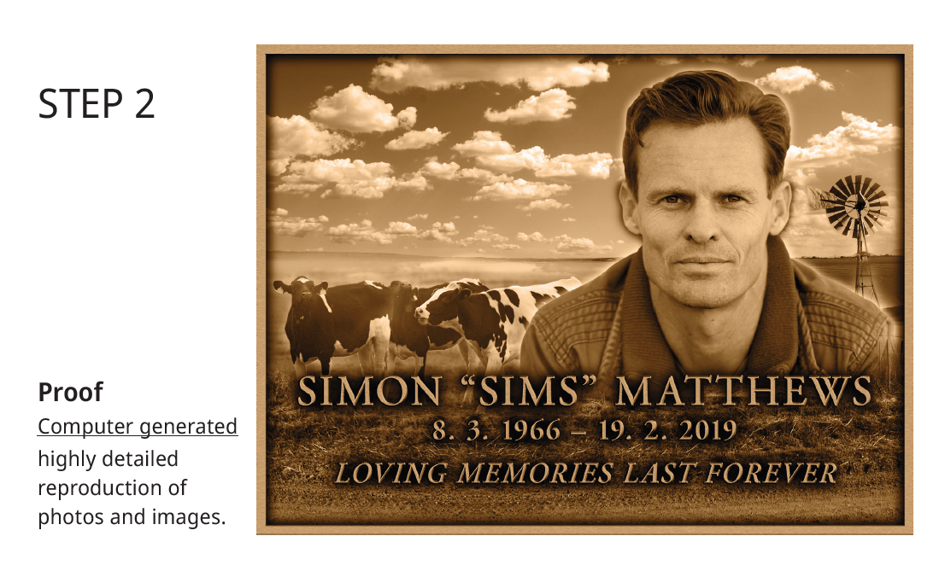

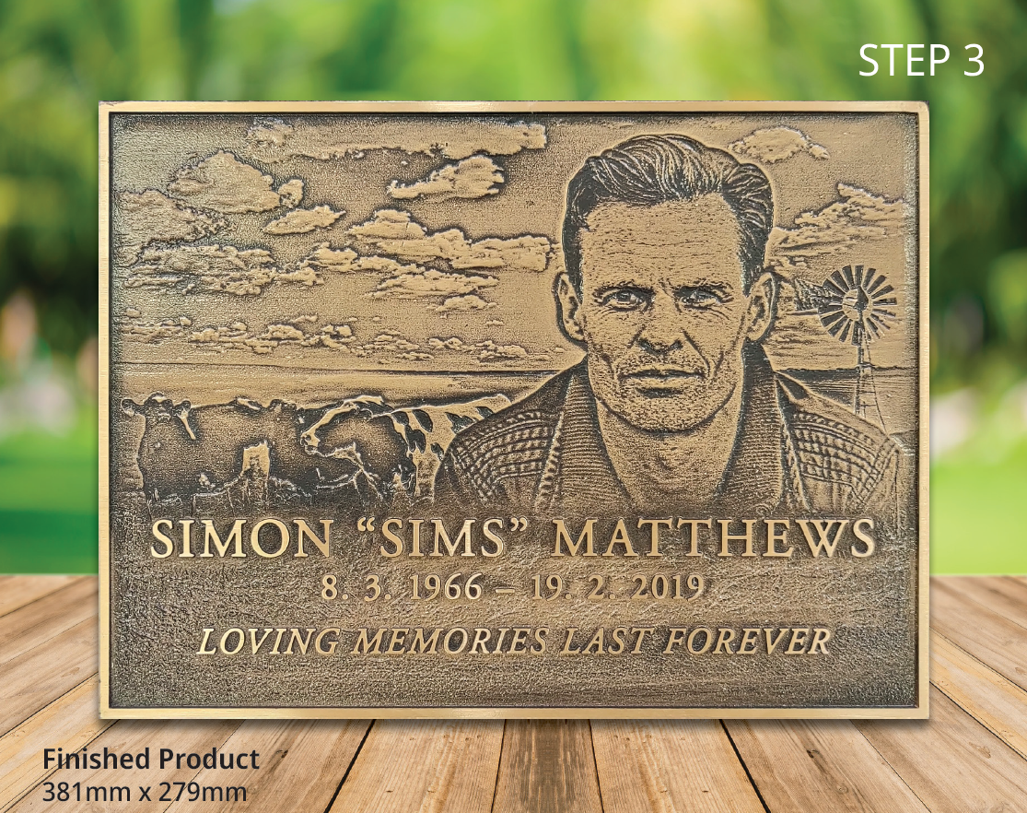
Lasting Memories Plaques

Slide 9
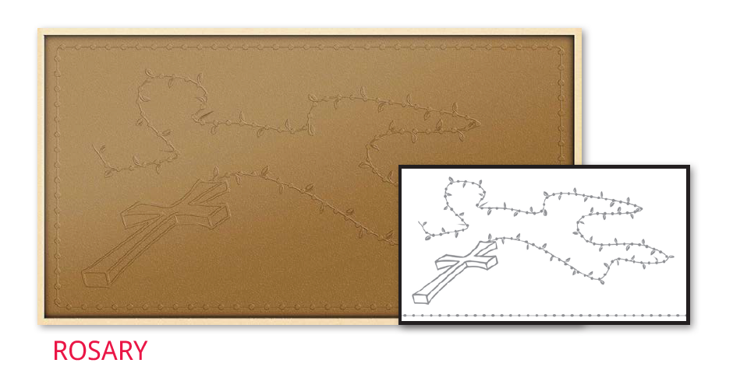
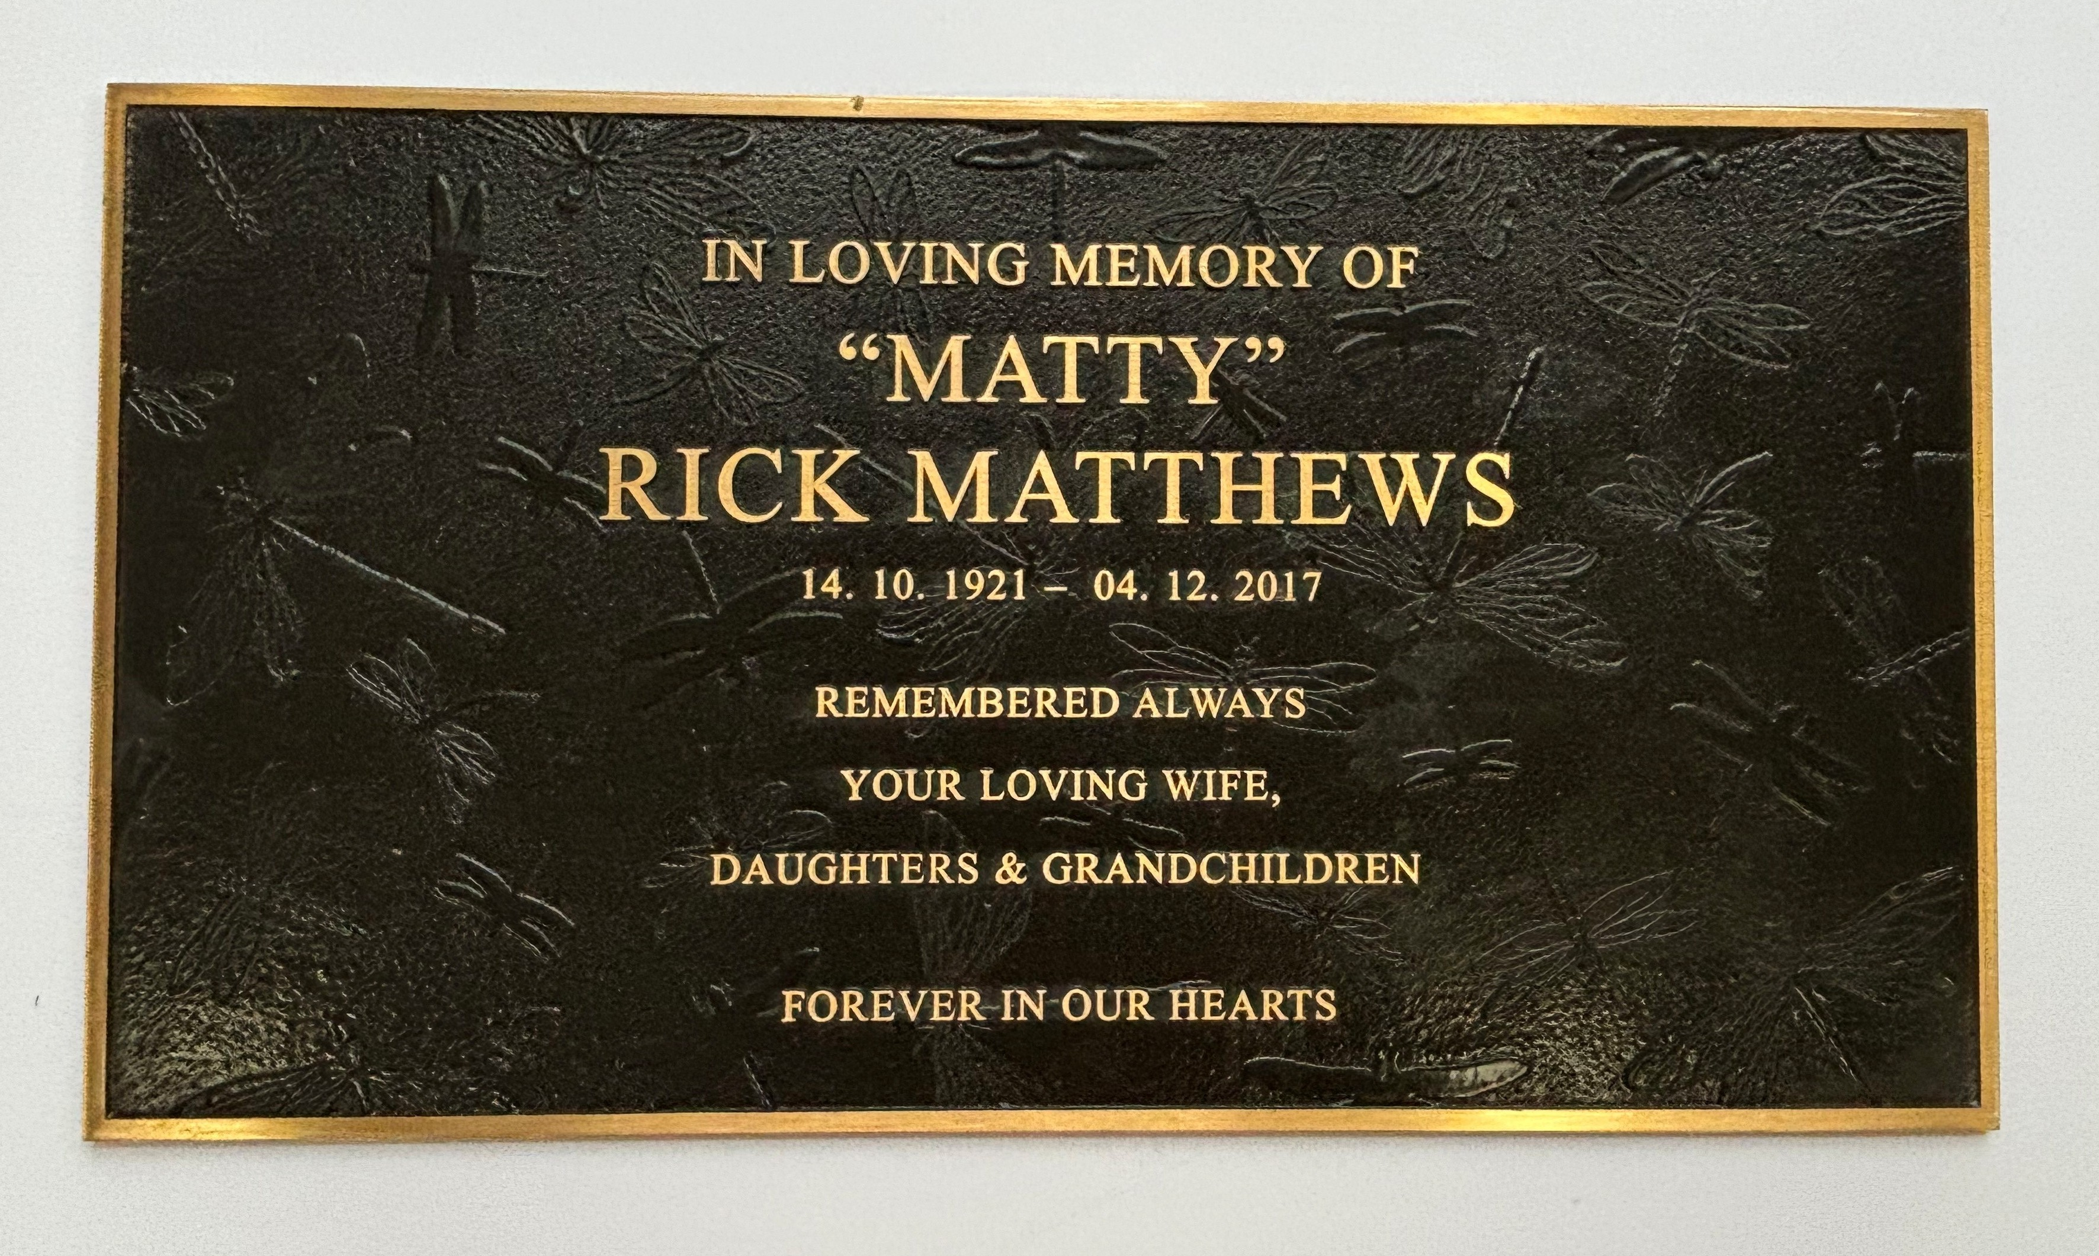
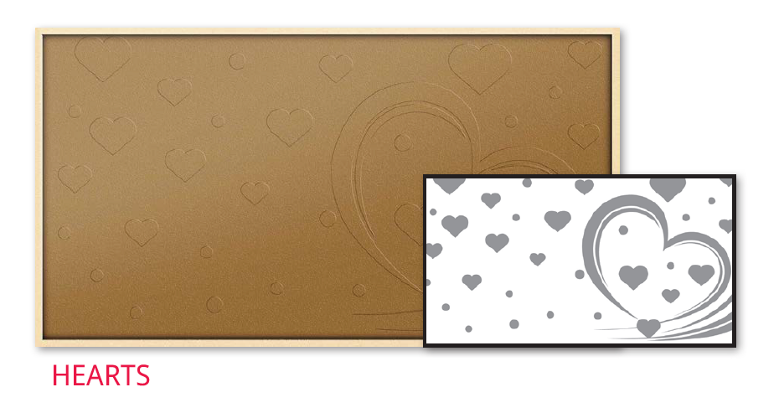
Shadowline Plaques
Available in 9 different backgrounds
Burial and larger cremation plaques
Notes:
Training

Slide 10
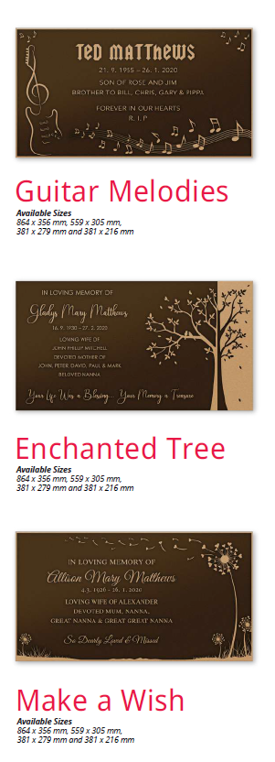
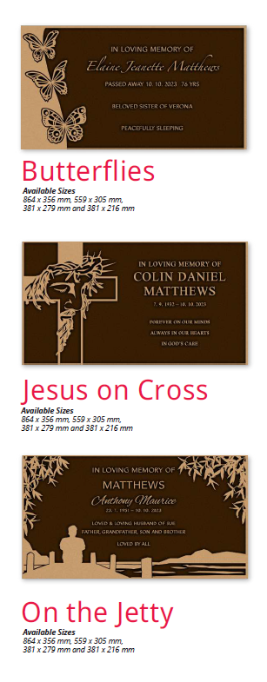
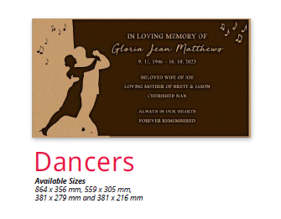
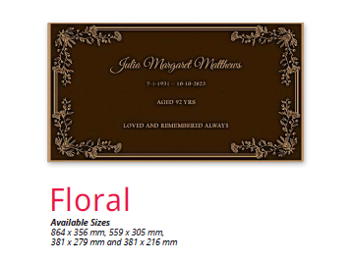
Artist Series

Slide 11
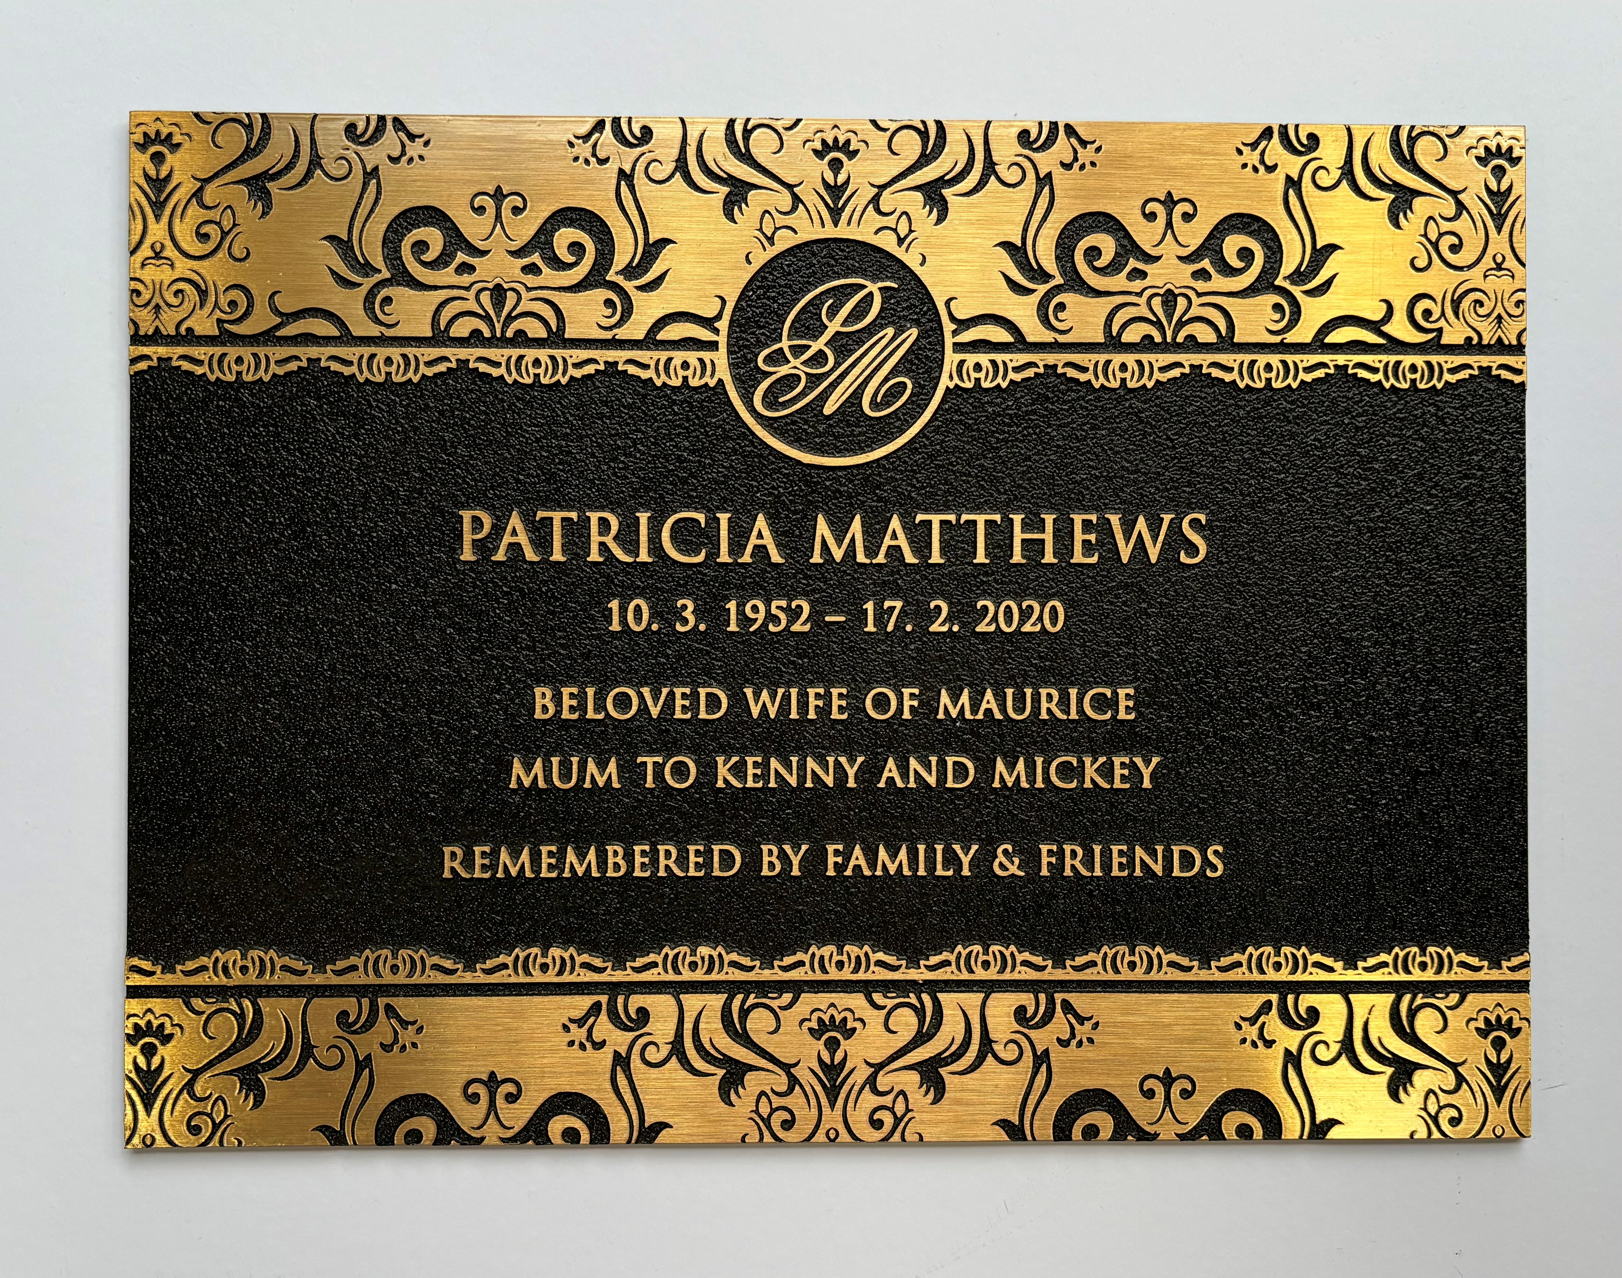
Sustainable Memorial Product
At Arrow Bronze we manufacture bronze plaques that will last a lifetime.

Slide 12
Sustainability and the Environment
We are the industry leader in sustainable manufacturing processes.
Continue to reduce energy consumption with a shift towards renewable.
Investing in significant capital for inhouse converting of waste material back into usable bronze ingots.

Slide 13
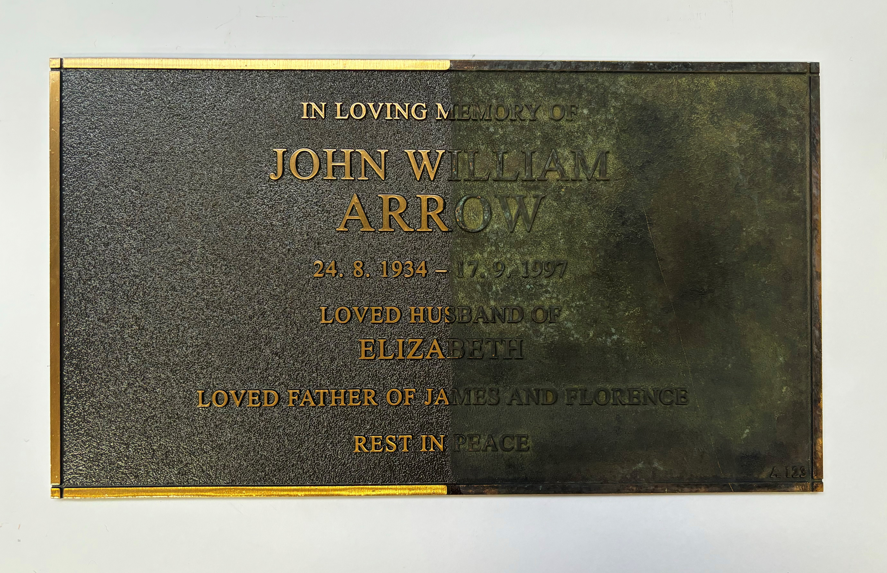
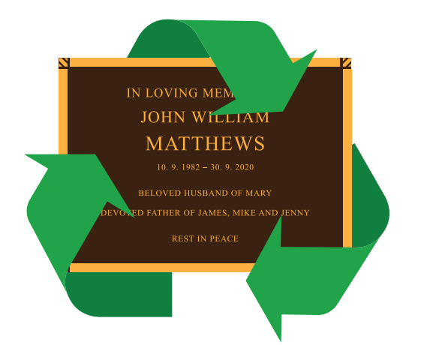
Refurbishing and Recycling

Slide 14
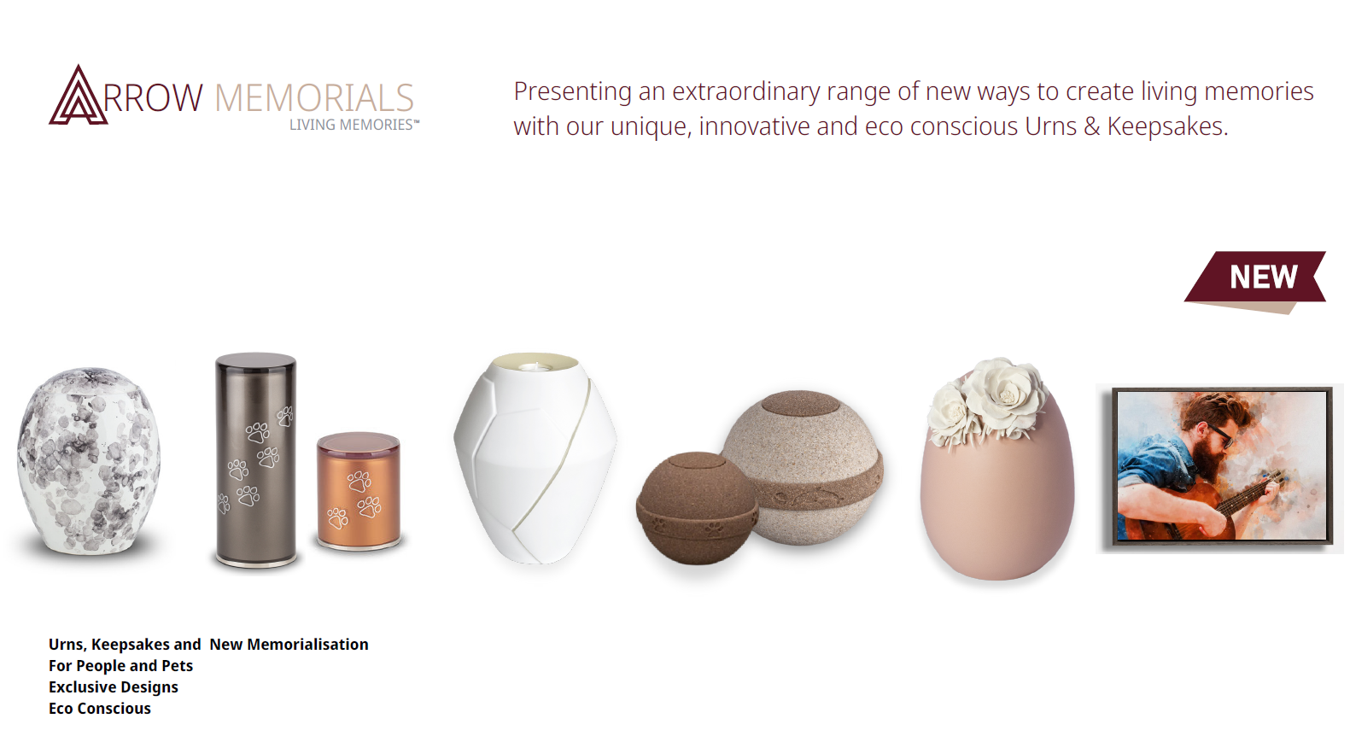

Slide 15

By strengthening our partnership
through collaboration, together we can
improve both our businesses
and make a
difference to the lives
of grieving families.

Slide 16

Thank You
Keep up to date with Arrow Bronze on Social Media

