Slide 1




Slide 2

Never judge by perception
Do you really know what your customers are after or can afford.

Slide 3

Memorial v’s Marker
Bronze Plaques are not just a “Marker” for the grave.
Our goal should be to make “Memorials”, something that will be memorable or bring a smile to peoples faces when they visit.

Slide 4


Upselling v’s Offering

Slide 5
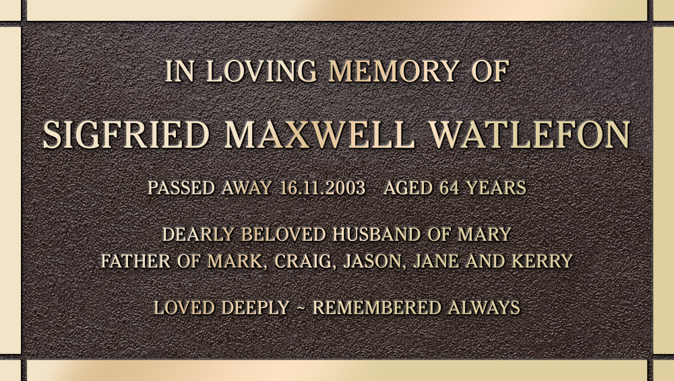
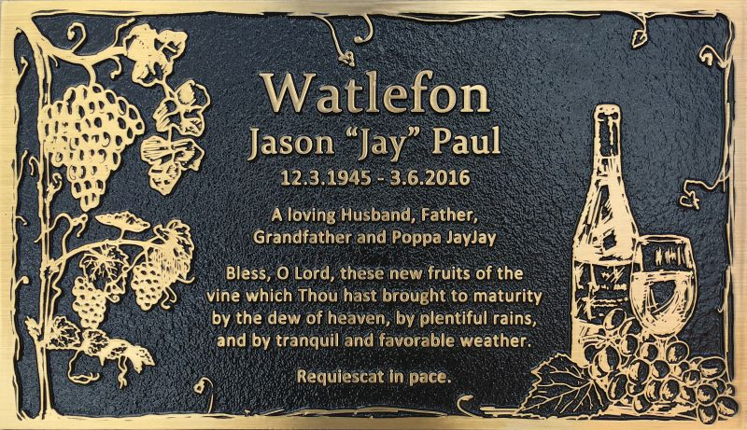
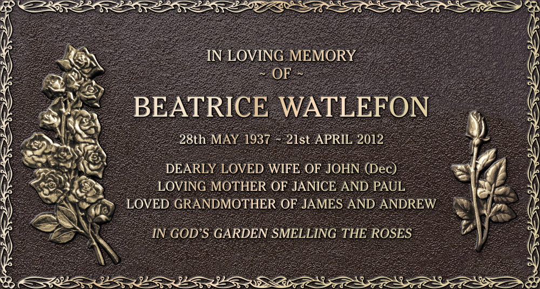
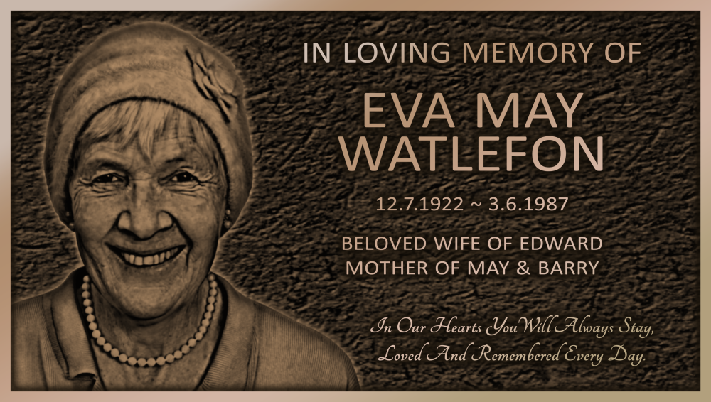
Bronze Plaque Pricing Points
Standard Range $
Artisan Range $$
Sculpture Series Range $$$
Bronze Image Range $$$$

Slide 6
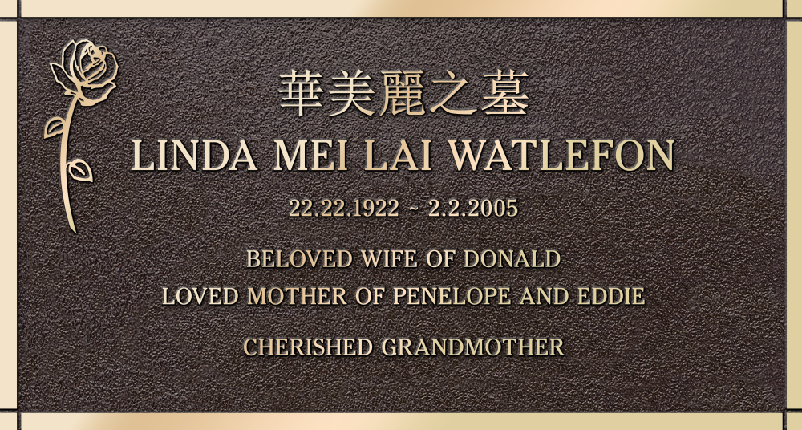
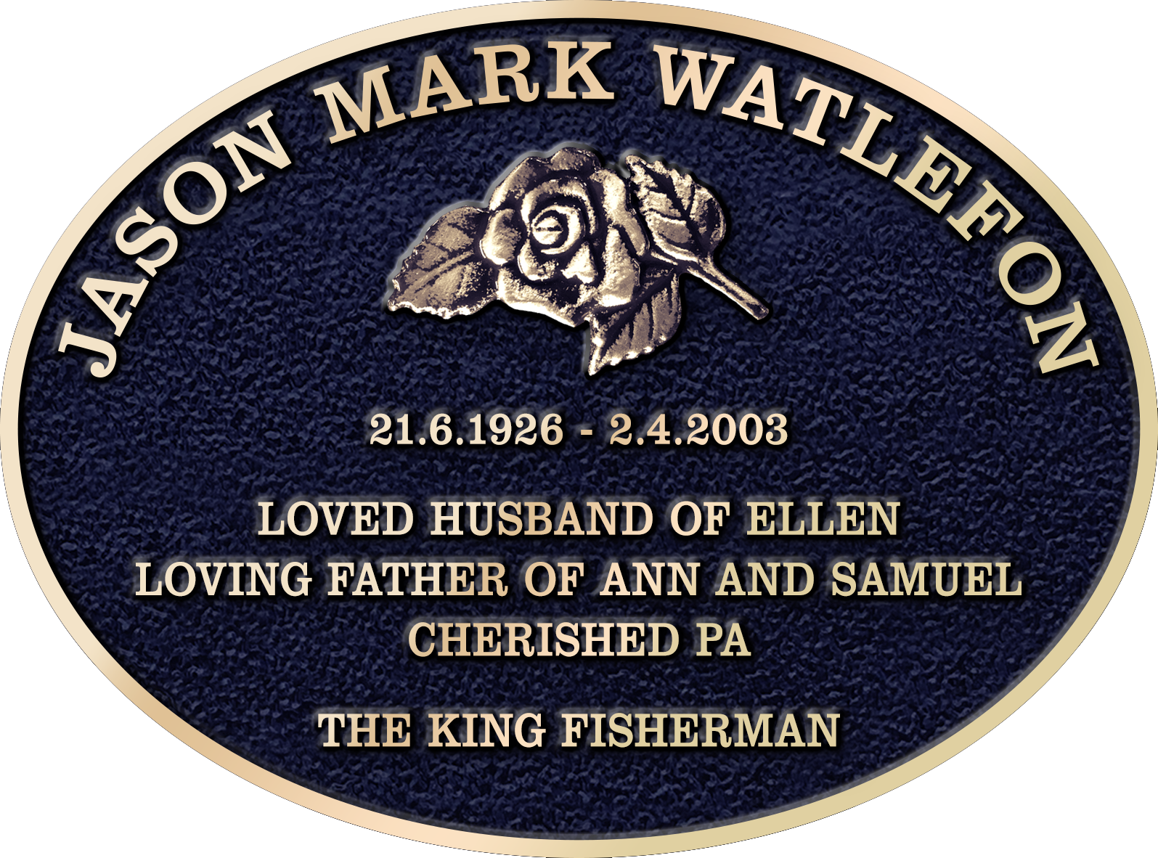
Option 1 – Standard (good range)
Phoenix’s lowest price range of memorials.
Blank canvas range allowing families to build up with inscription, emblems and colours to design a suitable memorial.
Reminder: one flat relief emblem free on all plaques.

Slide 7
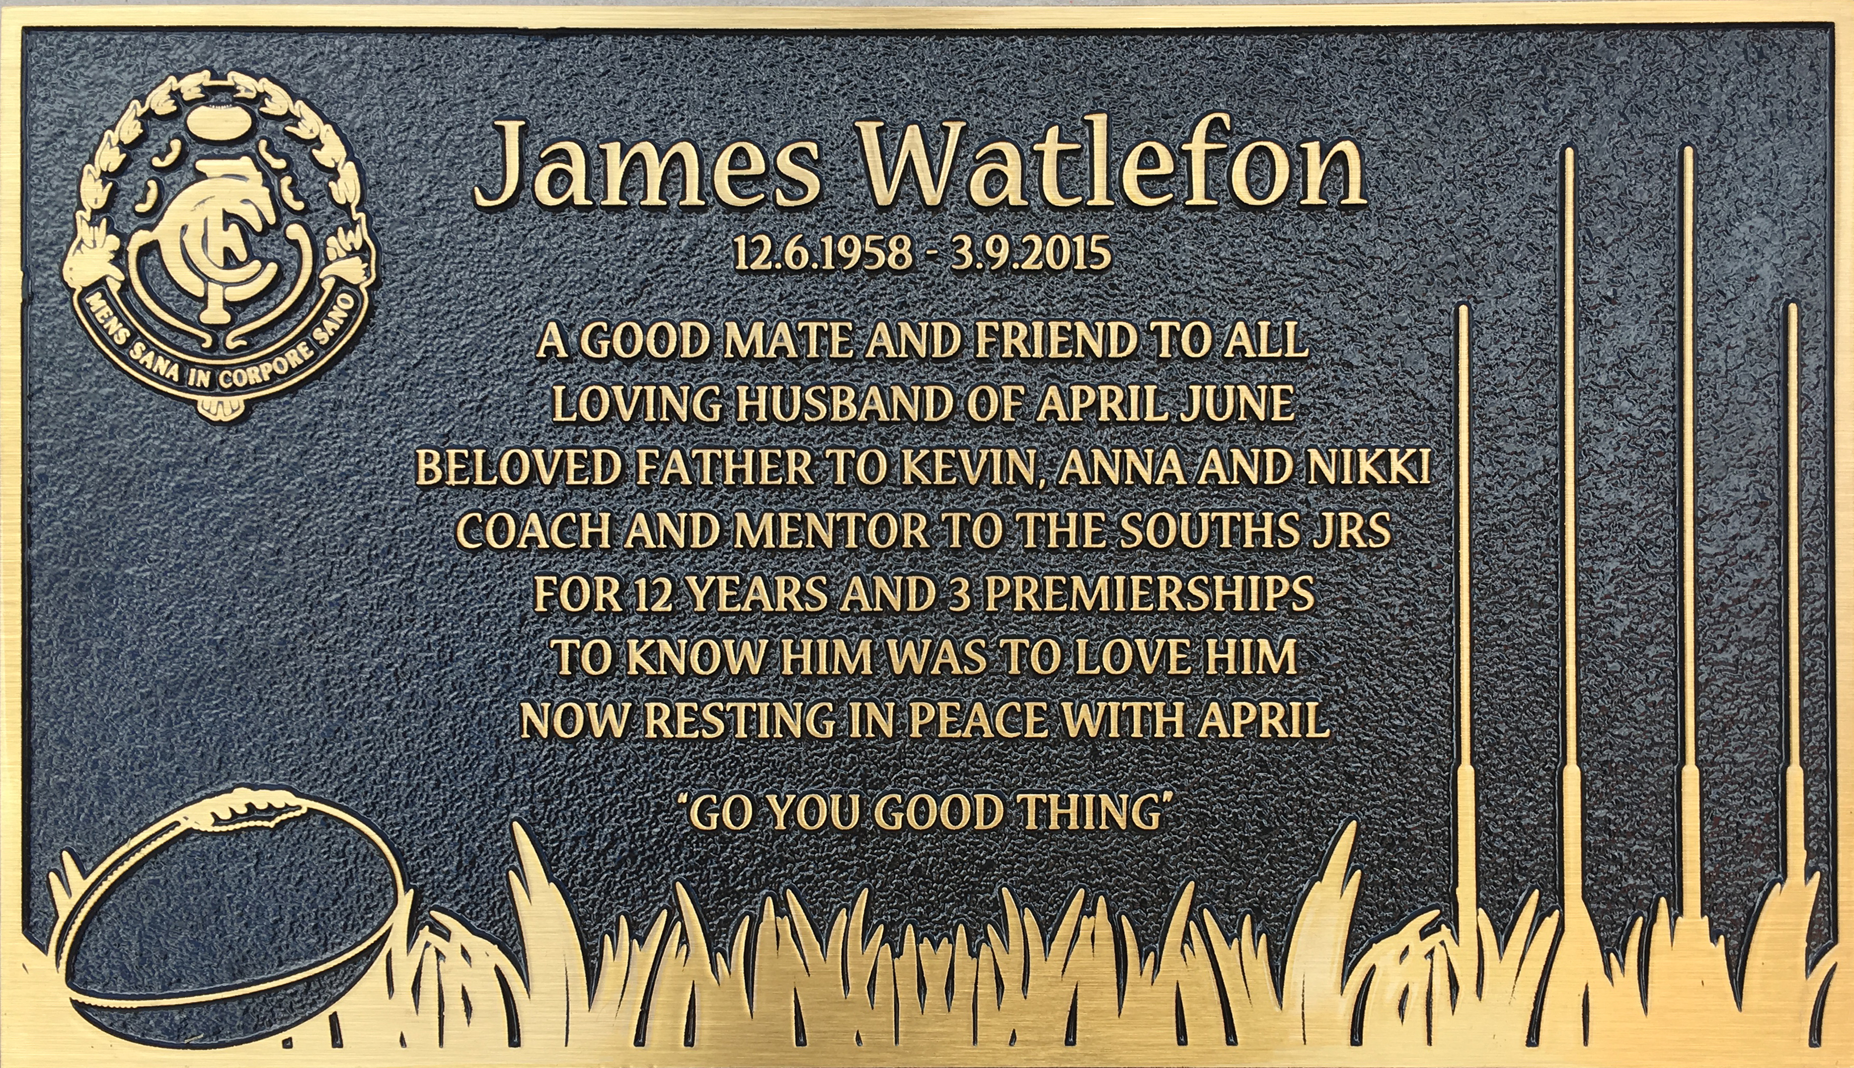
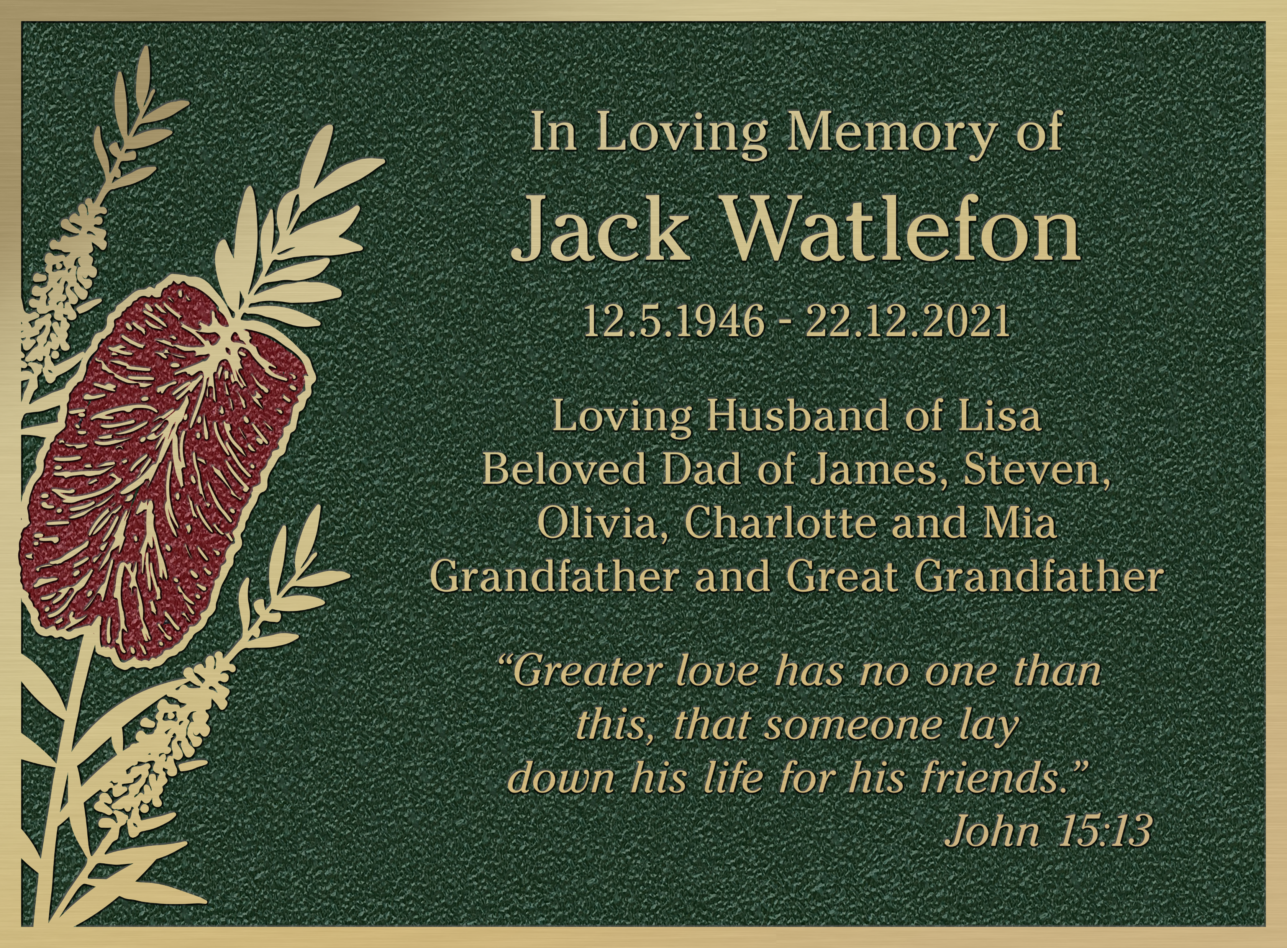
Option 2 – Artisan (better range)
Phoenix’s mid price range of memorials.
Selection of custom flat relief scenes that can be further edited to suit the end customers specific requests.
This range includes the new popular Coloured Artisan Range.

Slide 8
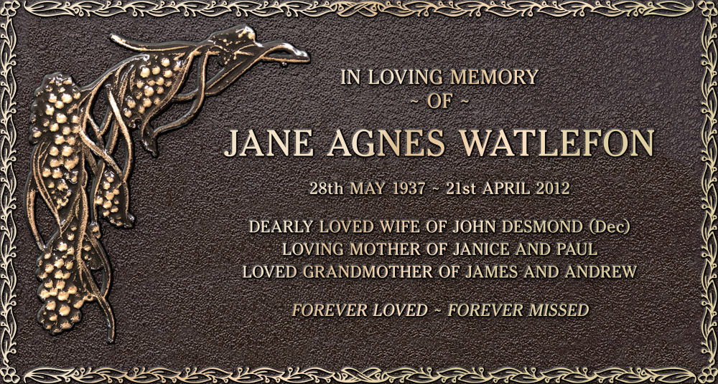
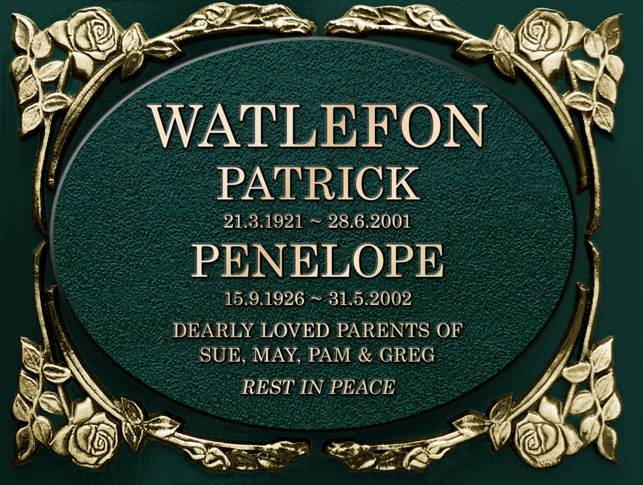
Option 3 – Sculpture Series (best range)
Like the Artisan, this range is in the middle pricing range.
Selection of set Bas Relief (Sculptured) scenes.
Available is 4 distinct ranges to suit the customers requirements.

Slide 9
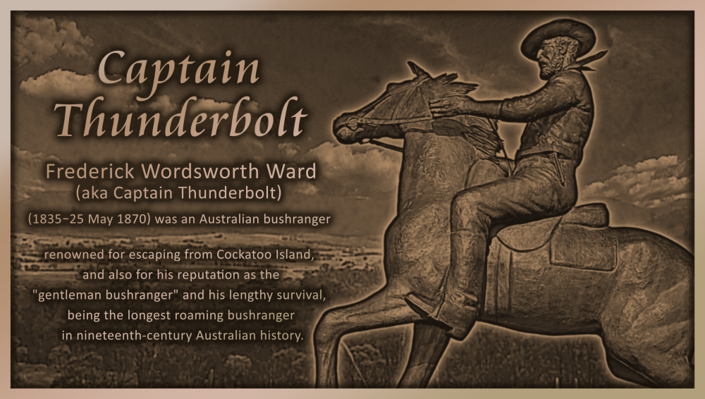
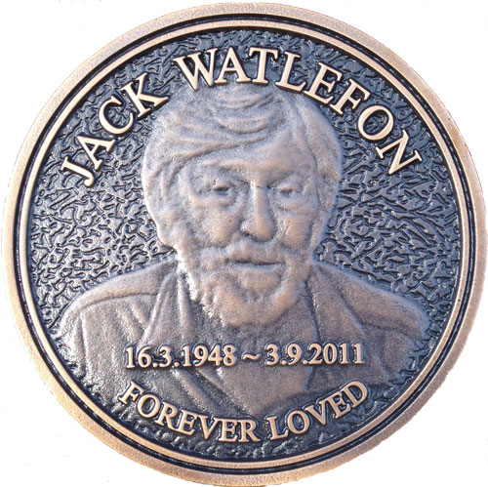
Option 4 – Bronze Image (wow range)
Phoenix’s top of the range.
Incorporates images supplied to Phoenix by the customer.
Images are cast into the plaque background with various pricing points depending on the quantity of images required.

Slide 10
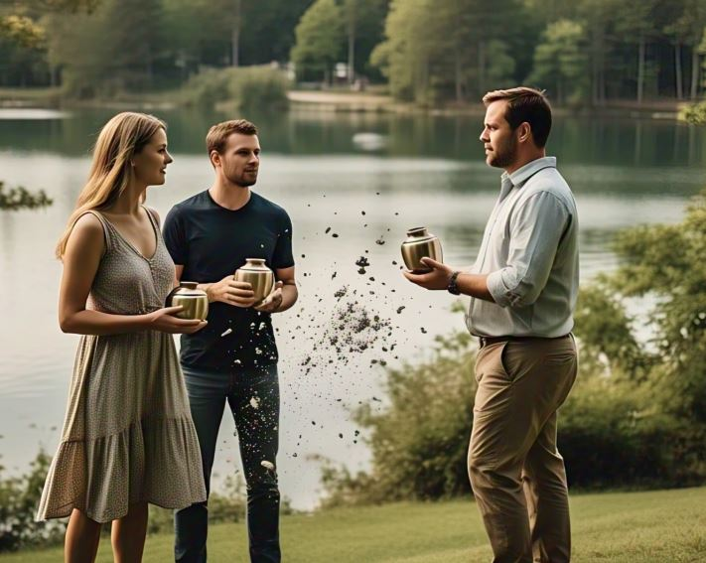
Scattering
Do you have memorialisation options for people who scatter ashes?

Slide 11

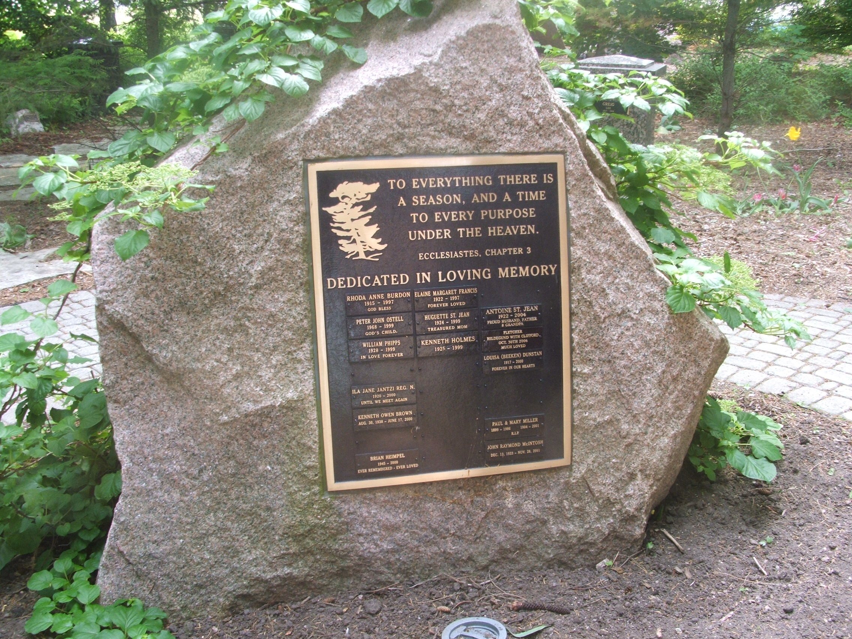
Scattering Memorial Options
Group memorials can provide a great source of income for the cemetery whilst also providing a low-cost memorial option to families.

Slide 12
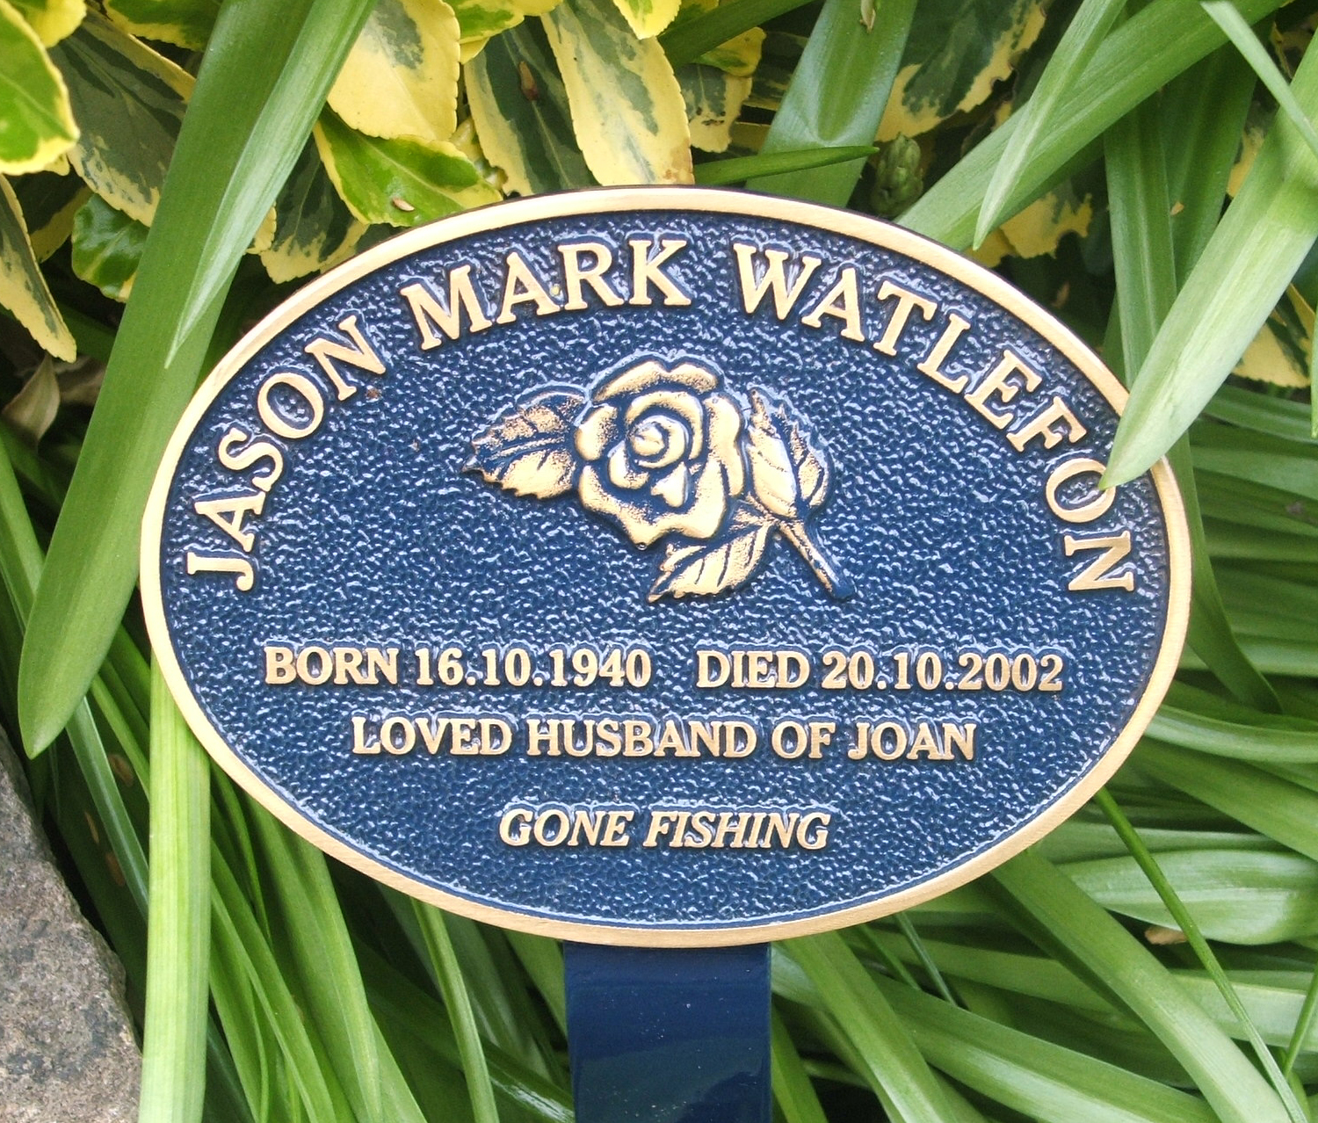
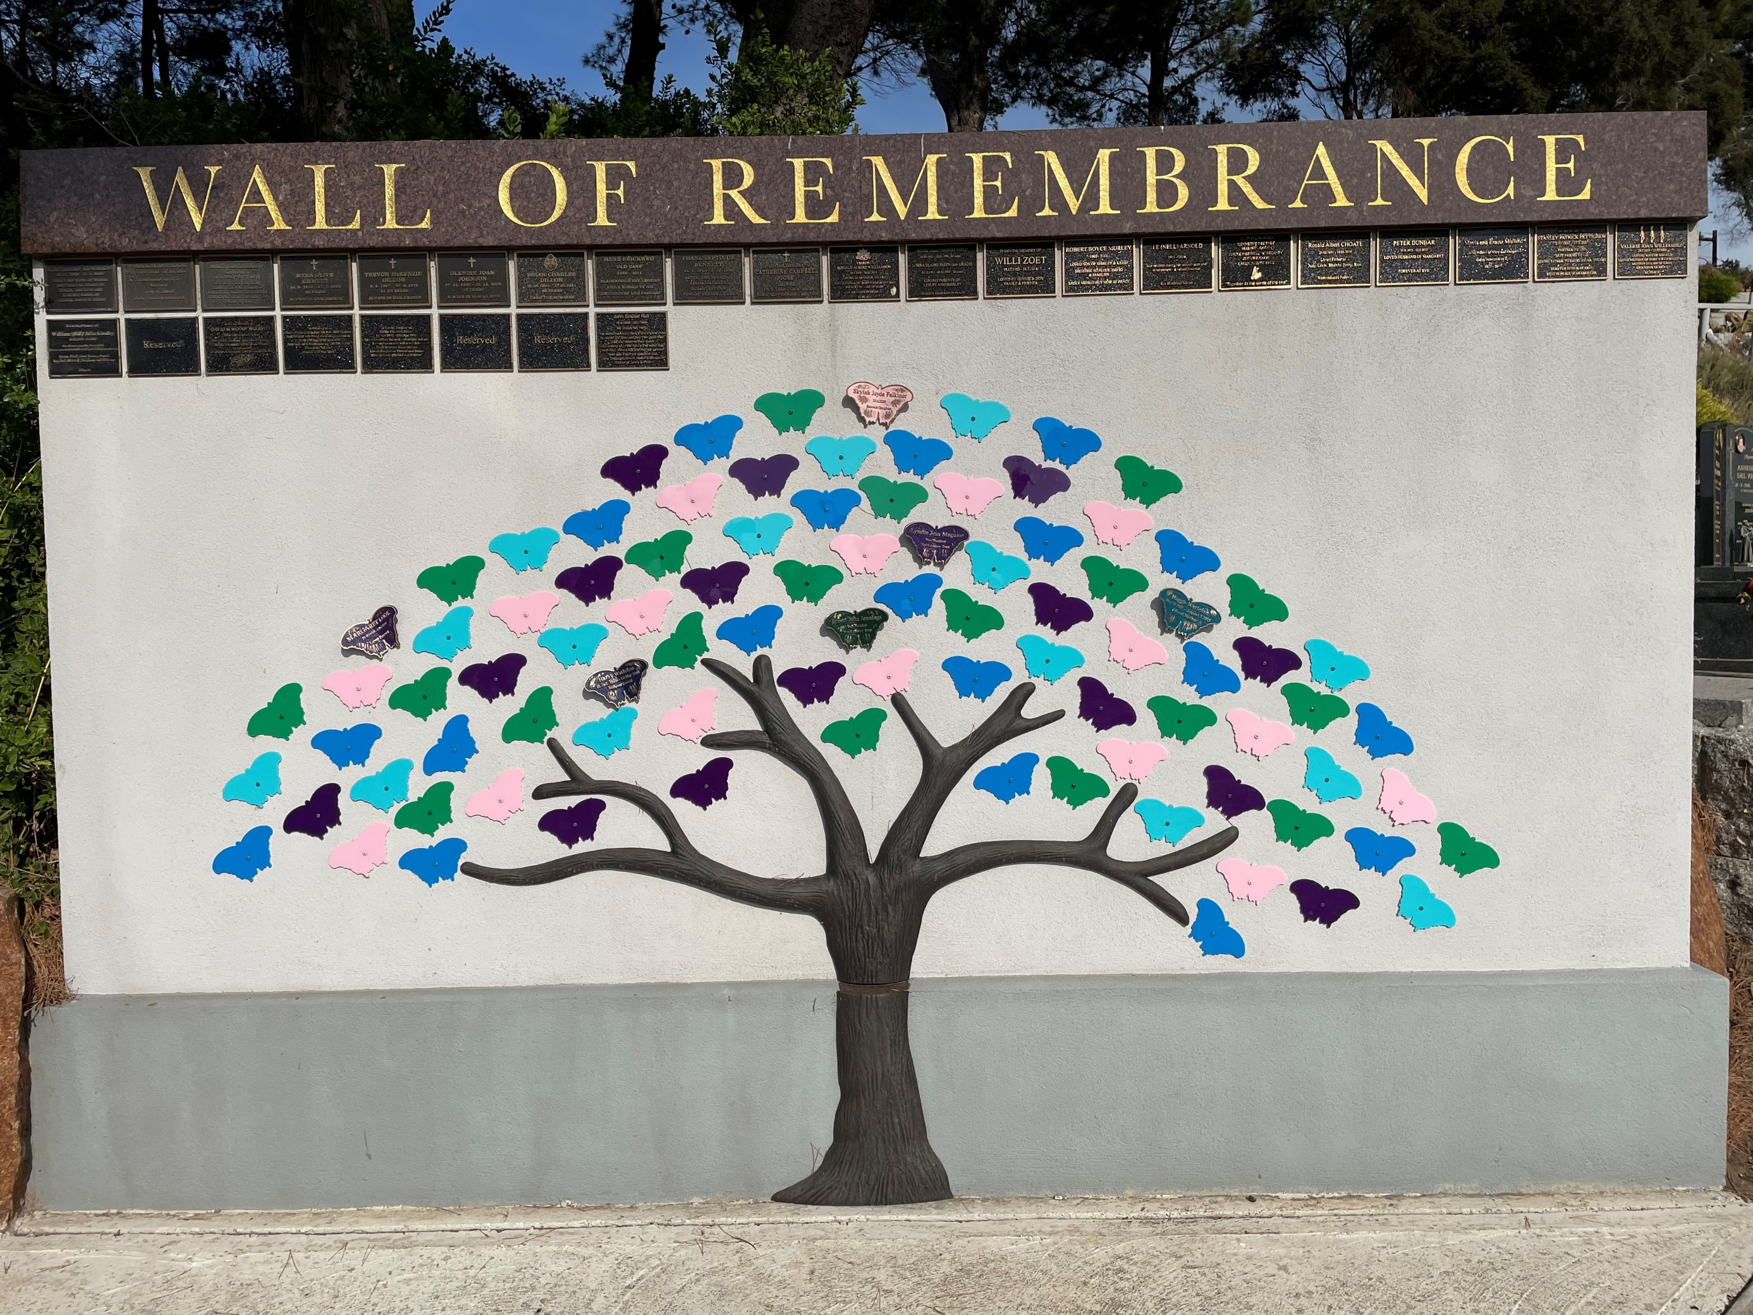
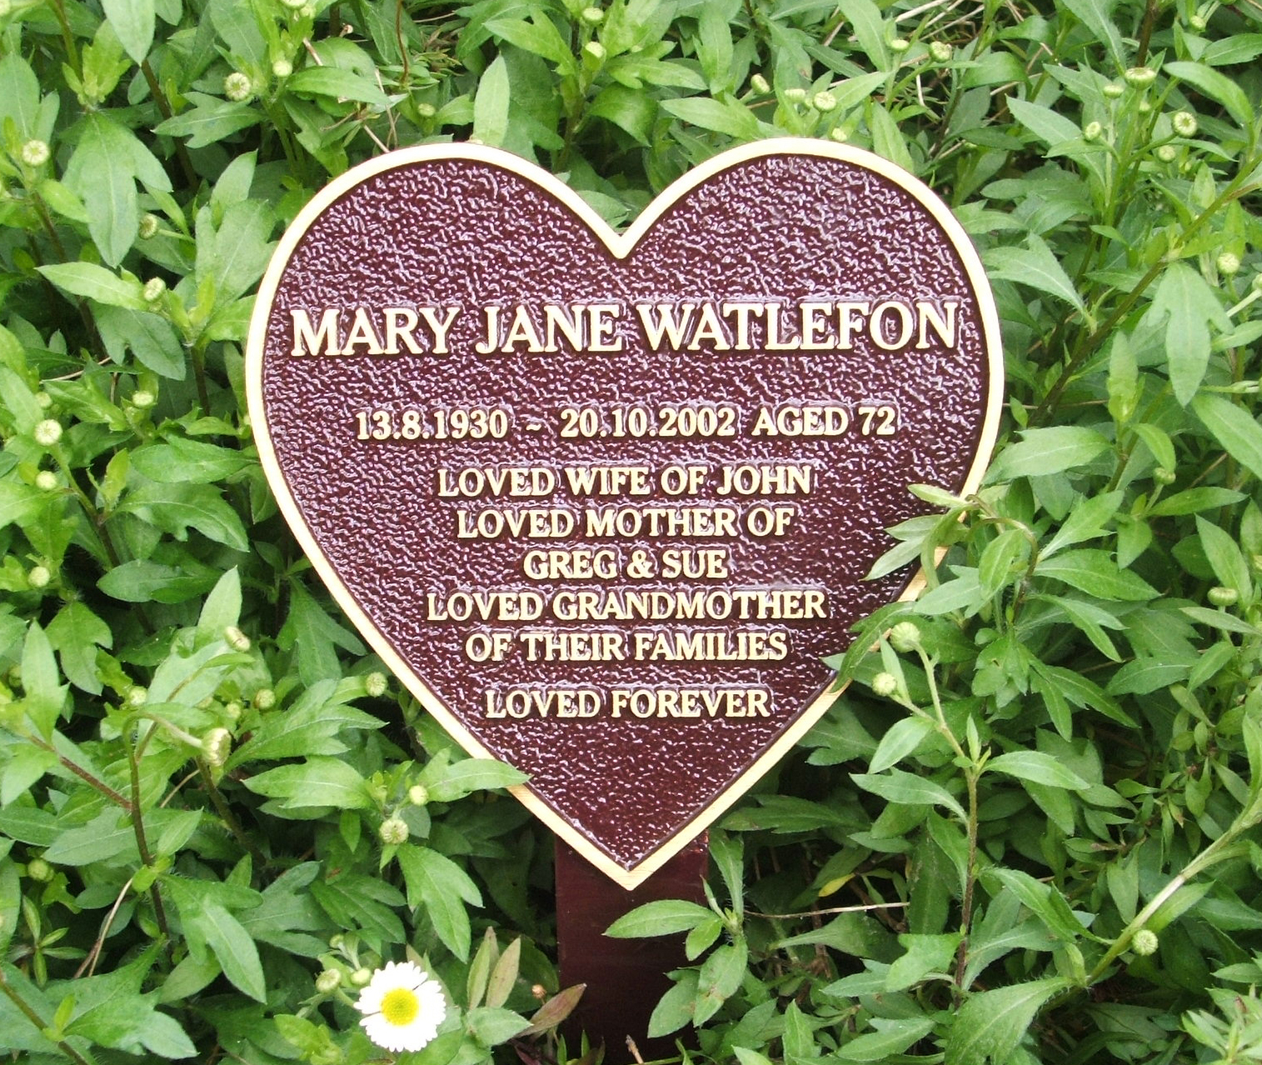
Scattering Memorial Options
Are you able to offer memorial options for those who want to memorialise outside the cemetery?

Slide 13

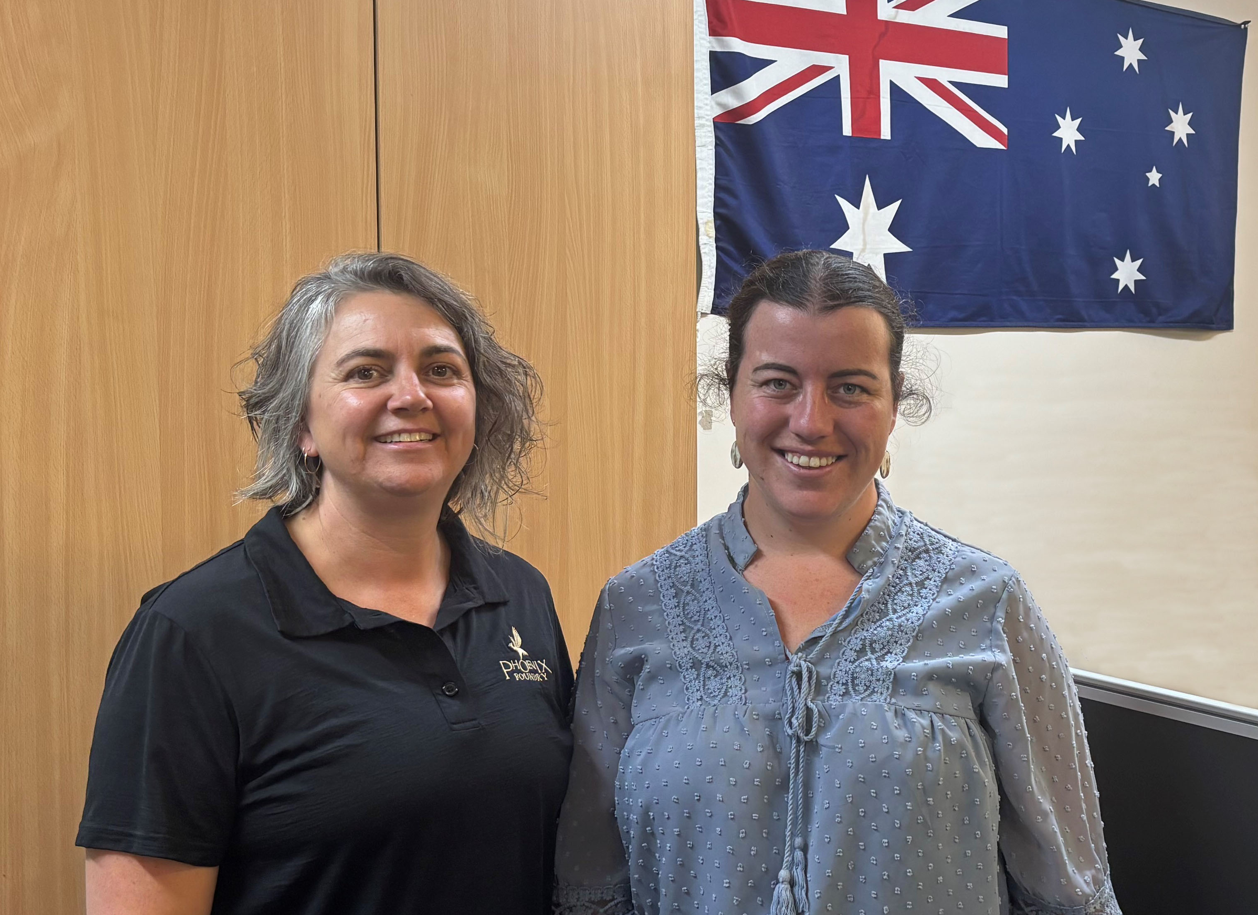

Thank You
Finally, a huge thank you to the CCAWA and all members.
As a 100% Australian Owned and Operated business we value the support that the cemetery profession domestically provides, and we look forward to helping you with your memorial needs into the future.

