Slide 1
CCAWA
April 4th , 2025

Slide 2
Who are we?
The Australasian Cemeteries & Crematoria Association (ACCA) is a non-profit professional organisation that exists to provide leadership, professional services
and development, communication and networking platforms to the cemetery and crematorium industry.
Current Board
President - Lauren Hardgrove – Catholic Cemeteries and Crematoria (NSW)
Vice President (Acting) – Dean Matthews – Geelong Cemeteries Trust (VIC)
Steve Nobbs InvoCare
Michael Robertson – Adelaide Cemeteries Authority (SA)
Rob Moore – Fraser Coast Regional Council (QLD
Denise Ora – Metropolitan Memorial Parks (NSW)
Kristy Constantine – Bunbury Cemetery Board (WA)

Slide 3
Strategic Focus
Focus on improving and developing resources for our members and the wider industry.
Fostering collaboration and sharing of ideas across the country – including State Associations and related associations.
Collaborating and sharing ideas with International associations:
  International Cremation Federation
  NZCCC (NZ)
  OACFP (Canada)
  Institute of Cemetery and Crematorium Management (UK)

Slide 4
Training
Launch of the Learning Management System (ACCA learning Hub)
Development of new professional development courses and accredited training –
  Cert. IV in Supporting Grieving Clients (ETA 2026)
  Cert. III Cemetery and Crematorium Operations (ETA 2026)
2025 Course calendar available on ACCA Website – accaweb.com.au
Open to CCAWA members - affiliated membership cost

Slide 5
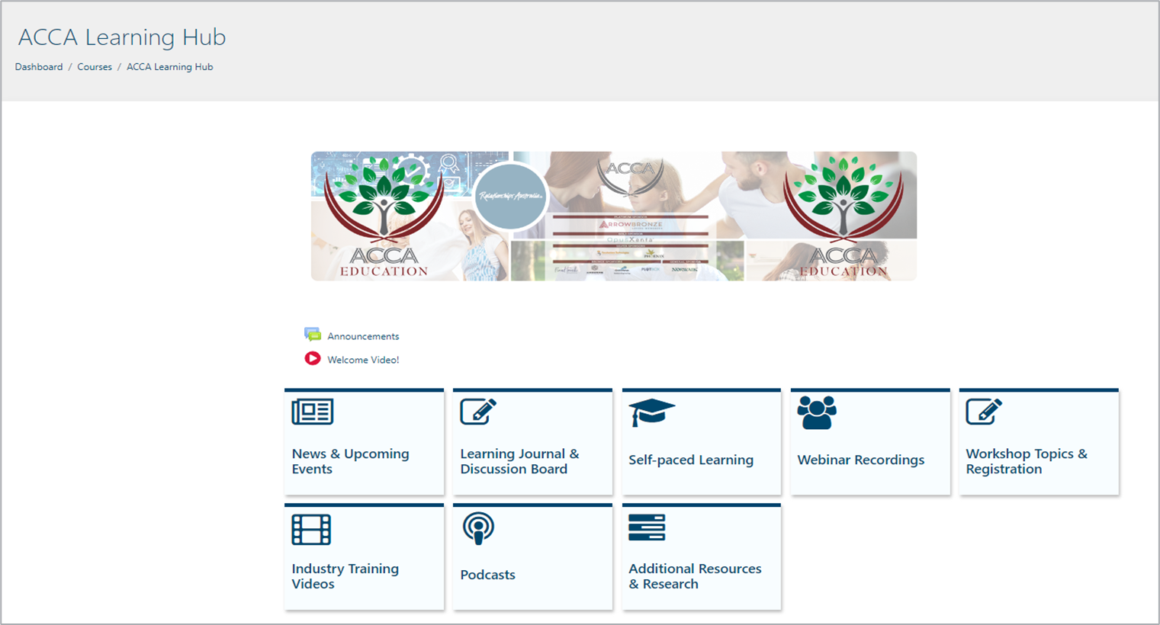
Notes:
ACCA learning hub is online now and being rolled out to our members.
This is a one stop shop for all industry training needs including self pace courses, workshops, webinars, podcasts , industry training videos and resources.
All members and their staff will have access to this hub.
There will be a mix of free and paid courses available.
ACCA will continue to invest into this hub with new courses and content on a regular basis

Slide 6
New to our professional development program in 2025
New workshop topics
Masterclass for leaders
New Induction Program for new:
An Introduction to Working with
Grieving Clients
Mental Health First Aid
Compassionate Service
Responding to Family Violence
in the Workplace
Mental Health in the Workplace (Keeping Your Staff Safe)
Business Planning and Strategic Thinking
Workplace Bullying and Harassment
Leading with Impact
Notes:
ACCA education is continuing to develop new courses for this sector.
The topic s and content have come about through consolation with the industry. Please reach out for there is a particular topic or course you feel would be beneficial for the sector.

Slide 7
New Staff/ Induction
(online and self paced)
Introduction to grief
How to effectively supporting grieving clients
How to manage Challenging Behaviors
Managing your own self care and building resilience
Notes:
This course is specifically designed for new starters (less then 12 months) . It will help equip staff with the necessary tools and knowledge to work in this industry .

Slide 8
Existing Staff Training
Vicarious Trauma
Managing Challenging Behaviors
Supporting Grieving Clients
Professional Boundaries in the Workplace
Compassionate Service
Negotiation and Conflict Management
Working with Diversity
Transitioning into Leadership
Mental Health First Aid
The Accidental Mediator
Group Supervision/mentoring

Slide 9
Leadership Masterclass (2-3 hours)
Transitioning into Leadership
Responding to Family Violence in the Workplace
Mental Health in the Workplace
(Keeping your staff safe)
Leading Difficult Conversations
Vicarious Trauma for Leaders
Individual Mentoring Sessions
Individual supervision
Group mentoring sessions
Leading with Impact
Business Planning and Strategic Thinking
Writing Business Cases and Proposals
Managing your Budget
Managing a Diverse Workplace
The Accidental Mediator
Mental Health First Aid
Media Training (full day)
Workplace Bullying and Harassment
Notes:
Designed for leaders (emerging, new and experienced) to help them carry out their tasks and manage staff.

Slide 10
New to our professional
development program in 2025
What’s next after I complete the available workshops?
Introducing mentoring sessions
Regular 1.5-hour sessions for staff and leaders
Continue to practice and enhance your skills
Explore individual case studies
Self reflect in a safe space

Slide 11

In development:
Accredited Training
Our consultation process has identified the need to develop additional accredited training to retain ACCA’s workforce and provide qualifications to staff in the cemetery and funeral sectors.
Work is underway to develop a Certificate IV in Supporting Grieving Clients. Currently being submitted to Australian Skills Quality Authority for approval.
Discussions underway with an RTO to deliver SIF30113 Certificate III in Cemetery and Crematorium Operations in the near future across Australia.

Slide 12
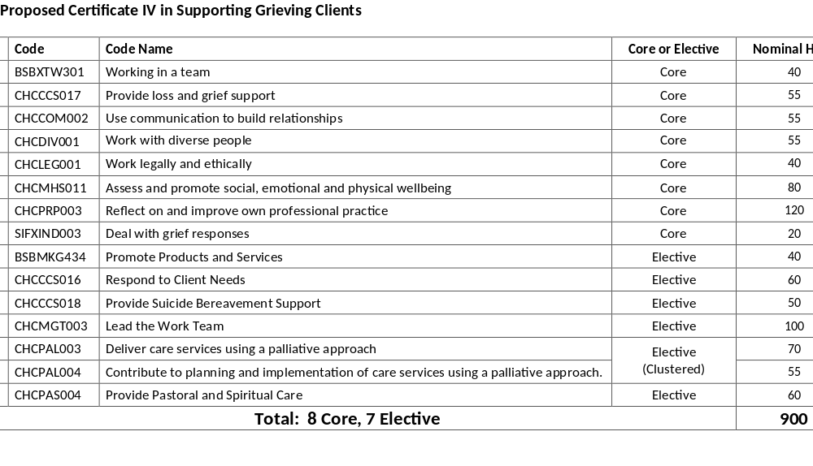

Slide 13
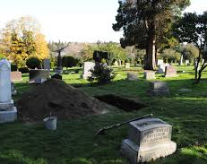
Australasian Safety Advisory Committee
Representatives from across the sector (Australia and New Zealand)
Working on issues impacting the sector
Sharing of ideas and resources to ensure the safety for all staff in the sector
Notes:
This committee is made up of industry professionals who are passionate about helping create a safer work place for our staff and those visiting our sites.
Committee is made up of a mix of staff form, Health and safety managers , Funeral directors, administration and operations staff form all levels.
Currently vacant positions available – WA representative would be great.

Slide 14
What’s coming up in 2025/26?
Mid-Year Seminar – July 16th/ 17th Brisbane/ North Stradbroke Island
  Talks on workplace safety , monument safety, Muslim and aboriginal burial and funeral practices, working with Community group “ Friend of the Cemetery”
Annual Conference – Sydney – September 14th-17th
Study tours
  China Cemetery tours May 11th-18th,
  Orthometals Europe 2025- June 4th-June 12th
Notes:
Mid yer- focus on front line staff- talks on workplace safety , monument safety, Muslim and aboriginal burial and funeral practices, working with Community group “ Friend of the Cemetery”
Registration for Mid year open now with a early bird price
Registration

Slide 15


Kristy Constantine
ce@bcb.wa.gov.au
08 972 13191
Questions?

