Slide 1

Mindfulness in Palliative care
Navigating death and dying in the world of the living.

Slide 2
What is palliative care?......
And why it’s a privilege.
Palliative Care Australia – defines this as…
Person and family-centred care provided for a person with an active, progressive, advanced disease, who has little or no prospect of cure and who is expected to die, and for whom the primary goal is to optimise the quality of life.
https:/palliativecare.org.au

Slide 3
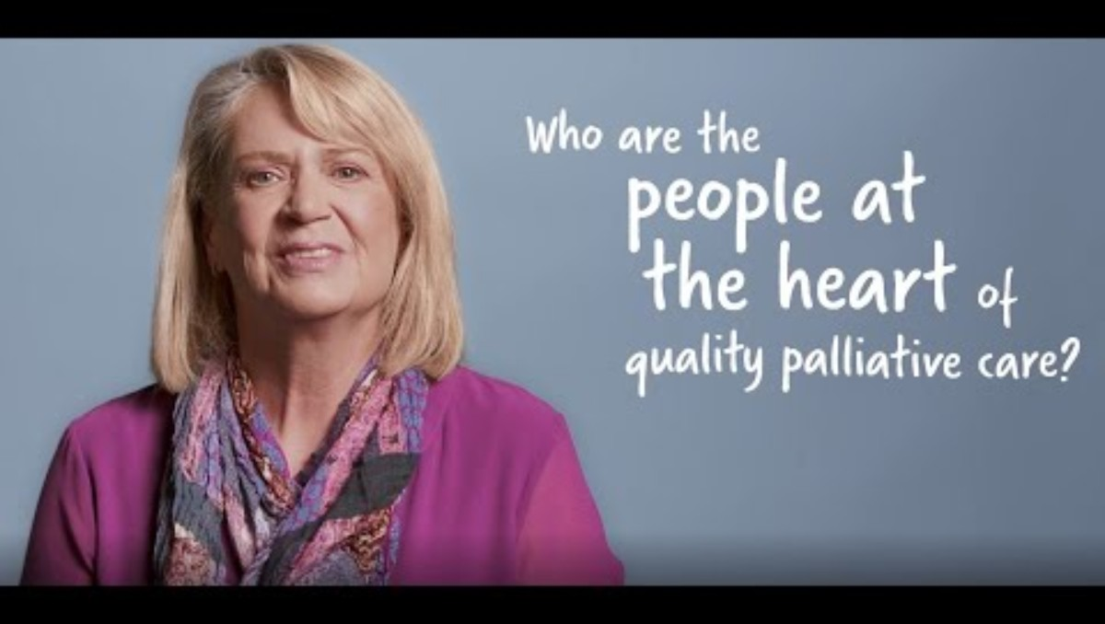
What palliative care means
Myth Busting
Mindfulness in Palliative Care.pptx

Slide 4

Who am I?.....
……and why am I here doing this job?
What qualifies my to do this job?
How do I know if I’m doing my job well?
The hats I wear – why “the job” and volunteering are a good mix.

Slide 5

The clinical team…
The patient and their carer
The GP
The specialist – oncologist, cardiologist, respiratory physician etc…
The palliative care consultant
Hospital/hospice doctors and nurses
Community palliative care nurses and cancer nurses.
Allied health team – physio, OT, radiologist, speech pathologist, dietitian, social worker, welfare officer.

Slide 6
What happens at home?
Community palliative care team – community support services
Managing stress, fatigue and coping with increasing need for symptom control and support.
Access to equipment, clinical support and respite services. CARERS AUSTRALIA SERVICES AUSTRALIA
PEACE OF MIND...
Apply for funding early on.
Make an Advanced Health Directive
Complete legal and estate affairs

Slide 7
What happens in hospital/hospice?
Admission through ED
Admission direct to hospice from the community.
Stabilising symptoms
Pain management options
Referrals to engage the necessary members of the palliative care team.
Ongoing clinical and psychological/emotional support for the person and their support network
Referral to ancillary support services and relevant NFP organisations
Family meeting with clinical staff to address expectations and answer questions

Slide 8

An example of best practice in pre-bereavement and bereavement support.
The importance of closing the loop of care for people navigating an end of life journey.
The relationship between government health facilities and NFP supporting organisations and why it’s so important.

Slide 9
What do they do?
Trained volunteers work alongside clinical staff and Busselton Health Campus – Hospice Unit to support patients and their families and carers with daily tasks, a willing ear and an open heart.
At the Busselton Hospice Care Inc. –
Bereavement support
Complimentary therapy services
Home visiting volunteers
Carer education
Community workshops
Lasting Words – Dignity Therapy …Creating a Legacy Document…Telling your story or leaving lasting messages as a way of leaving your legacy to the people you love and care for.
https://busseltonhospicecareinc.org.au
admin@busseltonhospicecareinc.org.au

Slide 10
SELF CARE
Everything we do is personal
Working in the sphere of death and dying will frequently be challenging….but remember, it’s a privilege….and you can cope….. and find it very rewarding.
Debriefing
Time alone
Keeping perspective

Slide 11
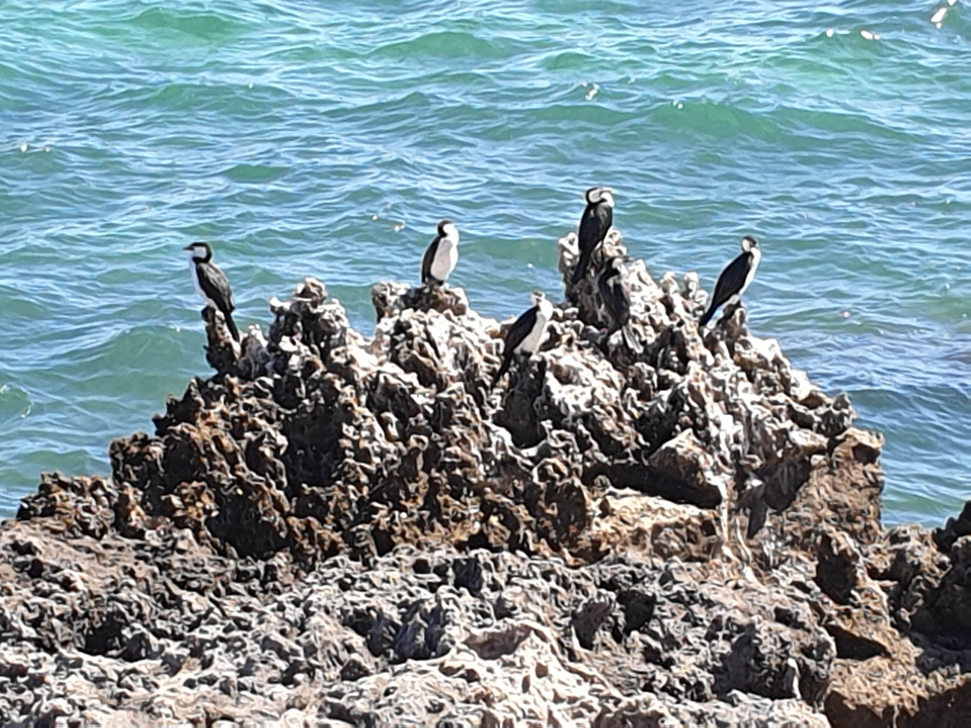
Debriefing
Choose a private and quiet space. Spare office, someone’s home, in a park.
Bring food… and an open mind and heart.
What went well…what didn’t?
Explore your teams’ emotional responses.
Discuss how to move on.

Slide 12
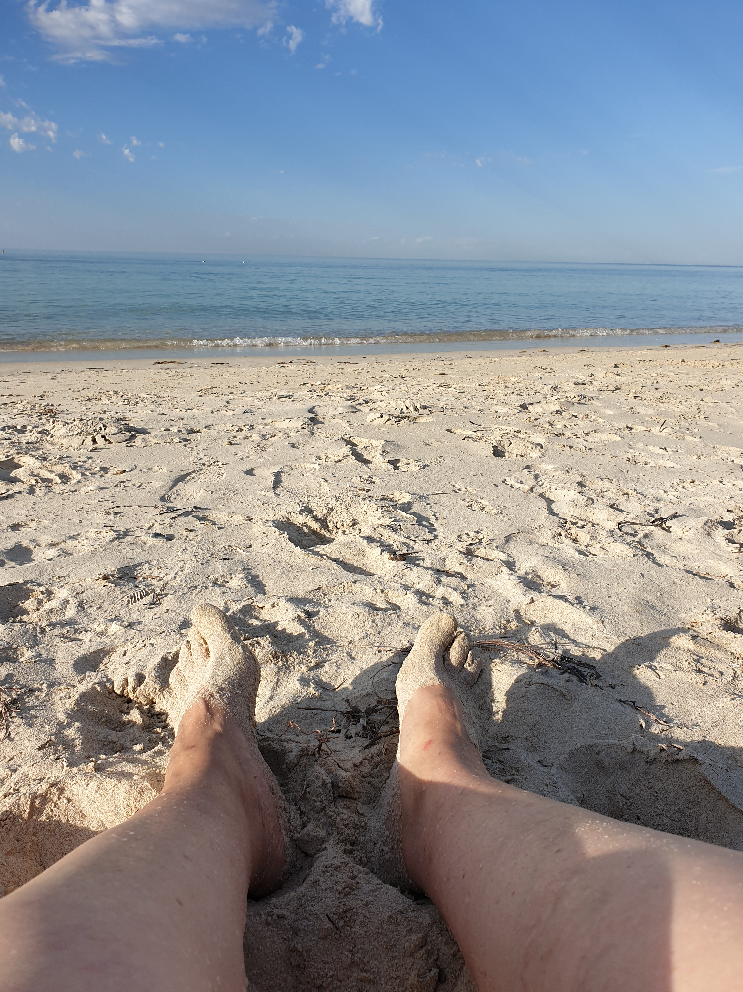
Time alone
Make time to process events and situations that have triggered an emotional response.
Feeling overwhelmed….busy brain…compassion fatigue?
Understanding the cortisol response and regulating your stress hormones.

Slide 13

Keeping perspective
Remember…..we are here to provide a service and facilitate…we are not here to fix other people and their personal issues.
Keep your professional boundaries.
Their stuff, although familiar to us….is NOT our stuff.
It’s their journey and their learning curve.

