Slide 1
Global expertise, local support
Kris Miller, Solutions Consultant APAC

Slide 2




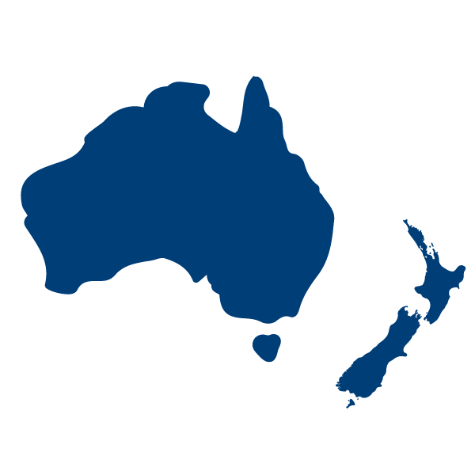


Global expertise, local support
Founded in 2014 (2019 in Australia)
120+ Employees and growing
Customer Success Ethos
Strongly active across APAC
Support 1,600+ facilities across 4 continents
Sydney, Boston, Belfast

Slide 3

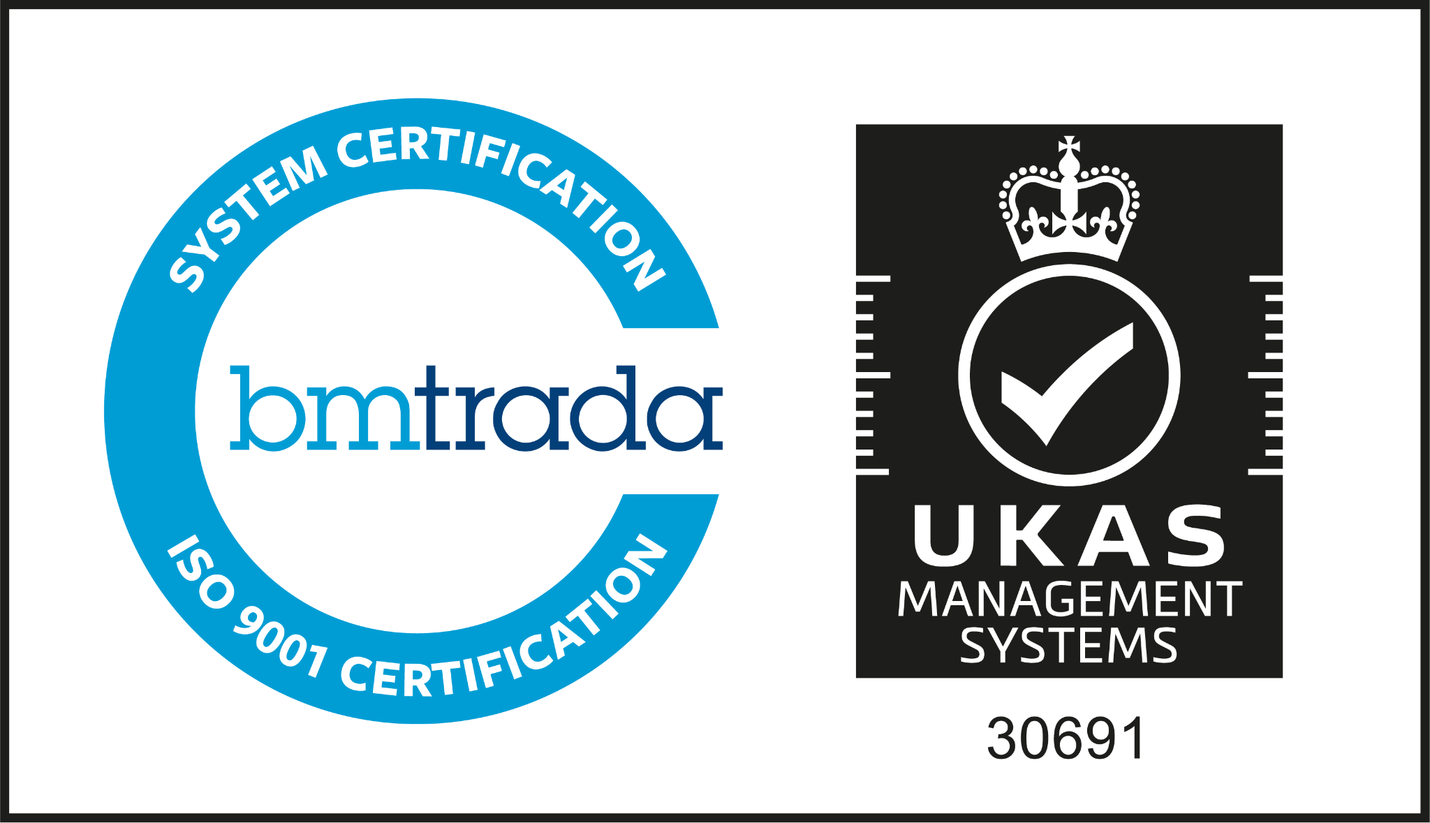
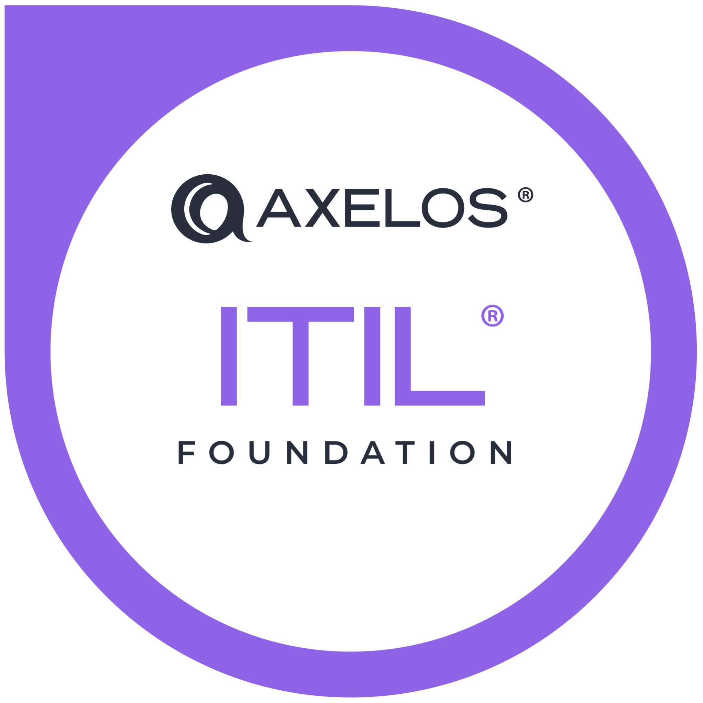
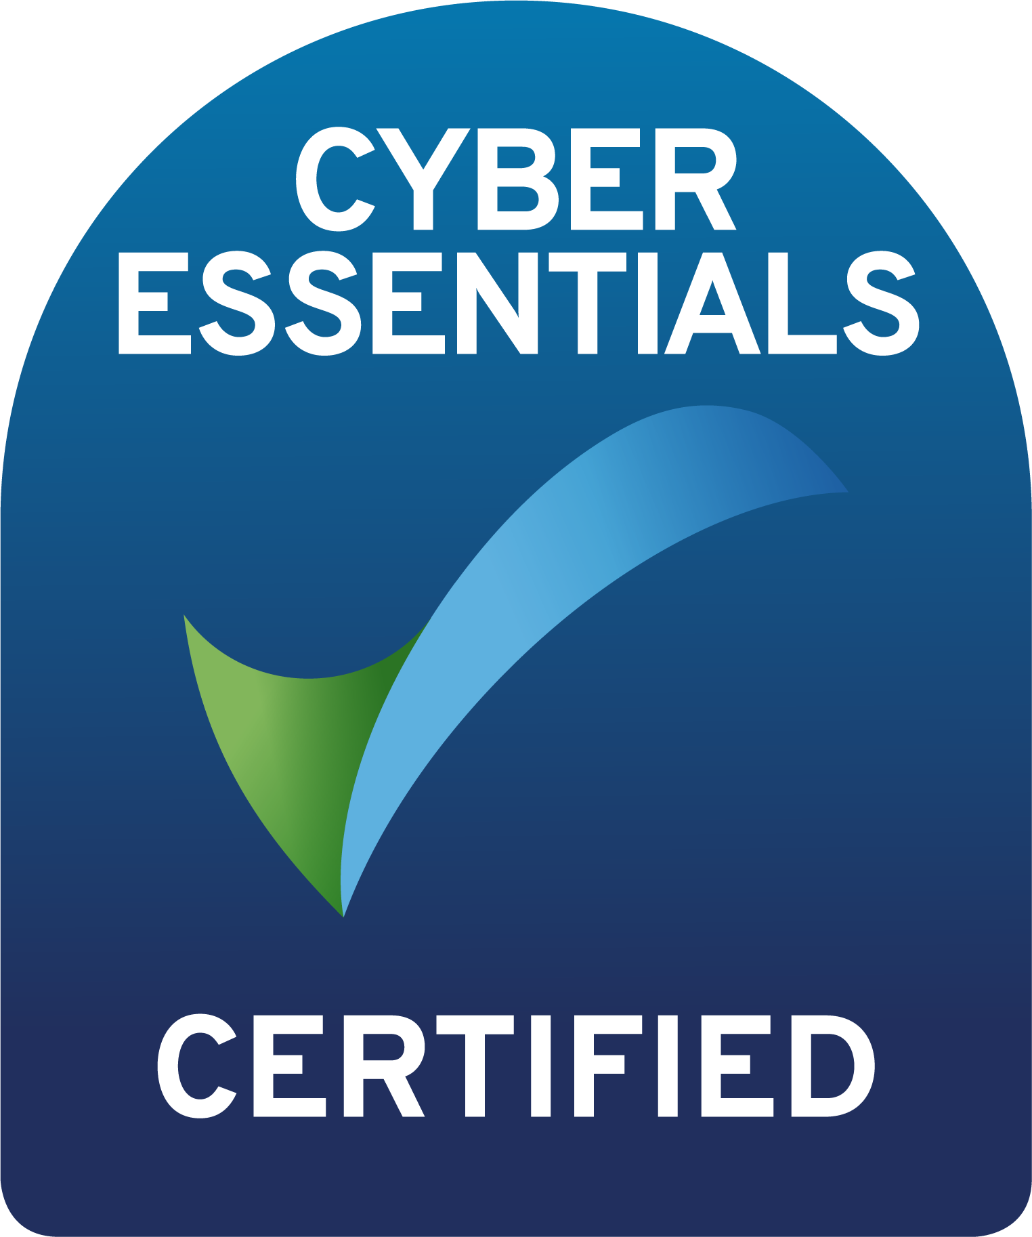
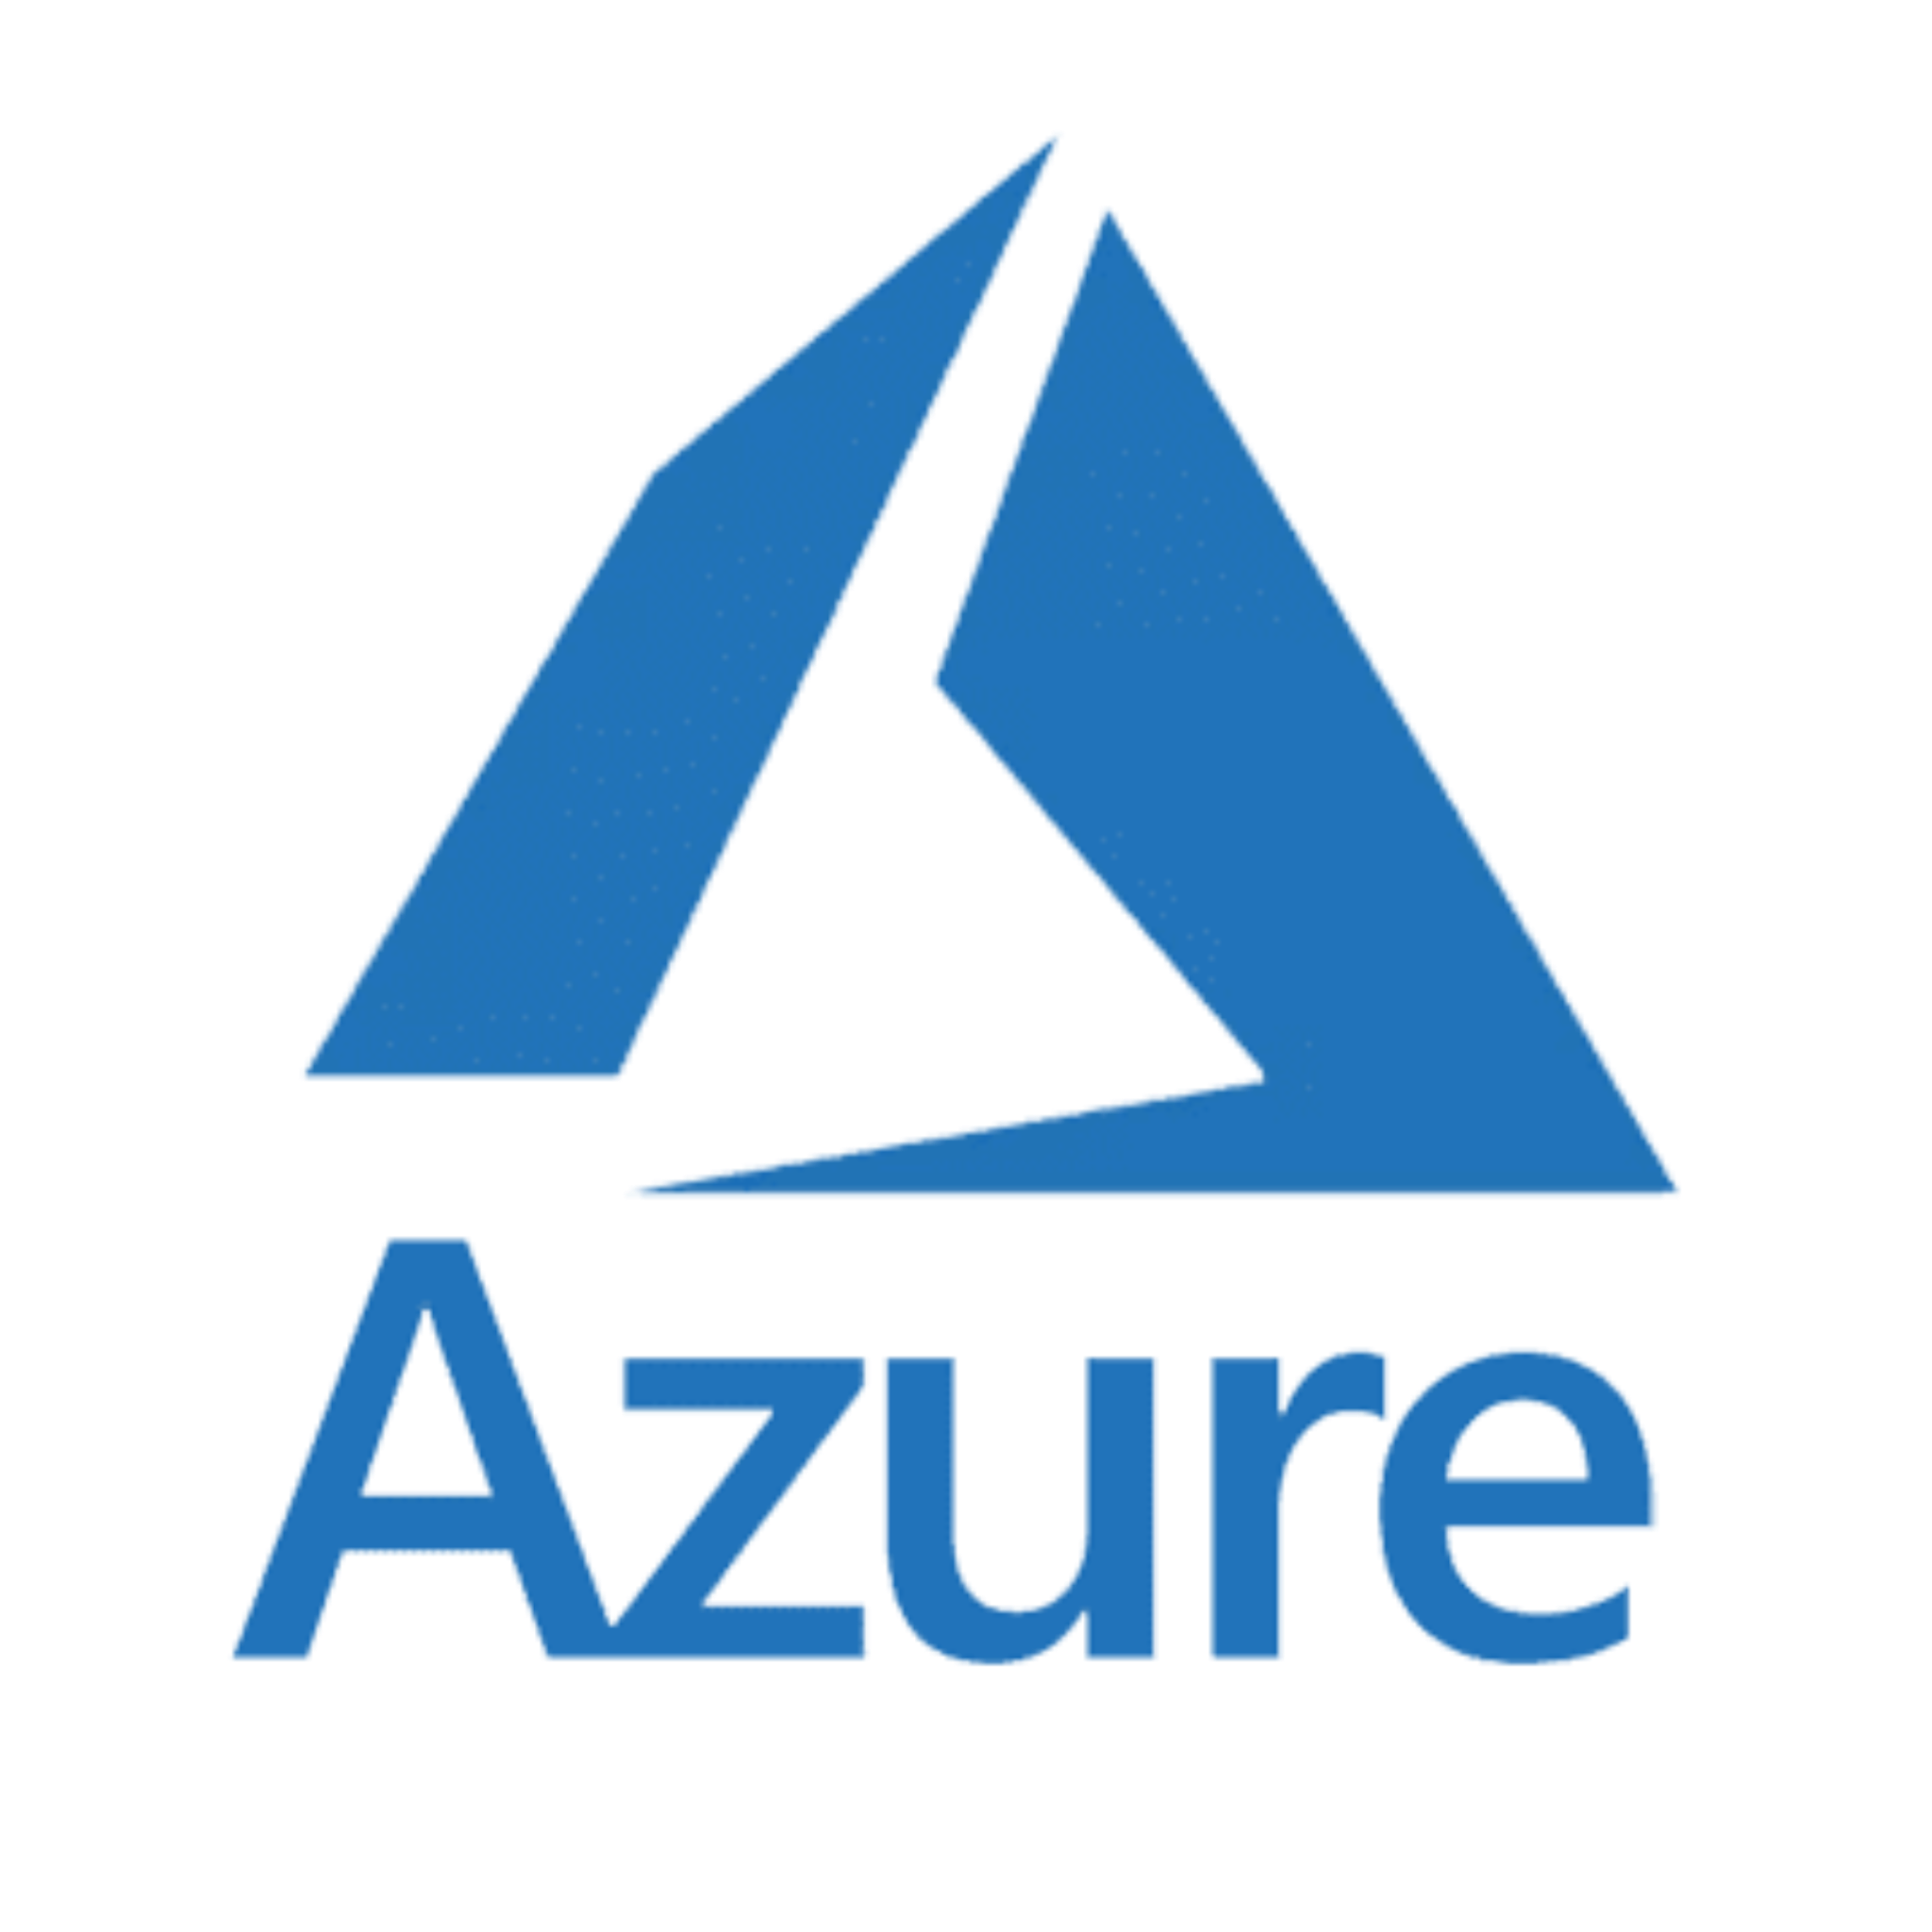
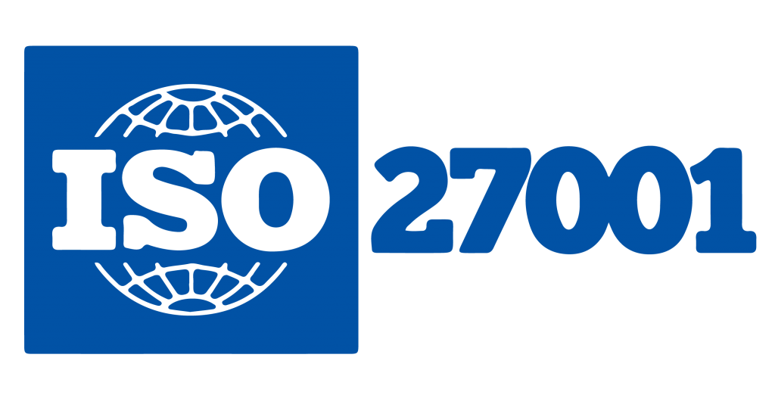
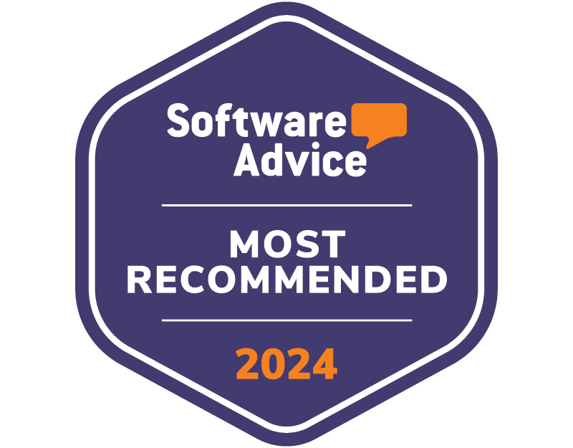
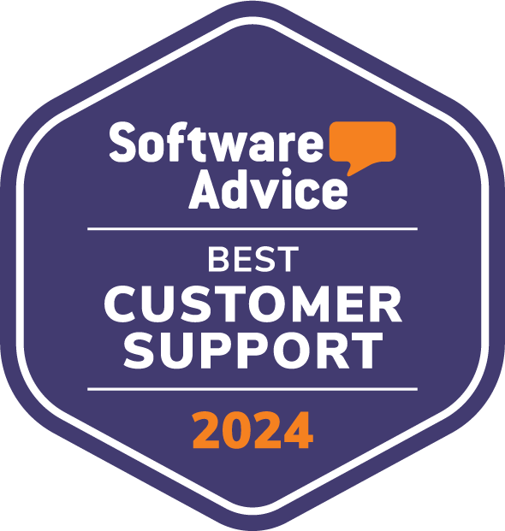
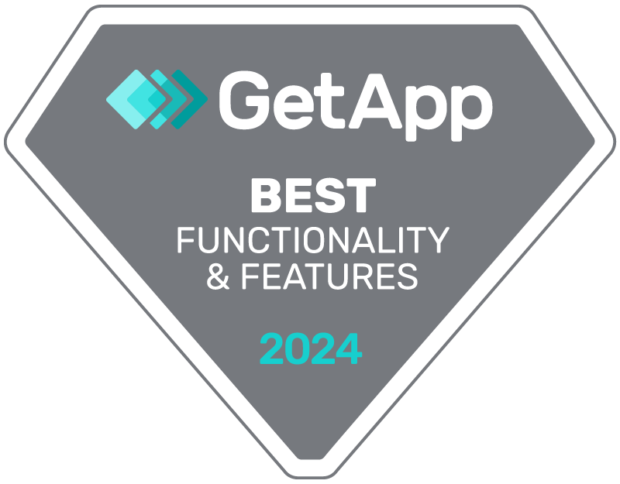
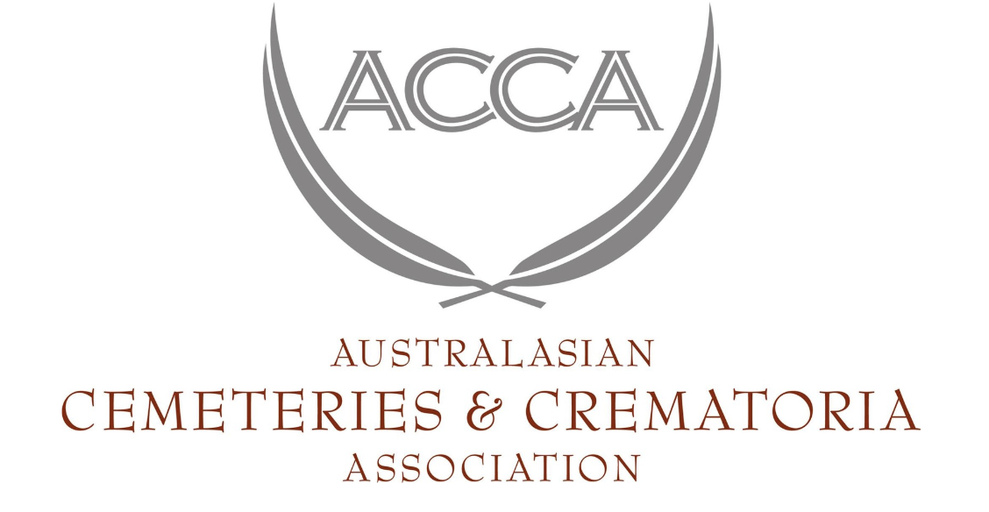
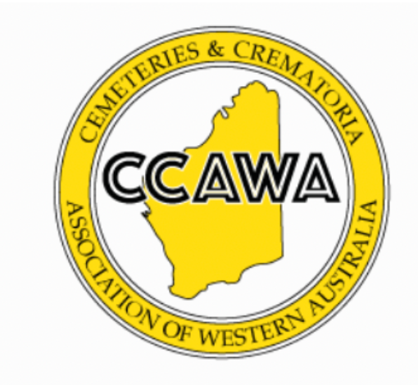

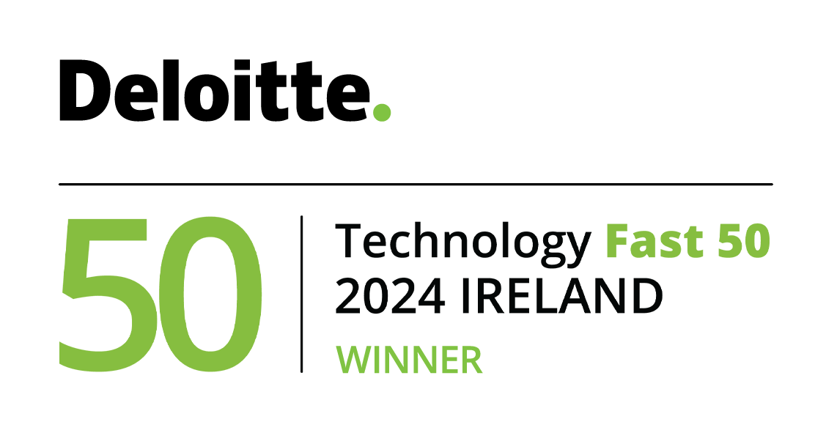
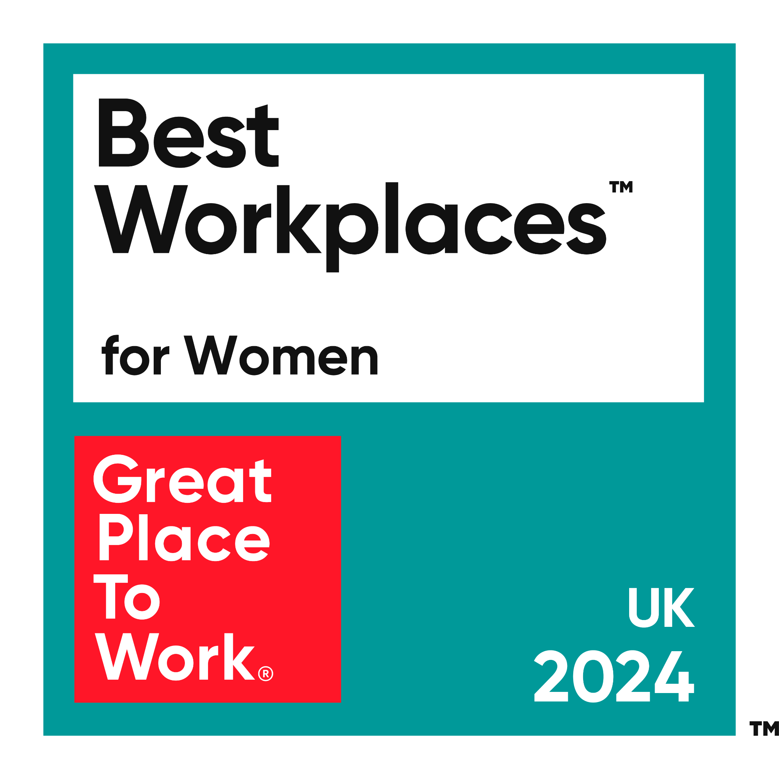
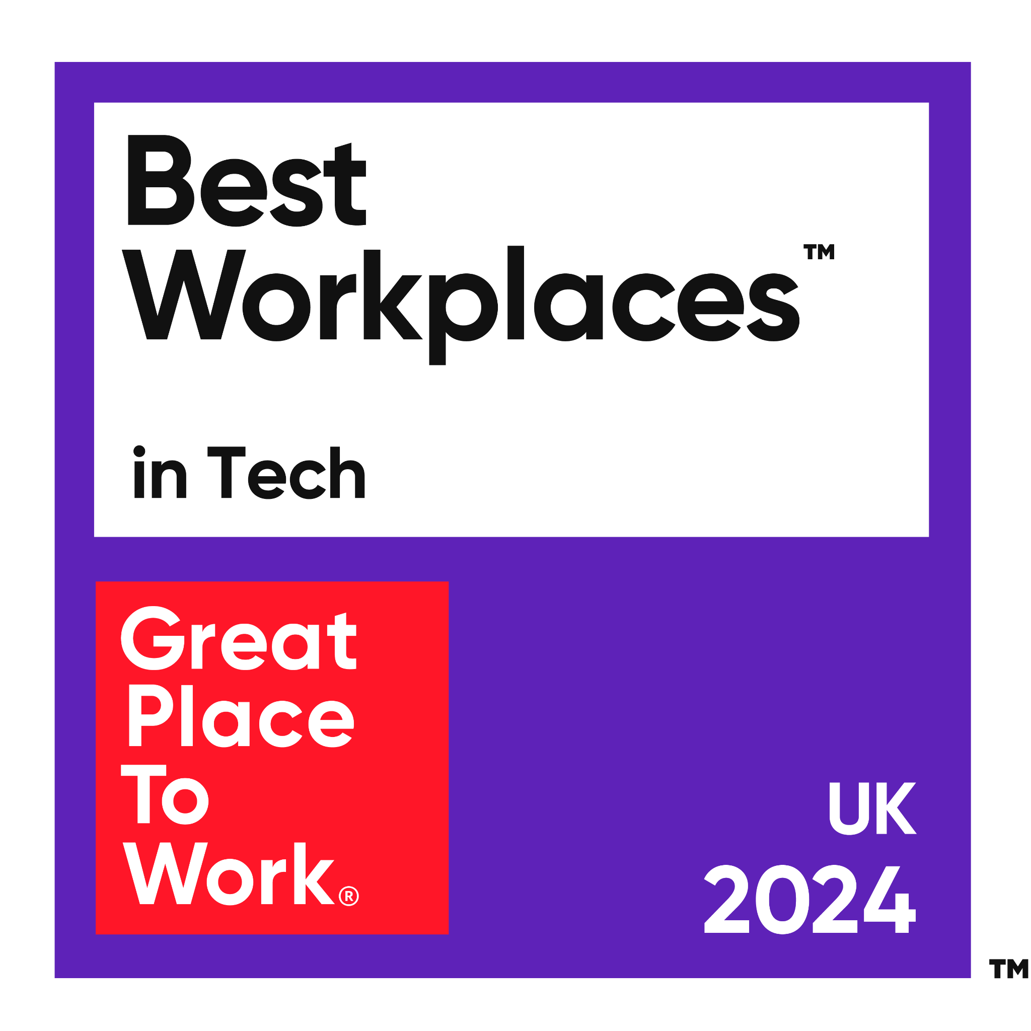
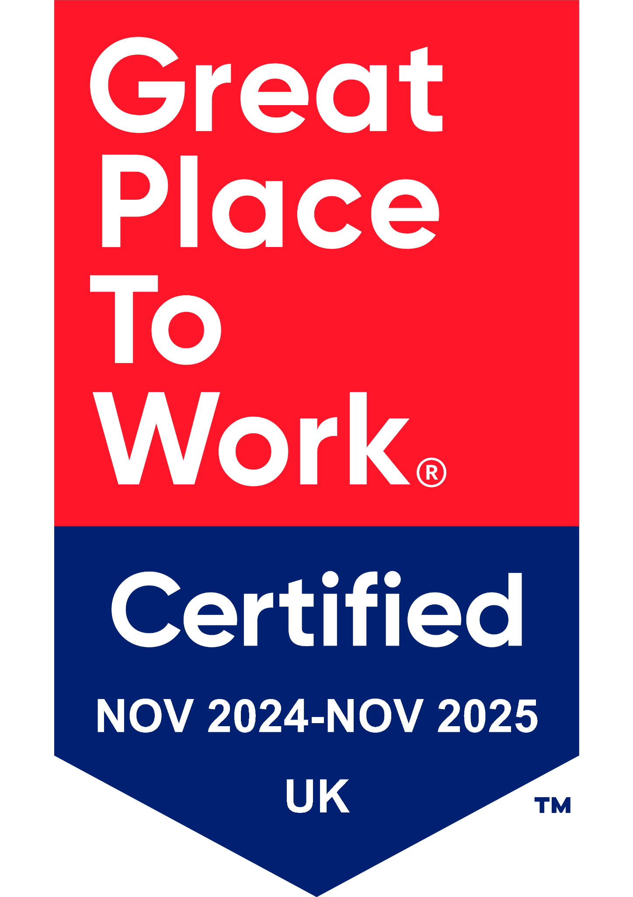
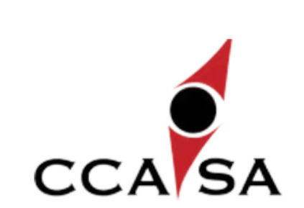
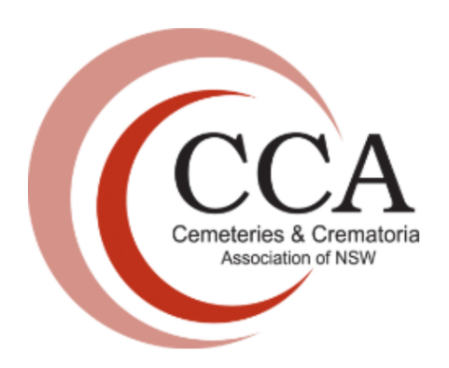
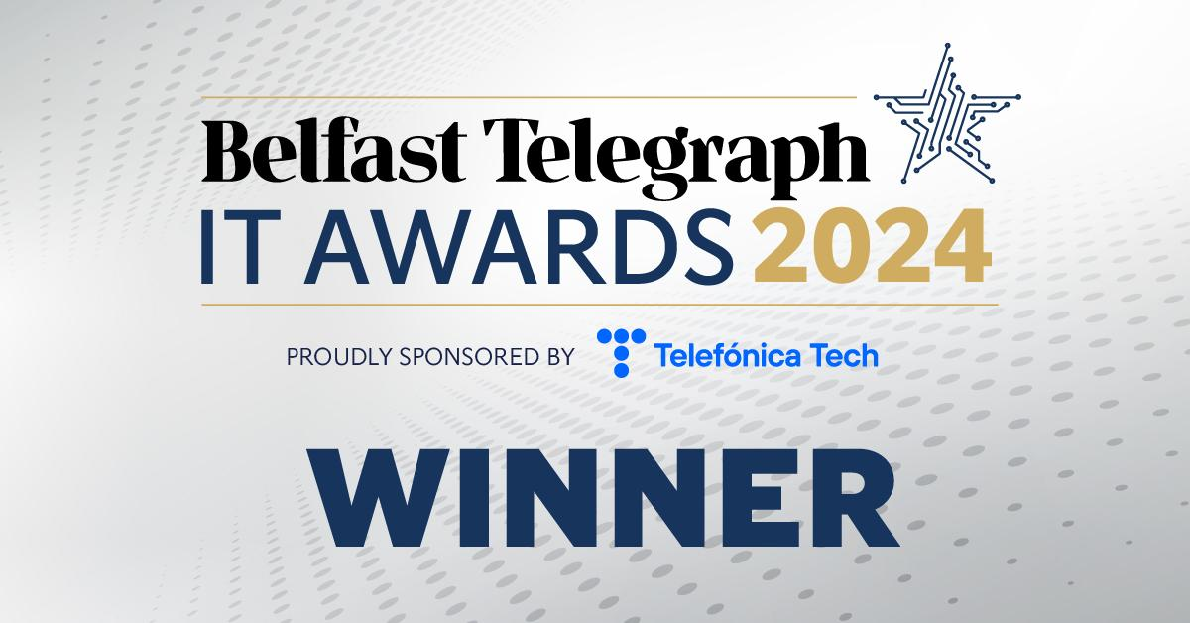
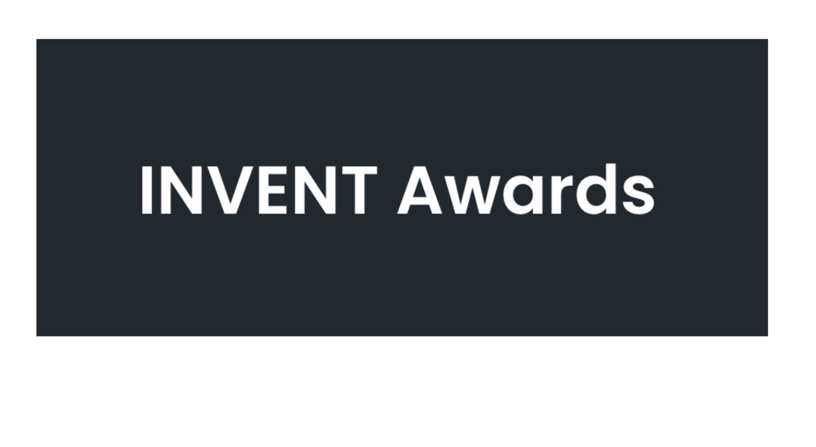
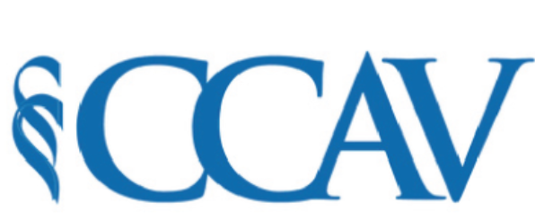
We are…
Quality management and
Customer support certified
Cyber Security
certified and assured
Best in Tech
Proud association member
Global award-winning
A Great Place to Work

Slide 4
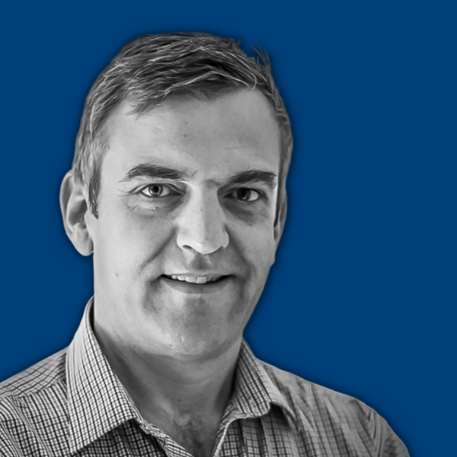
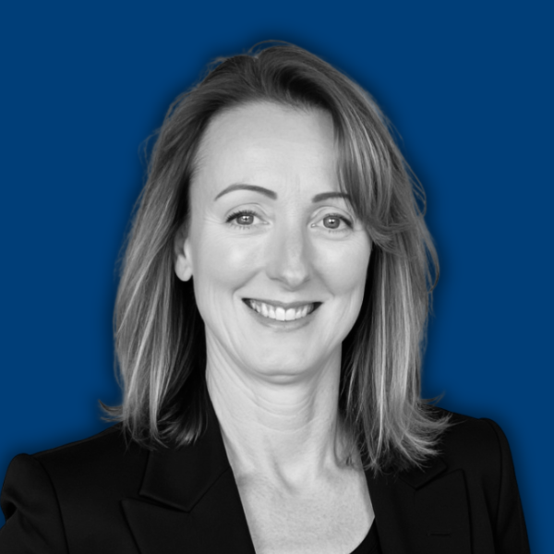
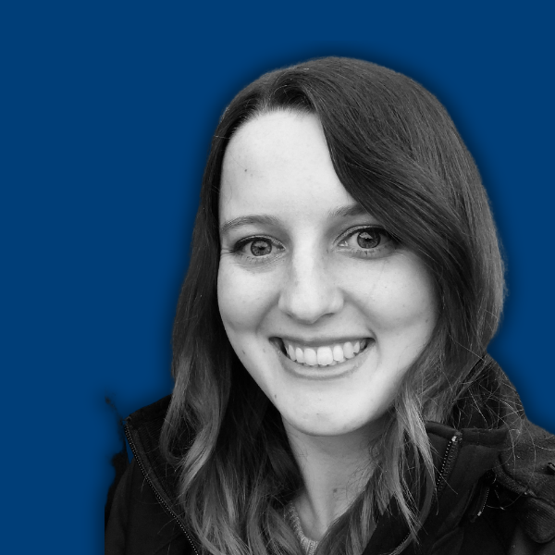
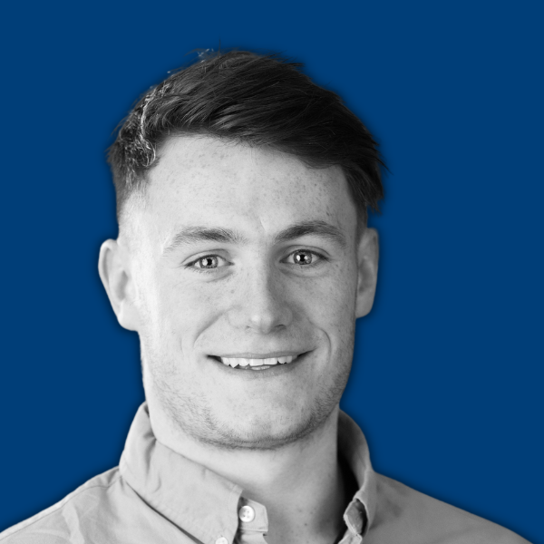
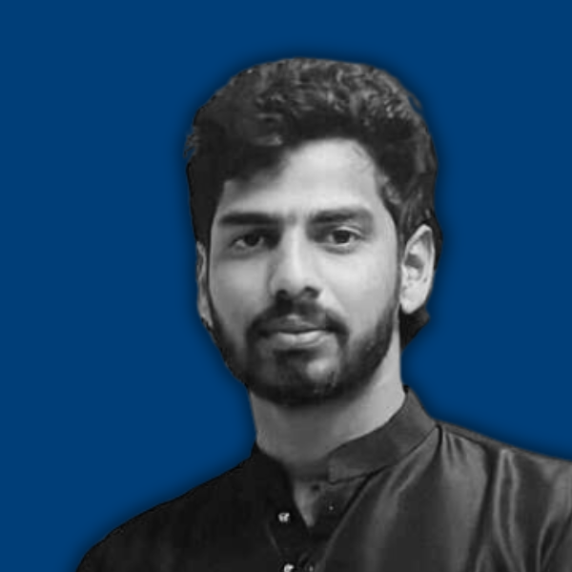
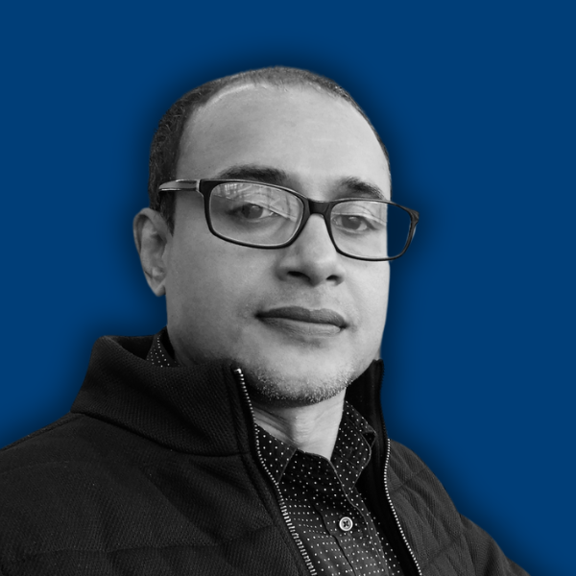
Global expertise, local support
Your APAC Team
General Manager, Martin Jackson
Solutions Consultant, Kris Miller
Customer Success Manager, Kate Terpstra
Senior Software Developer, Niall Shannon
Data Migration Engineer, Sai Vookanti
Customer Application
Support Consultant,
Prasad Gunawardana
Notes:
We currently have 30 customers across Australia and New Zealand.
And so we’re continuing to grow our APAC team to both support those customers and to grow our business further.

Slide 5
Global expertise, local support
Our Mission
Help take away some of the pain in dealing with death for families and those that serve them.
Notes:
Our mission continues to inform everything that we do.
Before we embarked on our journey we had no experience in deathcare.
Having applied our own ‘special set of skills’ to a mapping project for our local parish, we saw an opportunity in answering one simple question:
“What if we could do things better?”
Our initial goals were to solve the mapping problems for cemeteries in Ireland and the UK and to grow our customer base.
The early aspirations quickly grew the more we worked in the industry and understood the real problems that deathcare operators face daily.
Our focus from the start was, and still is, to align our mission with that of our customers, having families at the heart of what we build - this is still our north star today.

Slide 6

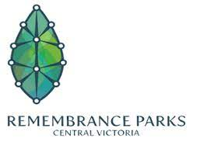


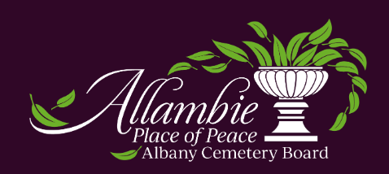


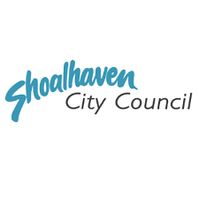


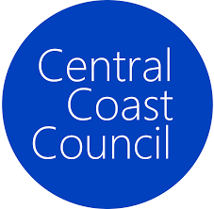
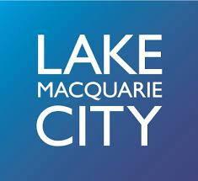

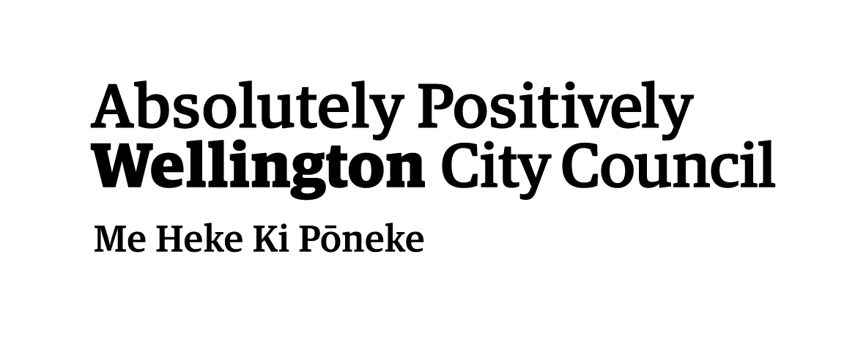



Our customers include…

Slide 7
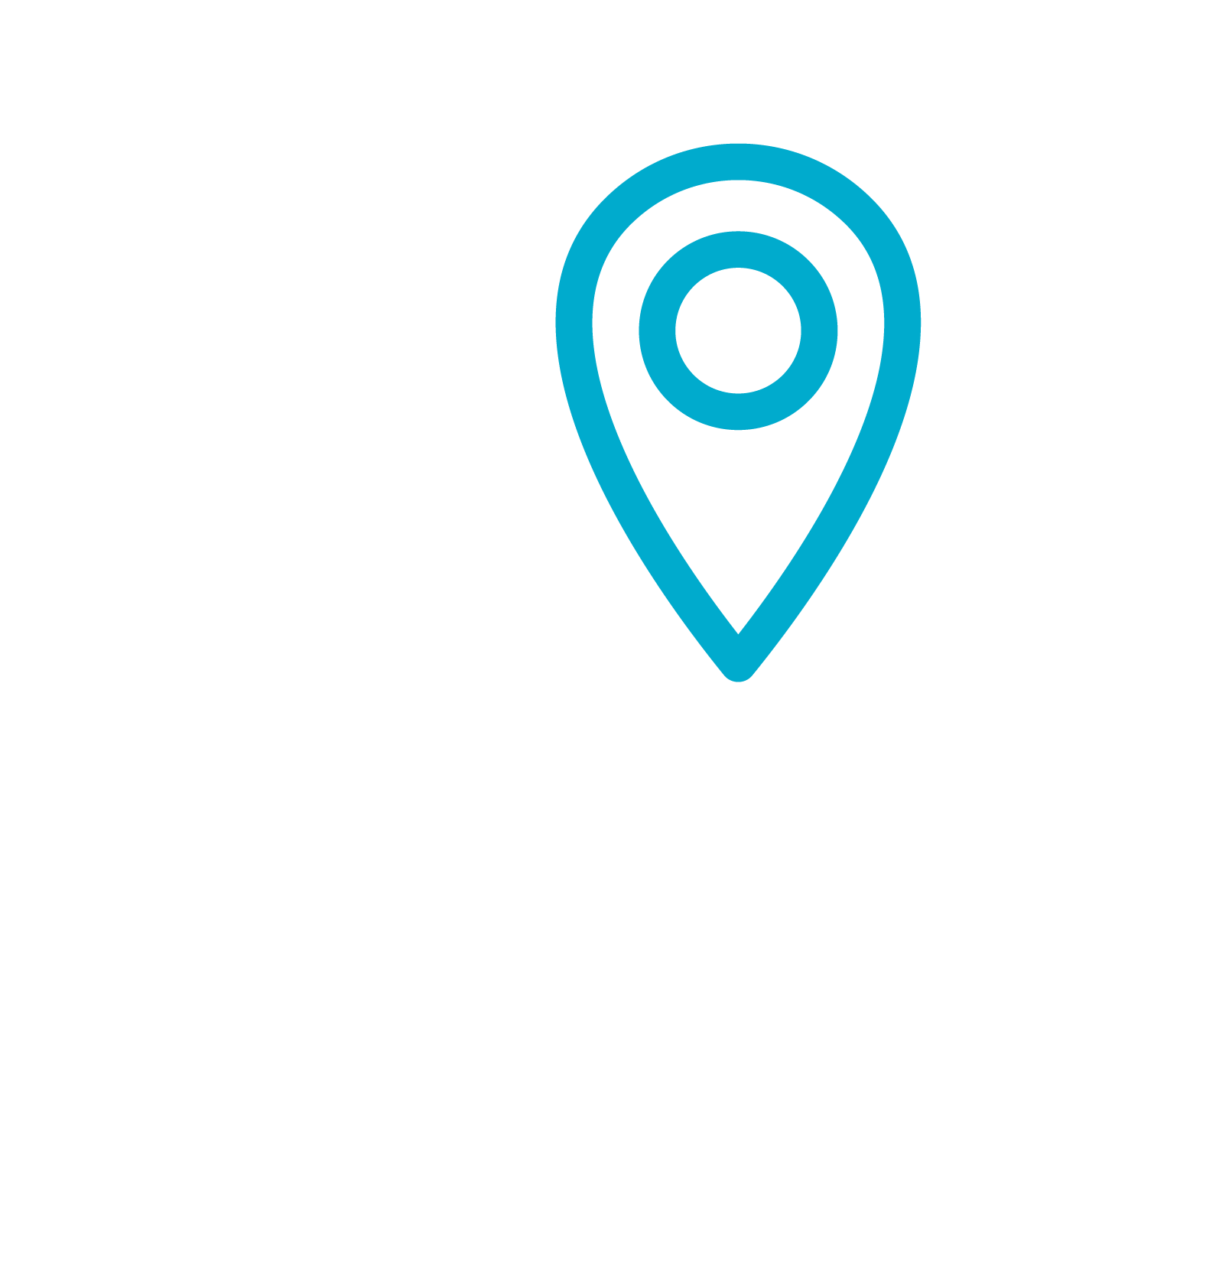
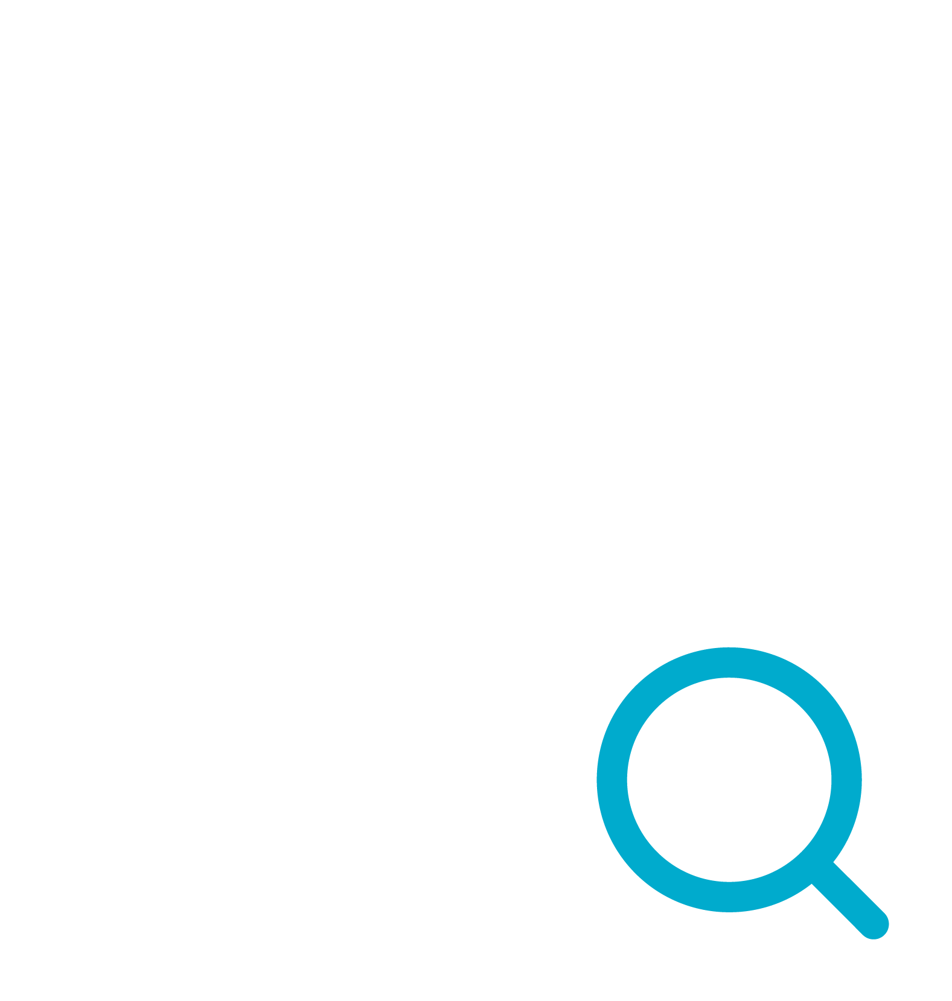



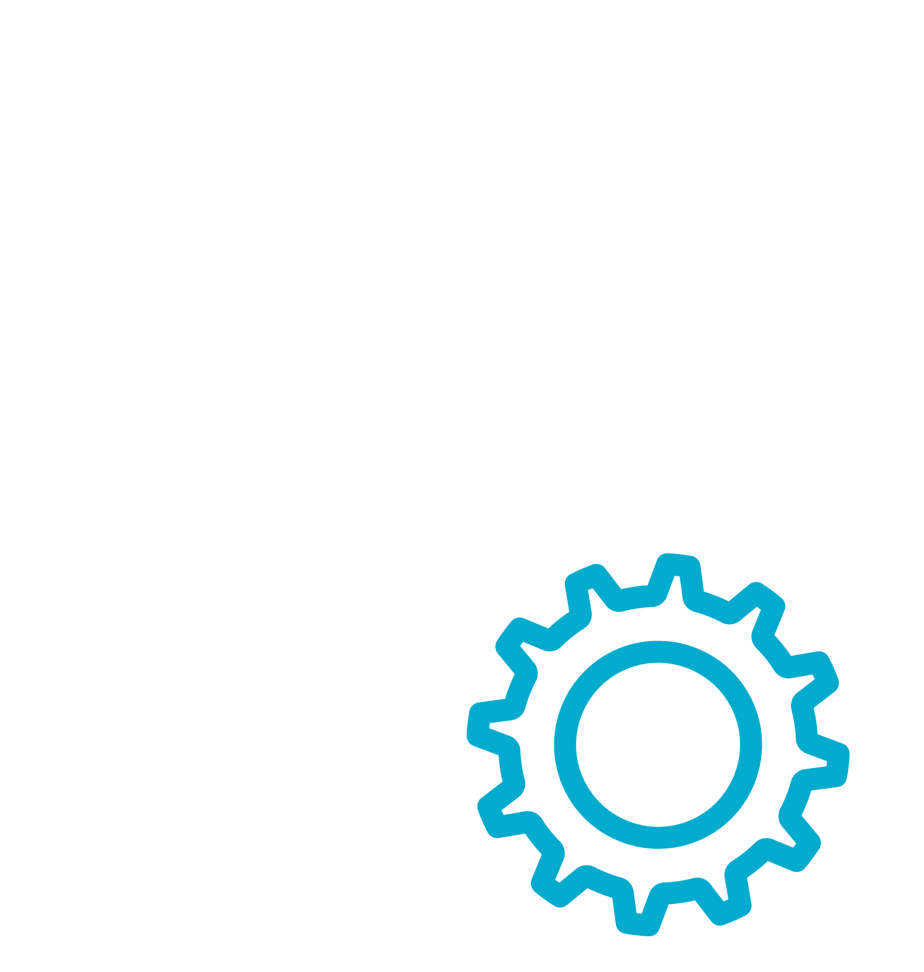


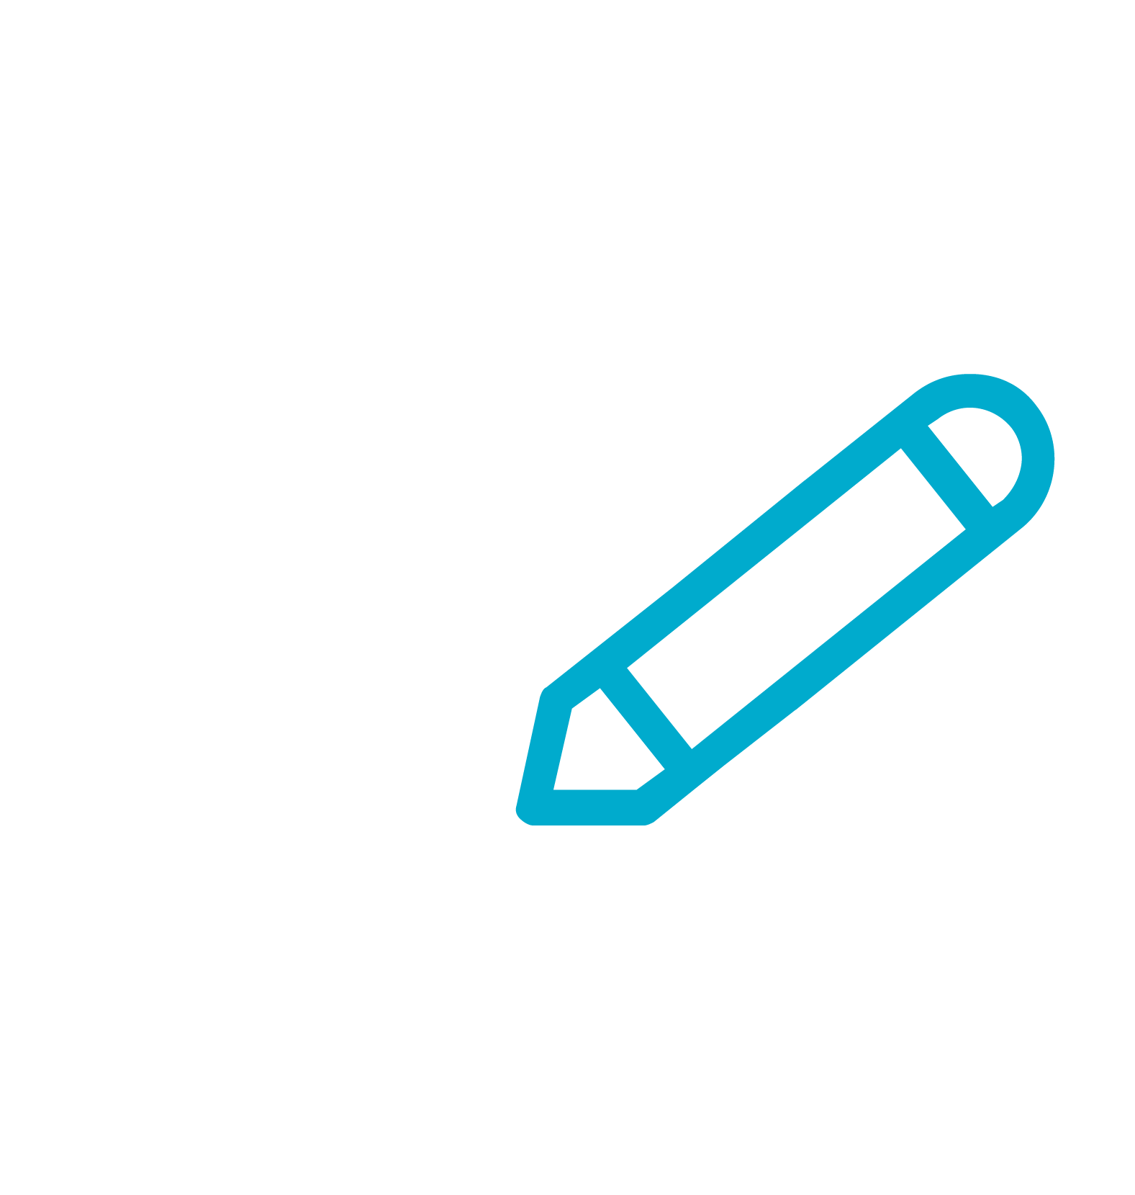


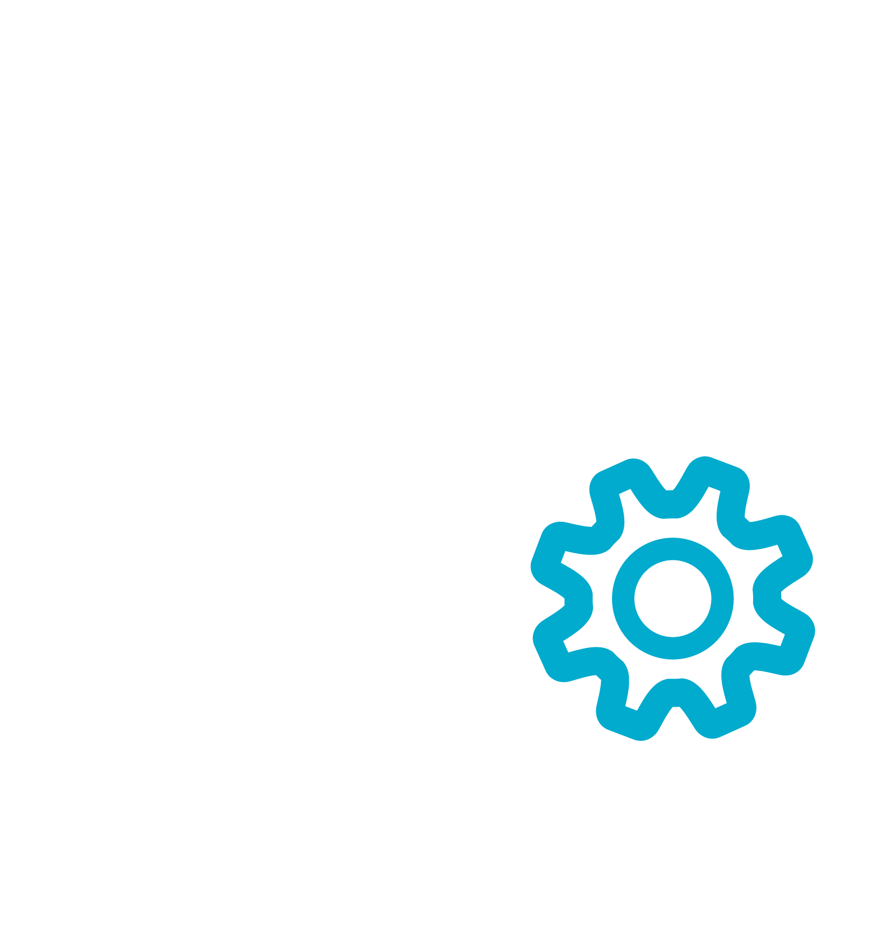
Global expertise, local support
Modular for Growth
Digital mapping
Scheduling
Records management
Document management
Inventory and Deeds management
Work Orders
Risk assessments
Funeral Director portal
Sales and Contract management
CRM
Financial management suite
Reporting
Notes:
Together, all of that creates a single source of truth for our customers.
A secure home for all records, including Plots, Deeds, Burials, Cremations, Memorials, Finance, and Headstone Testing.
Interactive cemetery mapping, colour coded to provide a digital model of each cemetery’s status and available inventory.
Integrated CRM, helping to generate and nurture the customer journey
24x7 access to online bookings, permit applications, and public burial searches with walk-to-grave directions.
All of that linked and updated in real time, exponentially increasing the overall value of your solution.

Slide 8
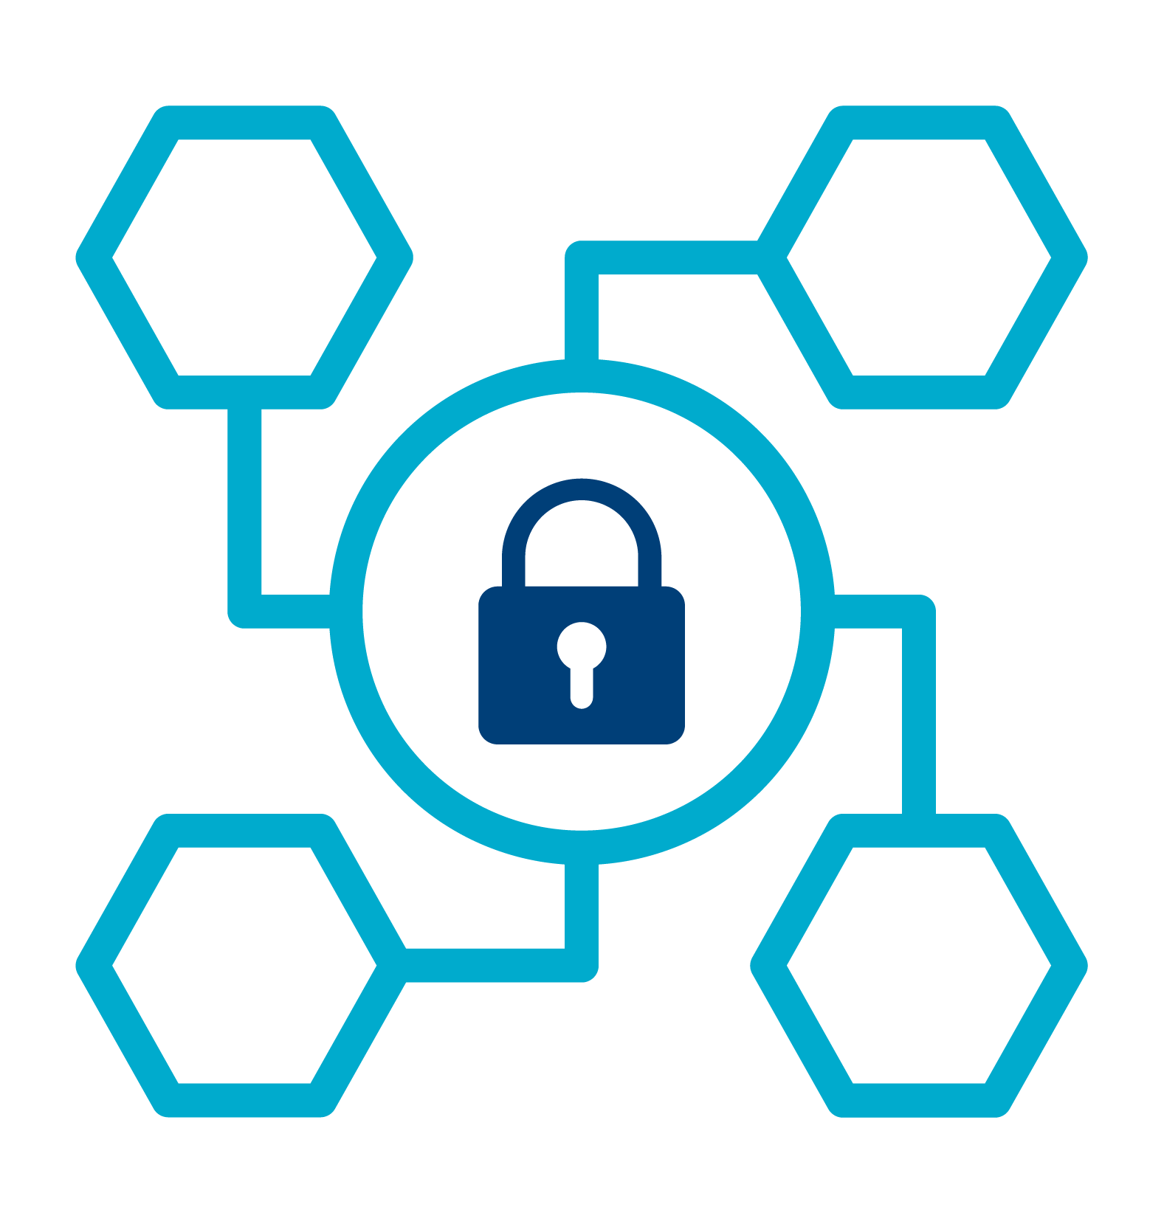
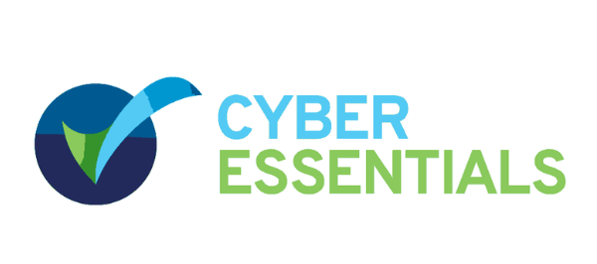
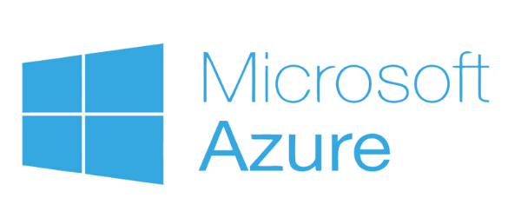
Global expertise, local support
Data Security.
Conform to data protection rules across regions
Cyber Essentials certified
Industry-leading data protection
Data encryption
Safe storage and backups
Regular security testing
Notes:
Your data is your most valuable asset. That’s why data within PlotBox is one of our No.1 priorities
In today’s world, more and more data being stored remotely in the cloud and more staff are working remotely, so its important that organisations secure their data.
As a cloud solution, we take all of that out of your hands and in a number of ways:
We conform to data protection rules across all jurisdictions
We’re ISO 27001 certified - taken all necessary steps to guard our organization against the most common cyber attacks.
We work with Microsoft Azure - the most comprehensive set of compliance offerings of any cloud service provider (95% of Fortune 500)
We use 3 best practices:
Data confidentiality - store all our data on a secure network on the cloud, requiring multiple layers of authentication
Data integrity - any changes in the data are logged - we can tell who made the change and when
Data availability - we ensure the data is made available to customer as and when they need it
To anyone concerned or worried about moving data onto a digital platform - it’s understandable and that’s why we put such stringent processes in place
BUT
There are risks with not moving your data - fire, theft with little backup options
THINK
What would happen if you were to lose all of that data.

Slide 9

Global expertise, local support
Our Vision
Notes:
That’s the corporate answer…and it’s only part of the story.
When we talk about changing the deathcare landscape, it’s not an idle claim.
The world is changing and the deathcare industry will evolve to meet it.
Land is becoming scarce, cremation is on the rise, green burials are gaining in popularity, new burial innovations are coming to the fore, how we interact with the online world is changing, AI has entered the game.
The aftermath of the pandemic has had a knock-on effect on the recovery of the economies globally and has added to the rise in inflation. This has ultimately led to a rise in interest rates, which puts pressure on the existing financing for these deathcare operators.
There’s been a notable shift in how different generations approach death and how they want to be memorialized. If deathcare operators can create and adjust their offerings to these changes, there will be many areas for growth.
All of these things, we will both be influenced by and influence change upon in how we develop our solutions.
We currently share knowledge and foster connections between our diverse customer base across the world.
We’ll continue our strategy for growth and expand our global presence. We’ll continue to hire the best people from multiple disciplines ensuring our customers receive top-class service, no matter where they are in the world.
But let’s come back to the very beginning, and our mission: to help take away some of the pain in dealing with death for families and those that serve them.
What’s also changing is the role of cemeteries and crematoriums. They’re no longer simply places to buried or cremated.
They play a key role in the grief journey for families and from an experiential perspective we want to be able to provide them with the tools to support those who matter most.
How can we then unlock new ideas for how providers meet with families and what the customer experience is like at the time of arrangement.
How can we help to remove the bureaucratic, transactional nature of meeting with families and really make it about emphasizing care - supporting - and educating them in the processes of burial and grief. That may mean being able to show interactive 3D digital maps for plot or niche options, letting them experience the space in a new way, then making it easier to make the arrangements more simply there and then.
Or it may be more fundamentally about allowing them to focus on serving families, providing excellent care, as opposed to fixating on records management, or keeping track of work orders - in short, giving them more time to focus on what matters most.

Slide 10
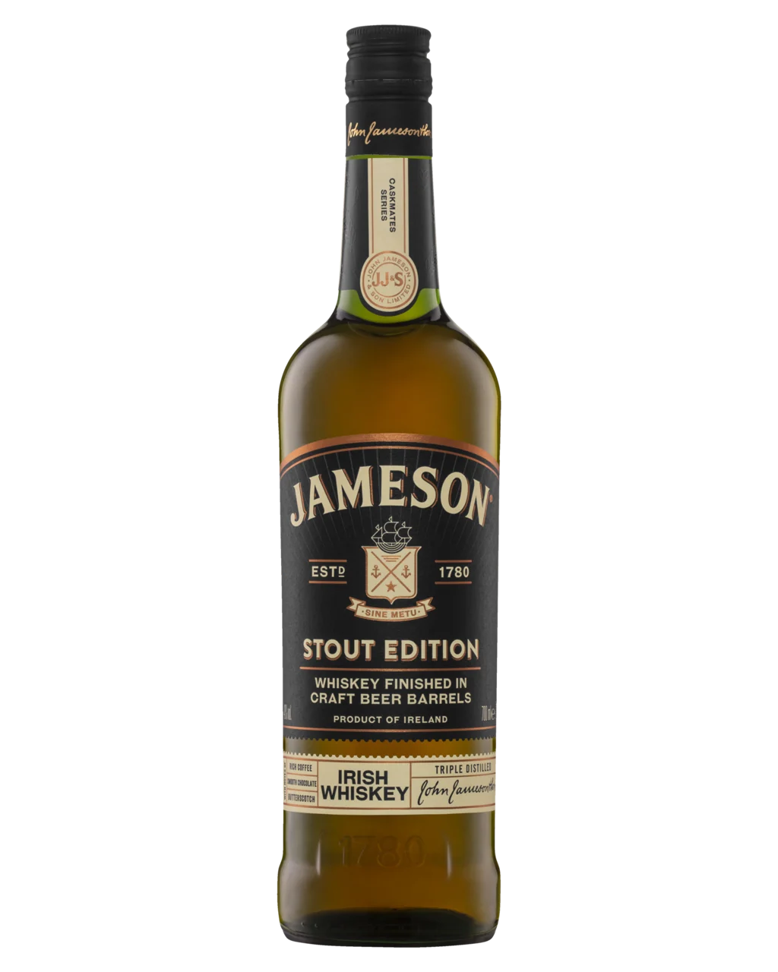

Slide 11
Thank you.
Kris Miller
Solutions Consultant APAC
kris.miller@plotbox.io
0438 595 738
https://www.linkedin.com/in/krismiller100/

